Slide 2
lickety-split
slithered
single

Slide 4
glide
sleek
seeping

Slide 6
romp
startles
snatch

Slide 7
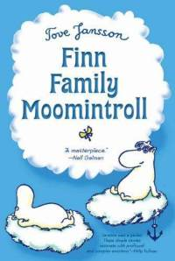

Slide 8
acquaintances
hazy
solemnly

Slide 9
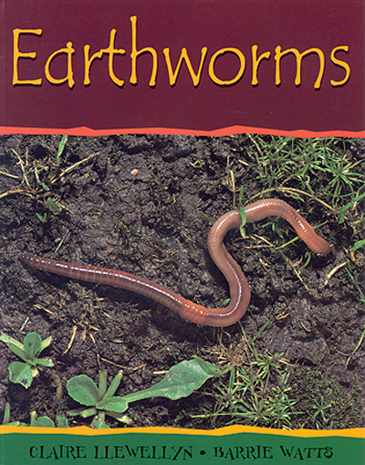

Slide 10
surface
nibble
ripen

Slide 12
obvious
harass
clutch

