Slide 1
1st Grade Text Talk
Unit 1

Slide 2
I can use words I learn from a text.
Notes:
Goal-
Students need to engage with the goal- read it, repeat it, write it, etc.

Slide 3
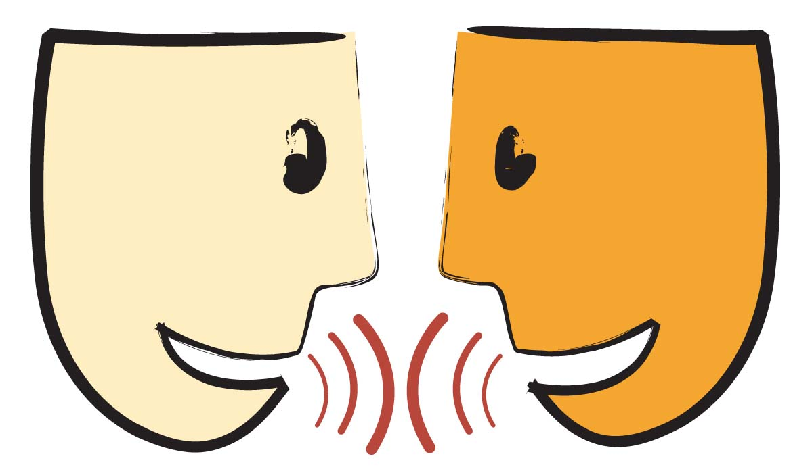
Tell your partner about a new word you learned last week.
Notes:
Access Prior Knowledge- (APK)
Turn and Talk

Slide 4
Notes:
New Information-
Read the book- provide a brief explanation of any words that may be new or unfamiliar to the students.

Slide 5
preferred
Notes:
Contextualize the word- Find it in the text
Say the word together

Slide 6
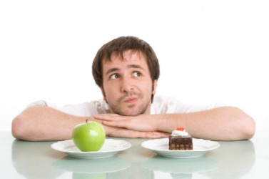
preferred
To choose or like better
than something else
I like cake better than apples.
Notes:
Give student friendly definition
Use the word in other contexts

Slide 7
Which do you prefer?
Chocolate ice cream or vanilla ice cream
Apples or bananas
Pencils or markers
Playing inside or playing outside
Reading or writing
Notes:
Engage the students with the word

Slide 8
promptly
Notes:
Contextualize the word- Find it in the text
Say the word together

Slide 9
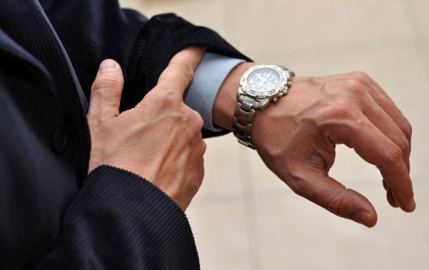
promptly
To do something right now
Notes:
Give student friendly definition
Use the word in other contexts

Slide 10
Thumbs up if this is an example of promptly. Thumbs down if not.
We decided to go to the movies right now.
I am going to get my room cleaned up immediately so I can play with my friends when they come over.
The doorbell rang 5 times before the man got up to answer the door.
Notes:
Engage the students with the word

Slide 11
awful
Notes:
Contextualize the word- Find it in the text
Say the word together

Slide 12
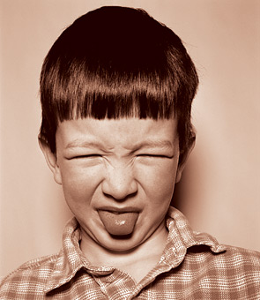
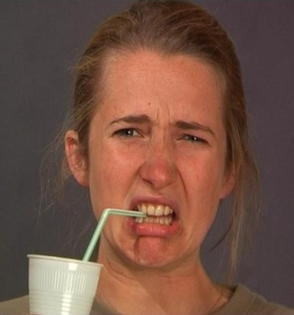
awful
unpleasant
Notes:
Give student friendly definition
Use the word in other contexts

Slide 13
Pretend like you have just tasted something awful.
Pretend like have just found something awful on the ground.
Notes:
Engage the students with the word

Slide 14
Who can use all 3 words in a sentence?
preferred
promptly
awful
Notes:
Read all three words and see if you can use them in one sentence.

Slide 15
Draw a picture to show you know what these words mean.
preferred
promptly
awful
Notes:
Application-
Students need an opportunity to use the words they just learned from the text.

Slide 16
I can use words I learn from a text.
Notes:
Goal-
Revisit the Goal

