Slide 1
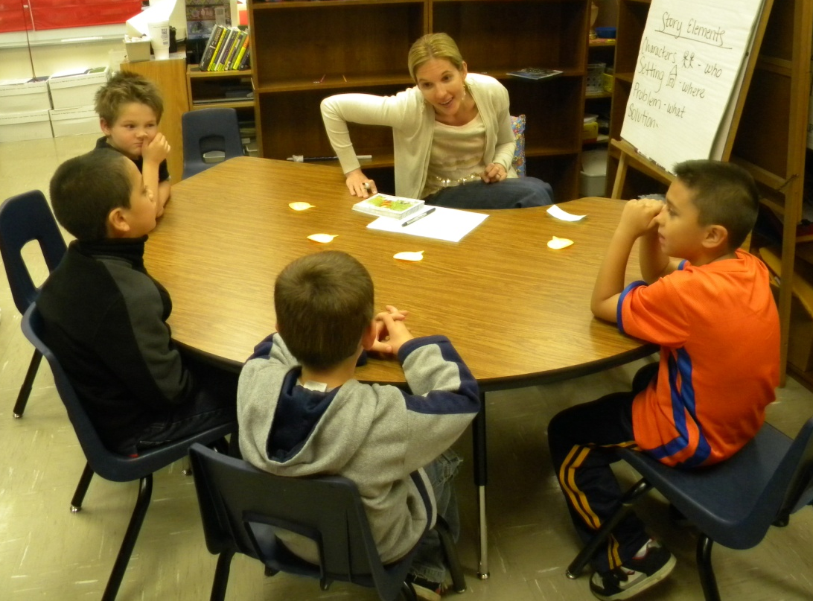
First Grade Small Group Instruction with Gretchen Childs
Grace Hill Elementary
Rogers Public Schools
April 27 2011
S.Hensley

Slide 2
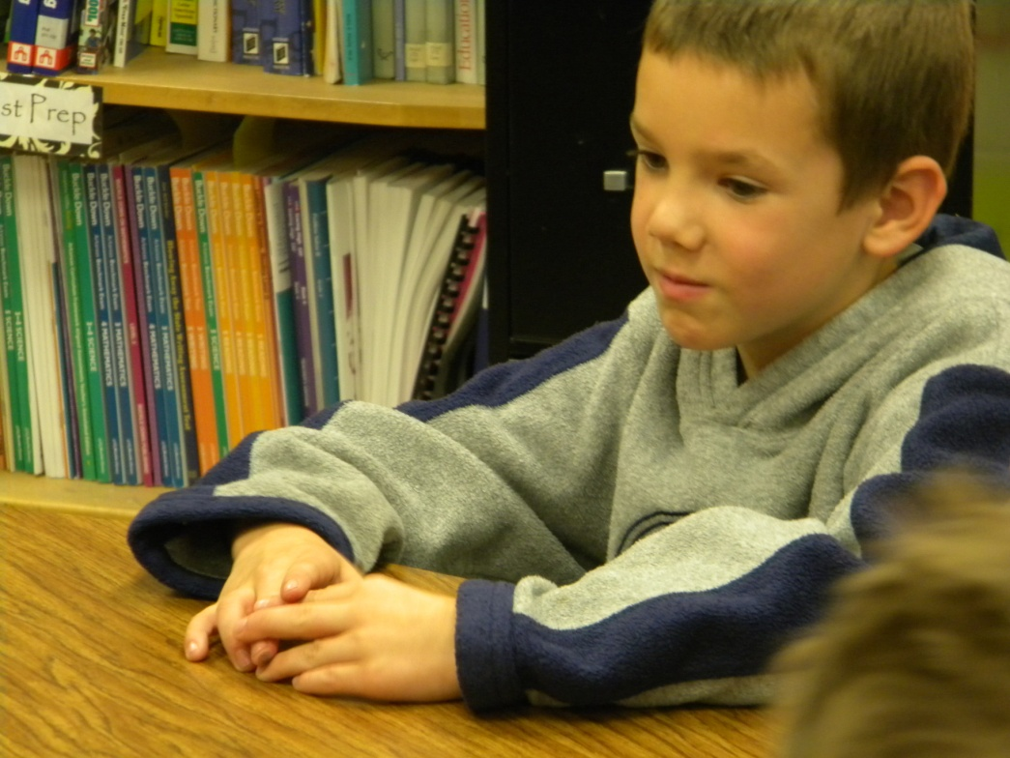
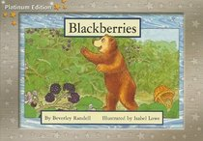
Group: First Grade (Grace Hill Elementary)
Focus/Goal: Identify characters, setting, problem, solution
Title: Blackberries by Beverly Randell
Level: 6

Slide 3
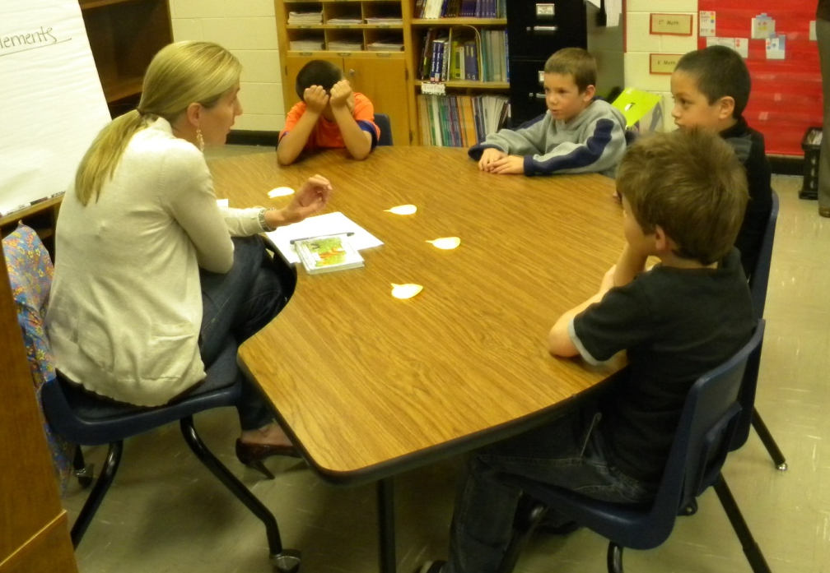
Before Reading
Access Prior Knowledge:
“Do you have a favorite book?”
Green Eggs and Ham was a favorite of the group.

Slide 4
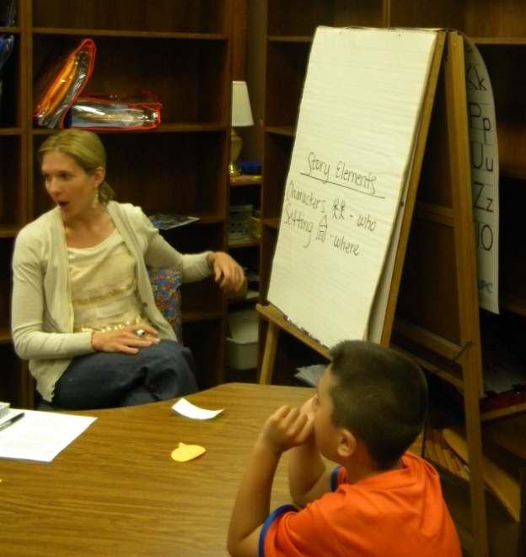
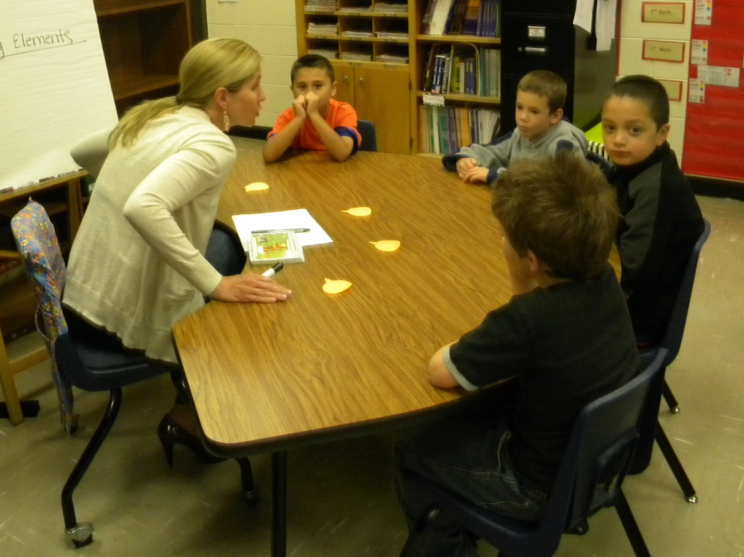
Before Reading
Access Prior Knowledge:
“Stories have something in common. What do you know about Story Elements?”
An anchor chart was created.

Slide 5
Before Reading
New Information:
“Do you know why these (story elements) are important to know? “
Story Elements
Characters who
Setting where
Problem what
Solution how the problem
was solved
“If you know these, you know what is happening in the story.“

Slide 6
Before Reading
Book Introduction (APK)
Read the title
Blackberries
Make predictions
“Who are the characters?”
Picture walk a few pages
Goal:
Read to find the characters, setting, problem and solution
Be able to tell me what happened in the story

Slide 7
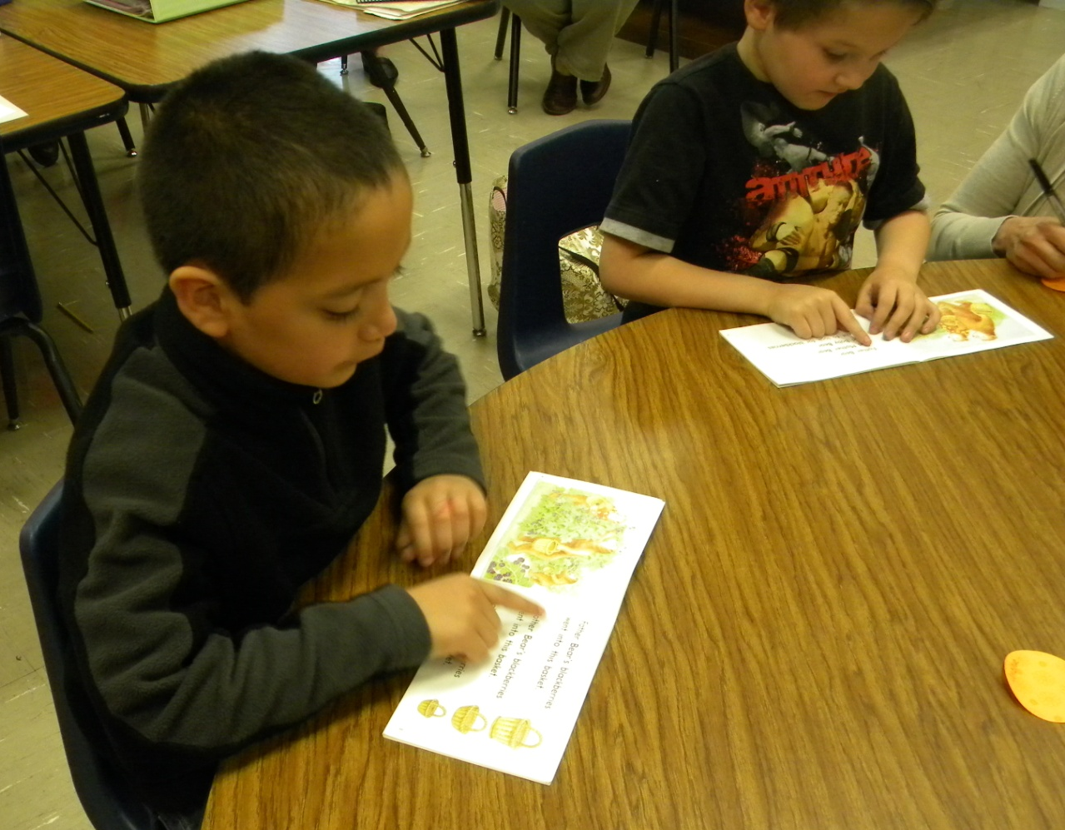
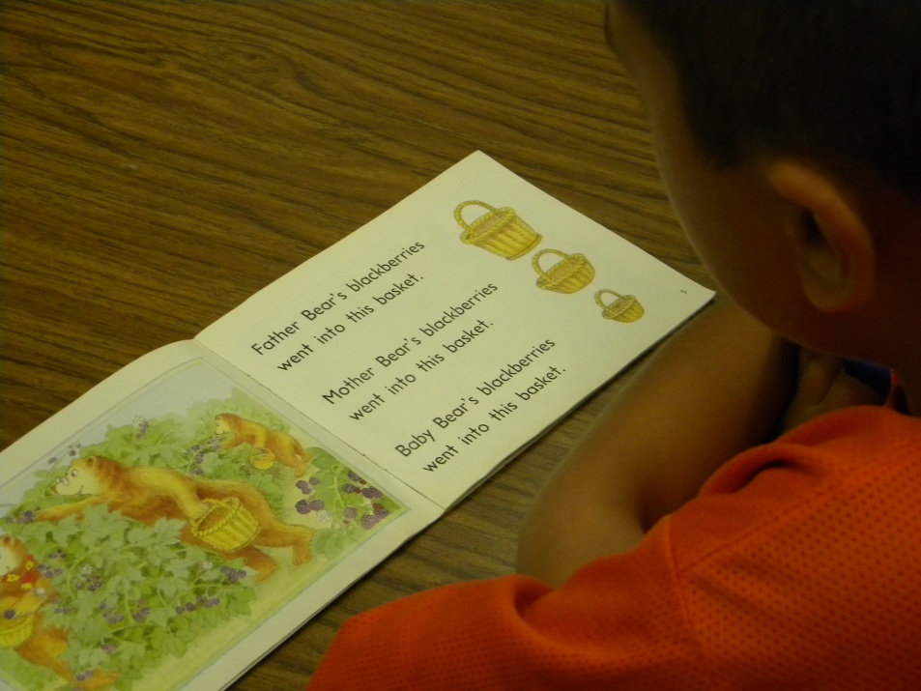
During Reading
The students:
read in whisper voices
looked for the story elements

Slide 8
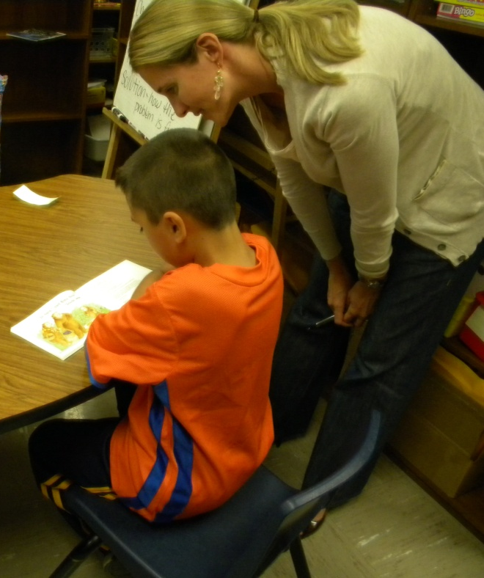
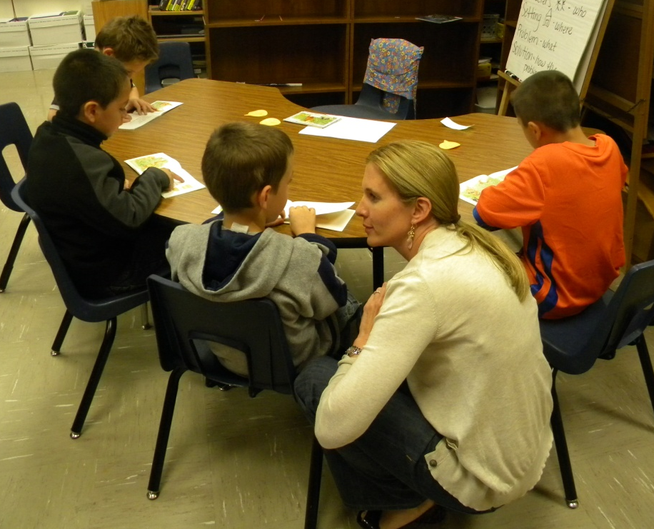
During Reading
Gretchen (the teacher):
listened to students read a portion of the text
prompted to the goals when necessary
jotted anecdotal notes about the students

Slide 9
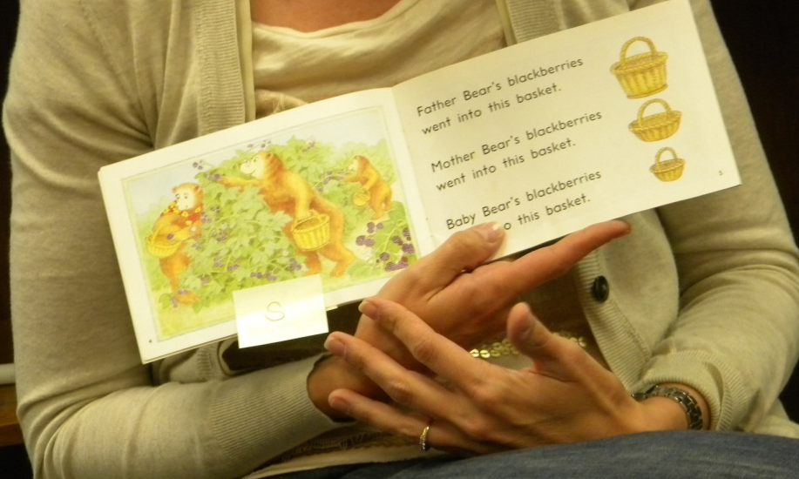
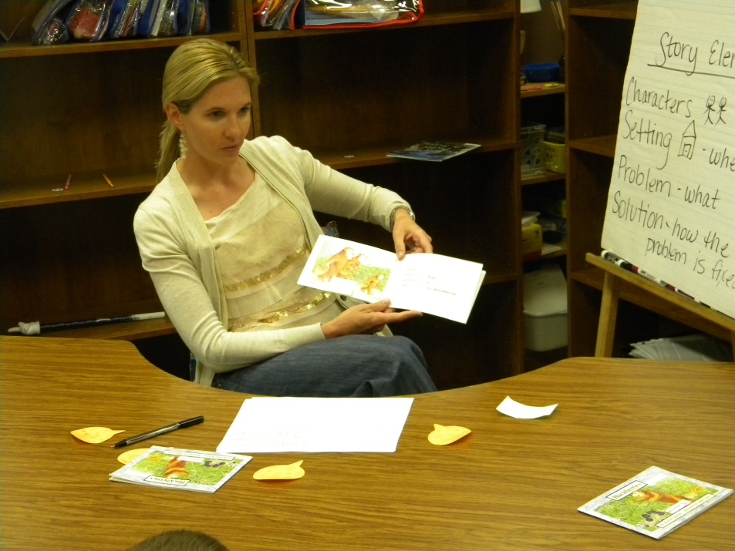
After Reading
C
S
Revisit the Goals:
The group discussed what happened in the story.
Gretchen used sticky notes to mark each of the story elements in the book. The group decided where to place the sticky notes.
Prob.
Sol.

Slide 10
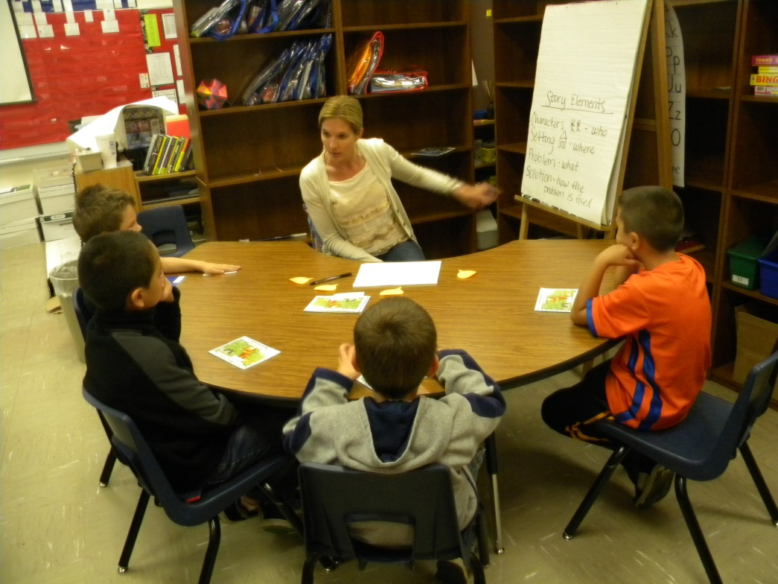
After Reading
Feedback from the students:
Gretchen asked the group, “Was finding the story elements easy, tricky or hard?”
The group used thumbs up, sideways or down to respond.

Slide 11
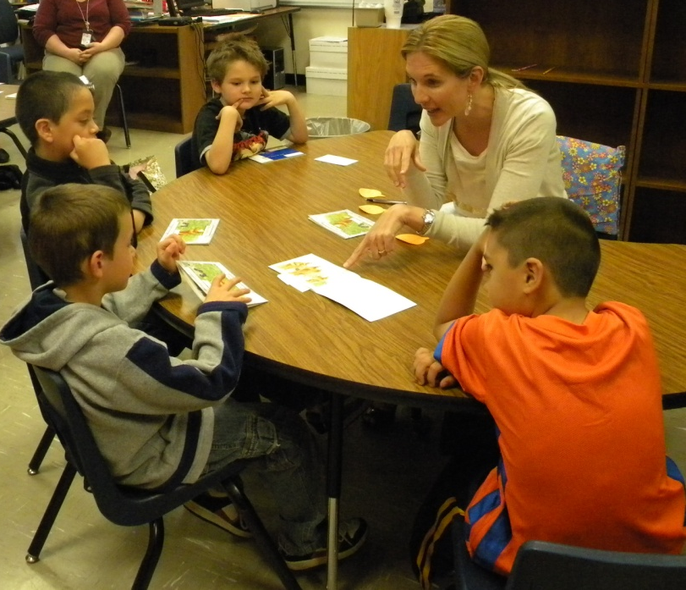
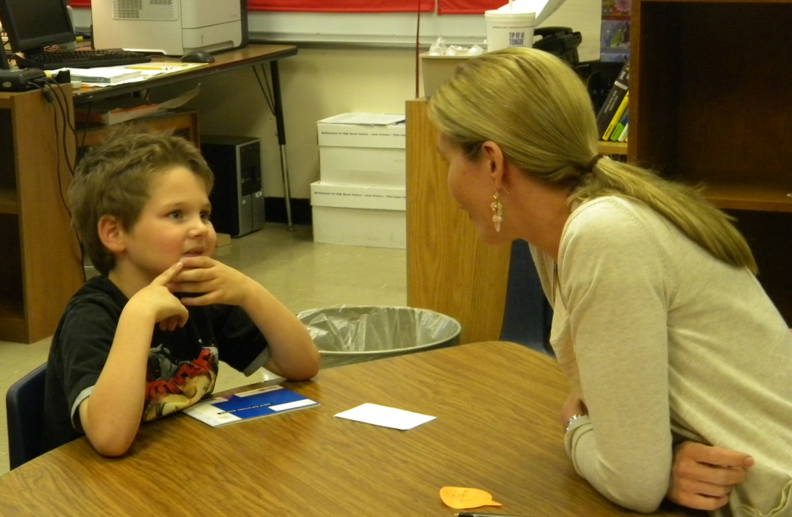
After Reading
Individual Feedback:
Gretchen gave each student individual feedback that was specific to the goals of the lesson.

Slide 12
Big Ideas from the debriefing session after the lesson:
Teach a skill or strategy, not the book.
Use activities and procedures that are specific to the focus of the lesson.
Students should be moving away from finger pointing at level 5-6.

Slide 13
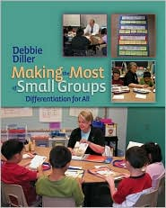
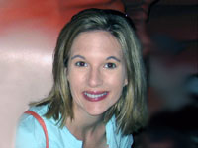
Diller, Debbie (2007). Making the Most of Small Groups; Differentiation for All. Portland, Maine: Stenhouse Publishers.
Gretchen Childs has been an educator for over 15 years. She has taught kindergarten and 2nd grade, as well as Special Education in Pre-K, 5th and 6th grades. She has been a District Literacy Coach, District Math Coach, and Reading Specialist. Gretchen has presented numerous workshops on literacy topics, and has traveled the country as a consultant for Debbie Diller & Associates since 2005. Gretchen earned her degree from Southwest Texas State University, with specializations in both Special Education and Reading. She also carries an Early Childhood Education endorsement. She resides in Pearland, Texas with her husband, Michael, and their three daughters.

