Slide 1
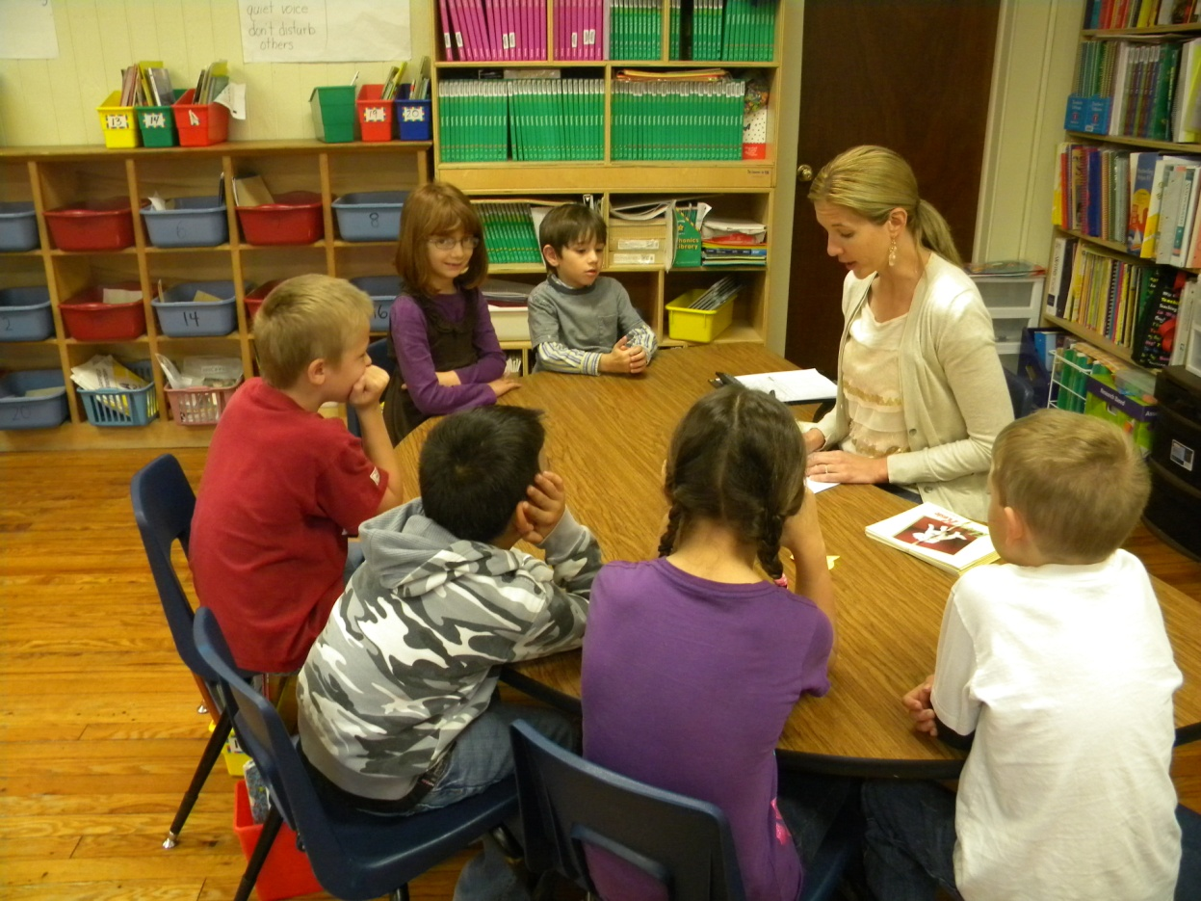
Small Group Instruction with Gretchen Childs
Garfield Elementary
Rogers Public Schools
April 27, 2011
S. Hensley

Slide 2
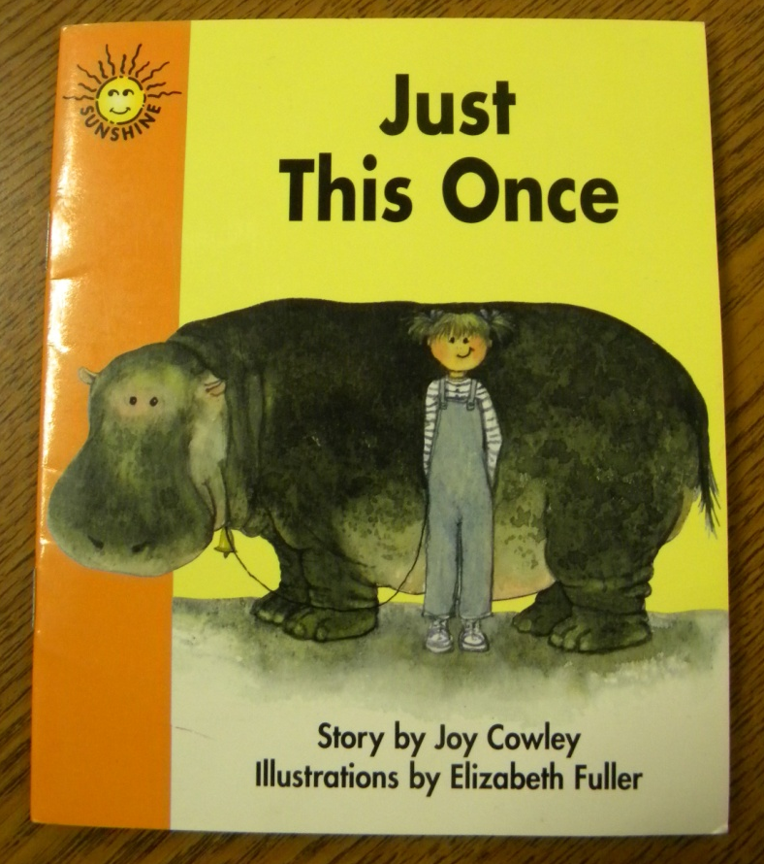
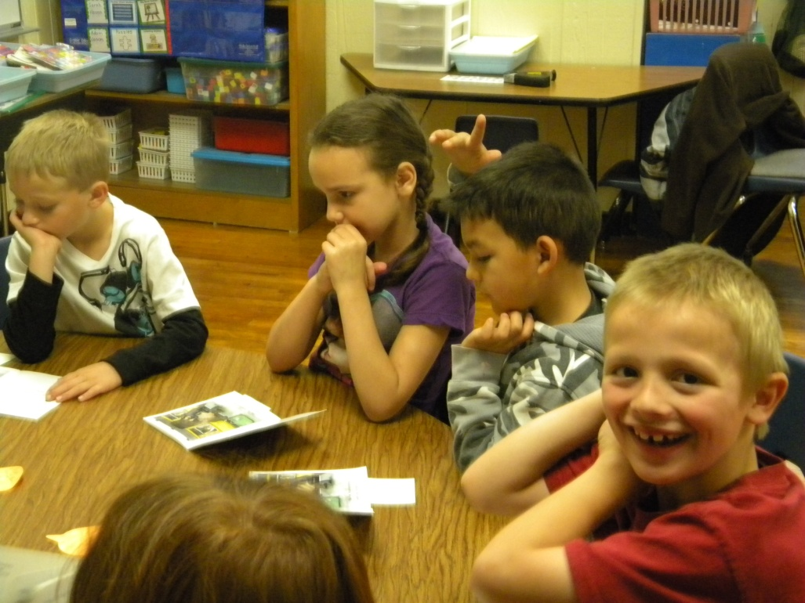
Group: First Grade (Garfield Elementary)
Focus/Goal: Reading Punctuation
Title: Just This Once by Joy Cowley
Level: 14

Slide 3
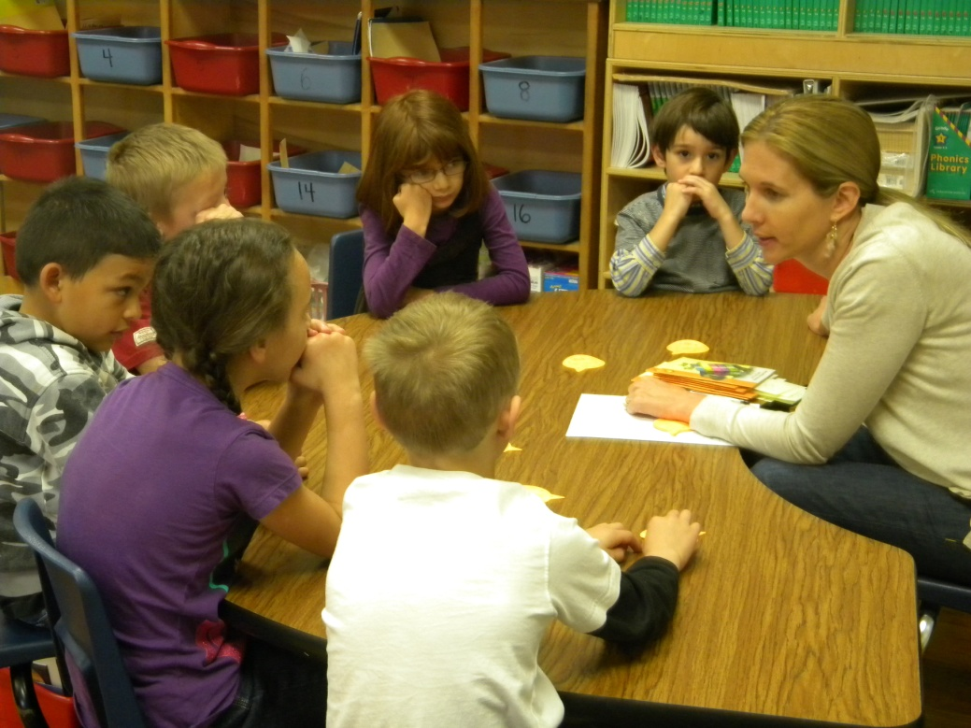
Before Reading
Access Prior Knowledge:
“Have you ever heard the word FLUENCY?”
“What sounds better?”
I---like---to---go---to---baseball---practice.
I like to go to baseball practice.
“Why does it sound better?”
The students explained that it sounded more interesting.

Slide 4
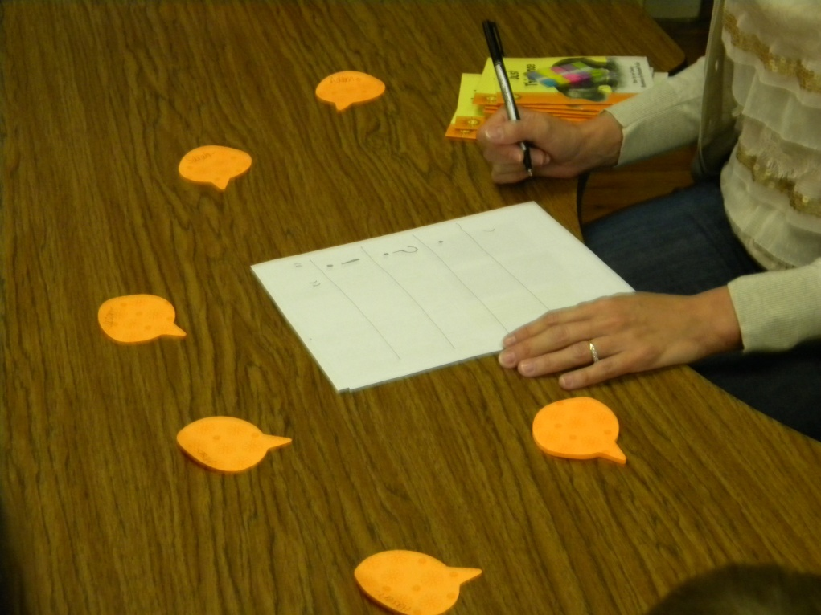
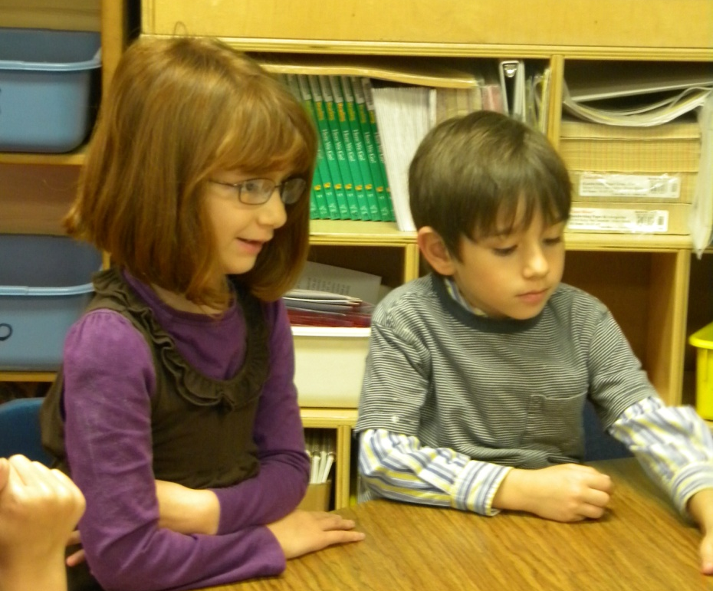
Before Reading
New Information:
A punctuation anchor chart was created.
Each mark was discussed.
, slow down
. stop
? voice goes up
! excited
“ ” talking

Slide 5
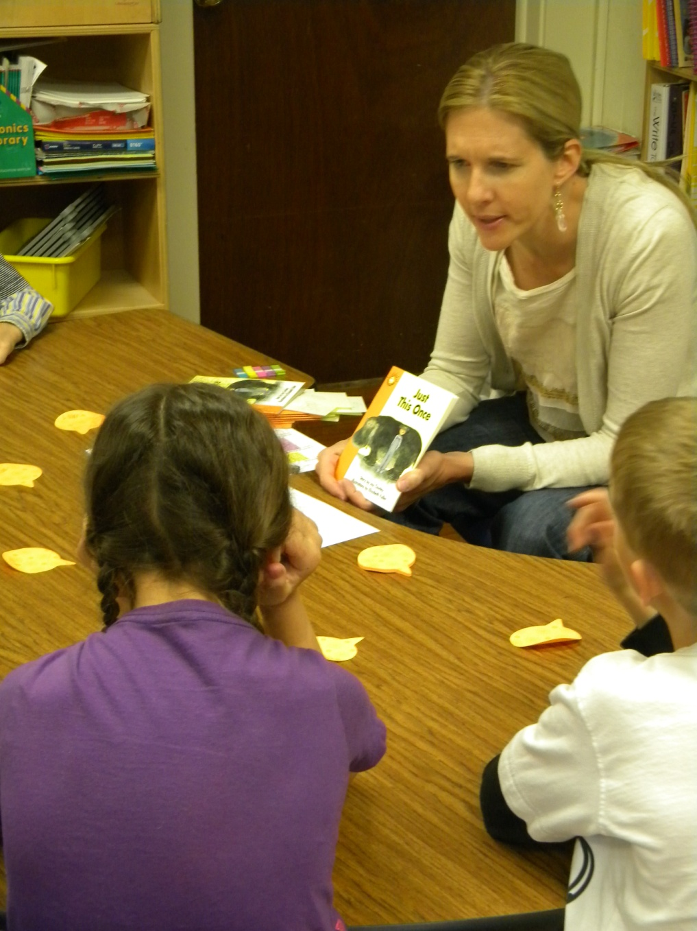
Before Reading
Book Introduction (APK)
Read the title
Just This Once
“What does it mean when someone says Just This Once”?
The students discussed the meaning.
“In this book, Liz wants to take her hippo on vacation.”
“Can you tell me what it means to howl?”
The group talked about babies howling.
Goals:
Read to page 9 to find out if the hippo goes on vacation with Liz.
Use your punctuation to help you understand what you are reading.
Mark your favorite sentence with a sticky tab.

Slide 6
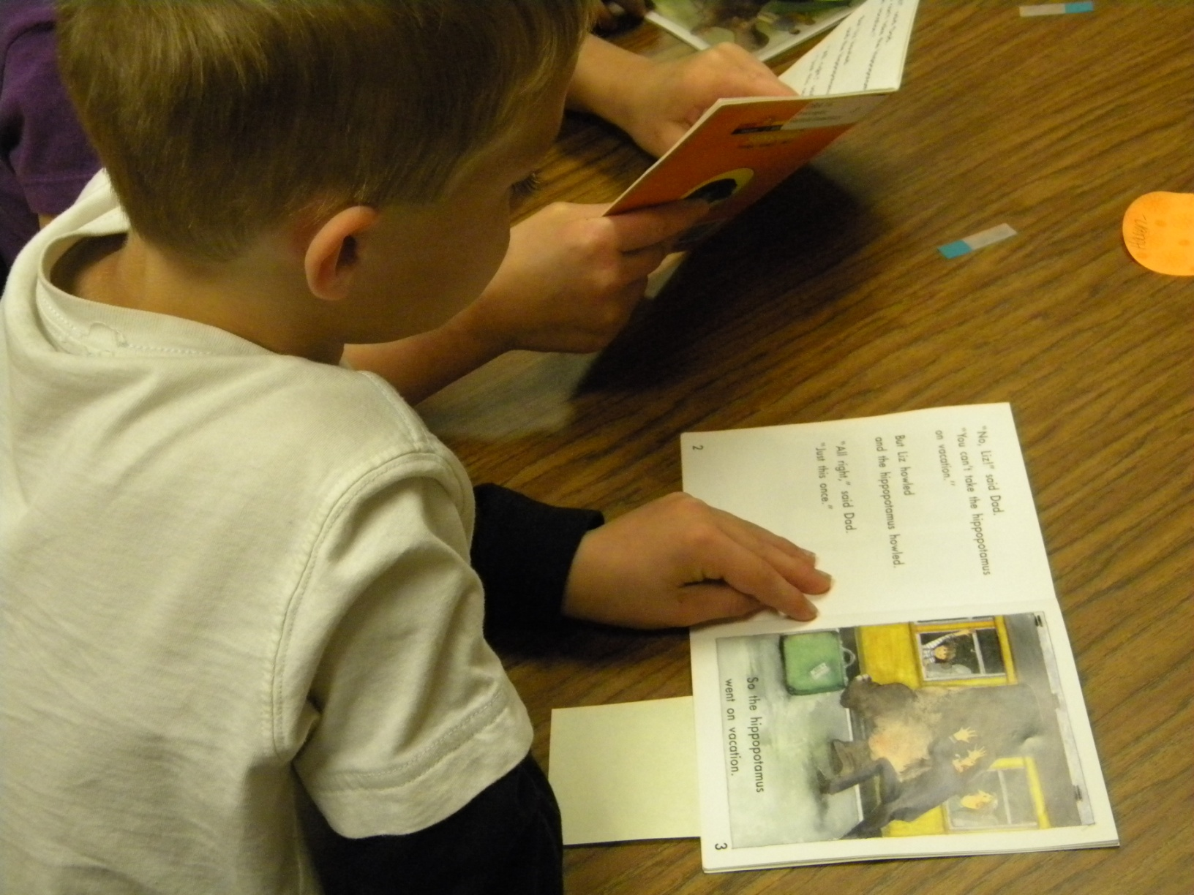
During Reading
The students:
read silently or in whisper voices
practiced reading the punctuation marks
marked their favorite sentence

Slide 7
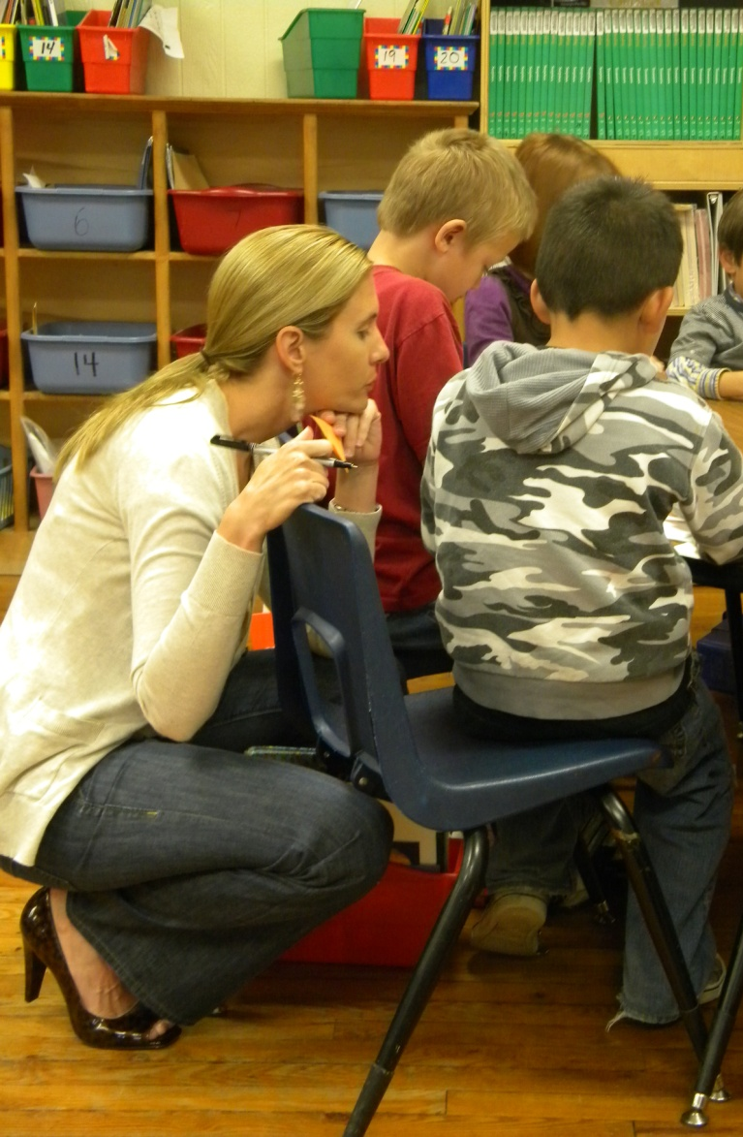
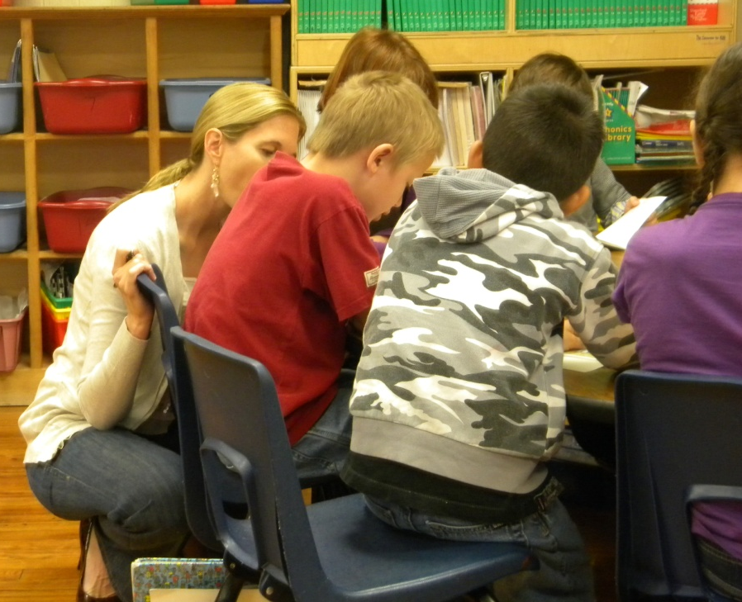
During Reading
Gretchen (the teacher):
listened to students read a portion of the text
prompted to the goals when necessary
jotted anecdotal notes about the students

Slide 8
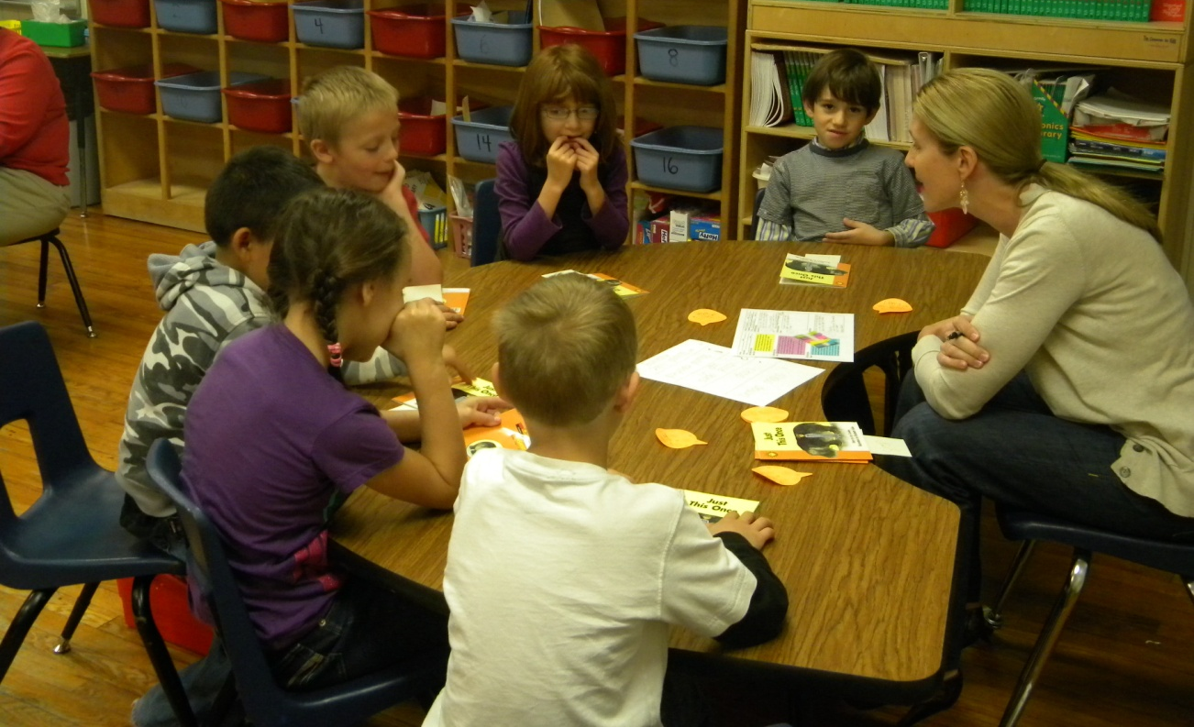
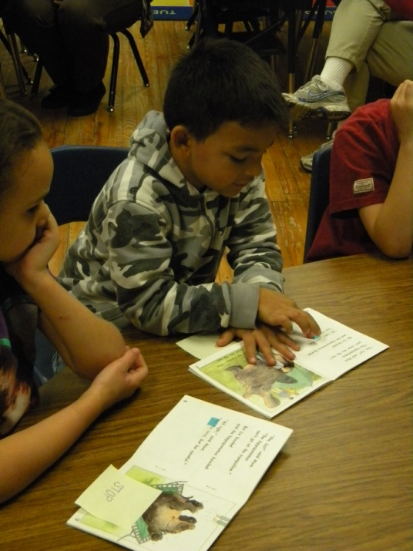
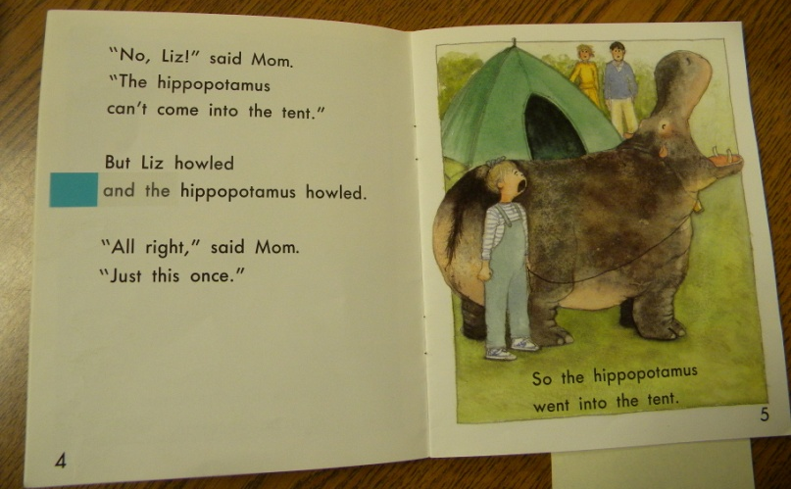
After Reading
Revisit the Goals:
The group discussed where the hippo went with Liz.
Students shared where they placed their sticky tabs and read their favorite sentences fluently for their friends.

Slide 9
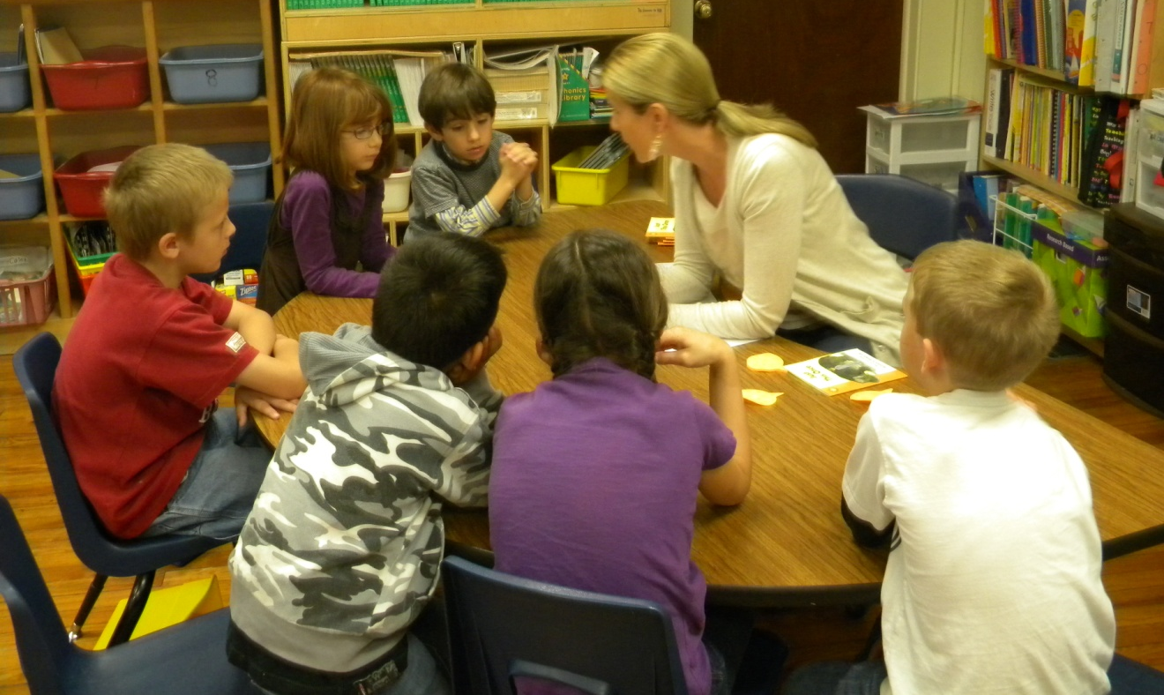
After Reading
Feedback from the students:
Gretchen asked the group, “How did you do using your punctuation to help you understand? Was it easy, tricky or hard?”
The group used thumbs up, sideways or down to respond.

Slide 10
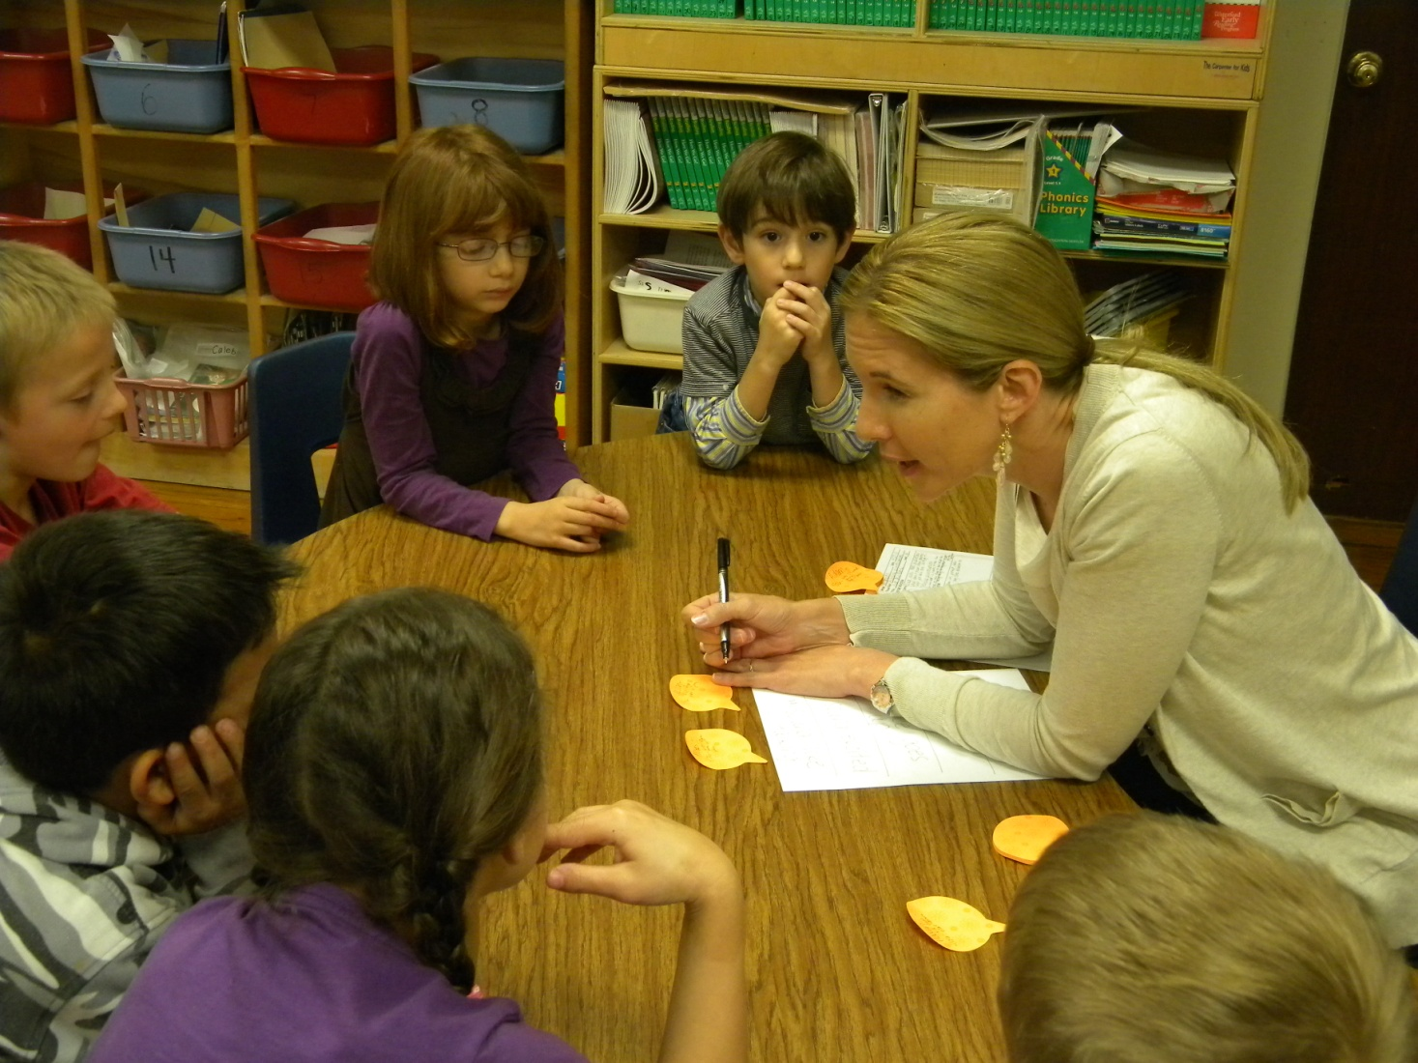
After Reading
Individual Feedback:
Gretchen gave each student individual feedback that was specific to the goals of the lesson.

Slide 11
Big Ideas from the debriefing session after the lesson:
Teach a skill or strategy, not the book.
Use activities and procedures that are specific to the focus of the lesson.
Students should be transitioning to silent reading at level 16.
Giving students a task (like using a sticky tab) can help them slow down and pay attention to comprehension.

Slide 12
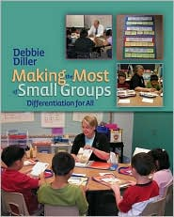
Diller, Debbie (2007). Making the Most of Small Groups; Differentiation for All. Portland, Maine: Stenhouse Publishers.
Gretchen Childs has been an educator for over 15 years. She has taught kindergarten and 2nd grade, as well as Special Education in Pre-K, 5th and 6th grades. She has been a District Literacy Coach, District Math Coach, and Reading Specialist. Gretchen has presented numerous workshops on literacy topics, and has traveled the country as a consultant for Debbie Diller & Associates since 2005. Gretchen earned her degree from Southwest Texas State University, with specializations in both Special Education and Reading. She also carries an Early Childhood Education endorsement. She resides in Pearland, Texas with her husband, Michael, and their three daughters.

