Slide 1
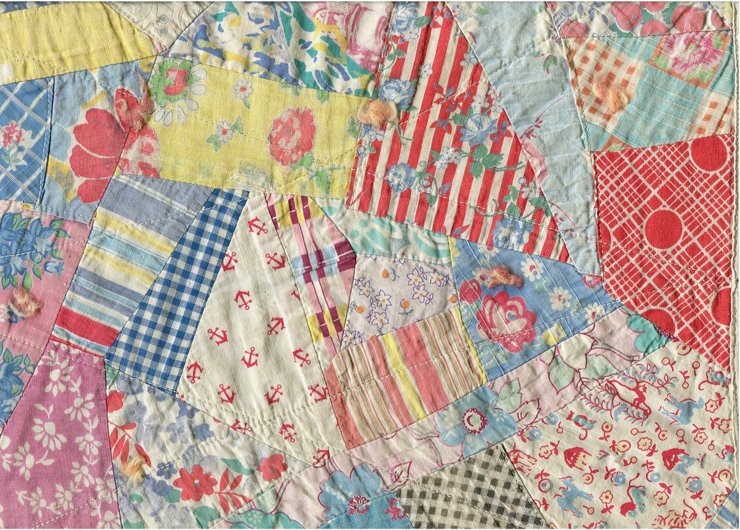
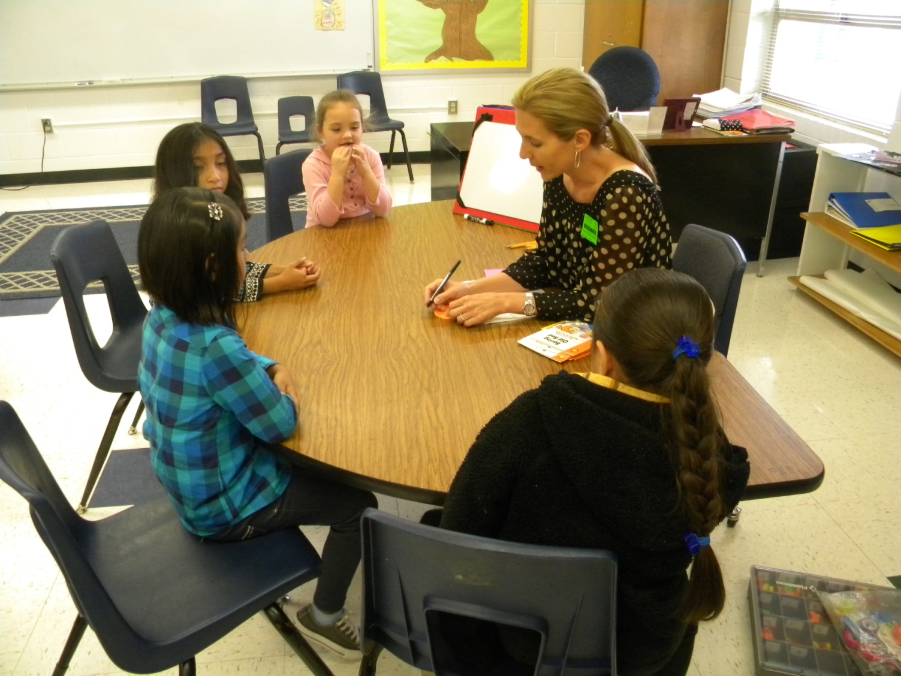
First Grade
Small Group Instruction
with Gretchen Childs
Eastside Elementary
Rogers Public Schools
April 26, 2011
S. Hensley

Slide 2
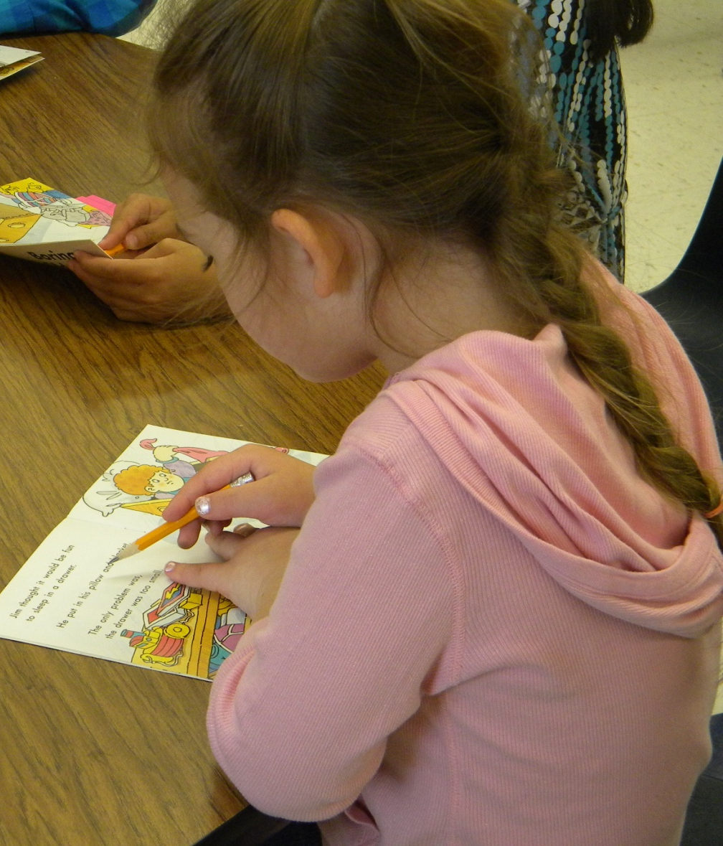
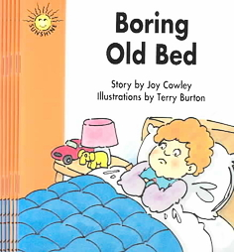
Group: First Grade (Eastside Elementary)
Focus/Goal: Inferring Character’s Feelings
Title: Boring Old Bed by Joy Cowley
Level: 16

Slide 3
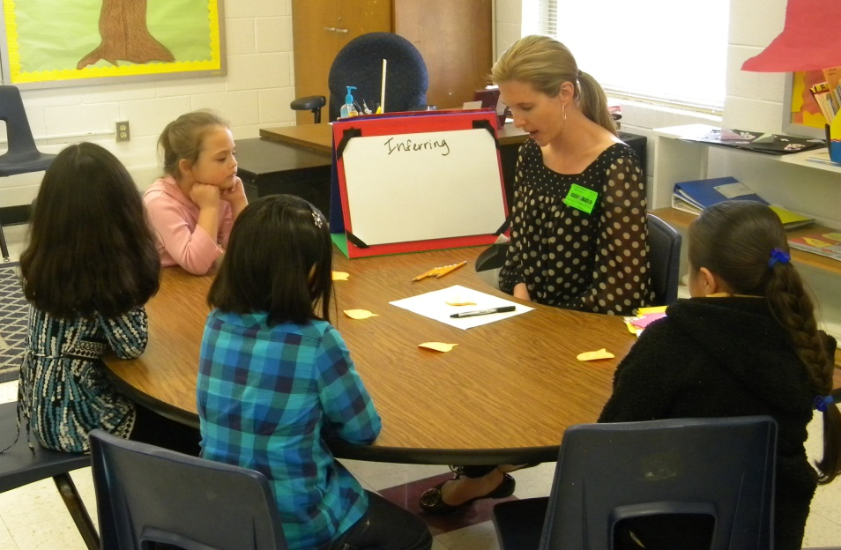
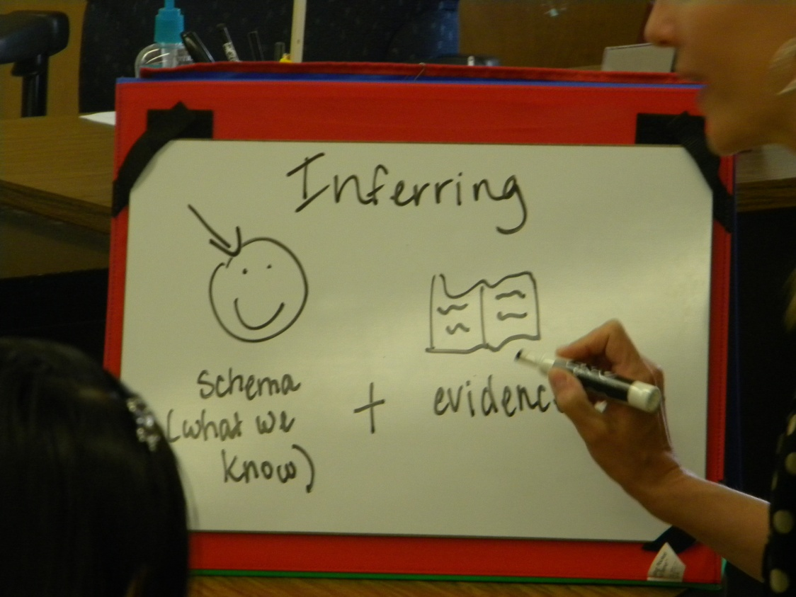
Before Reading
Access Prior Knowledge:
“What do you think this word means?”
Inferring
Gretchen used a personal story:
“Last night I got on an airplane in Houston, Texas to come to Rogers. The plane could not land in Rogers because of fog. The pilot took us to Oklahoma City instead”.
“What do you think happened after that?”
The girls shared:
“You got on a bus”
“You drove in a car”
“You got on another plane”
Gretchen explained that her flight had to wait for a
little while in Oklahoma City and then the pilot flew
back to Rogers and was able to land.
New Information:
She helped the girls understand that they used their schema about traveling and the evidence that she was there to infer what happened.
An anchor chart was created.

Slide 4
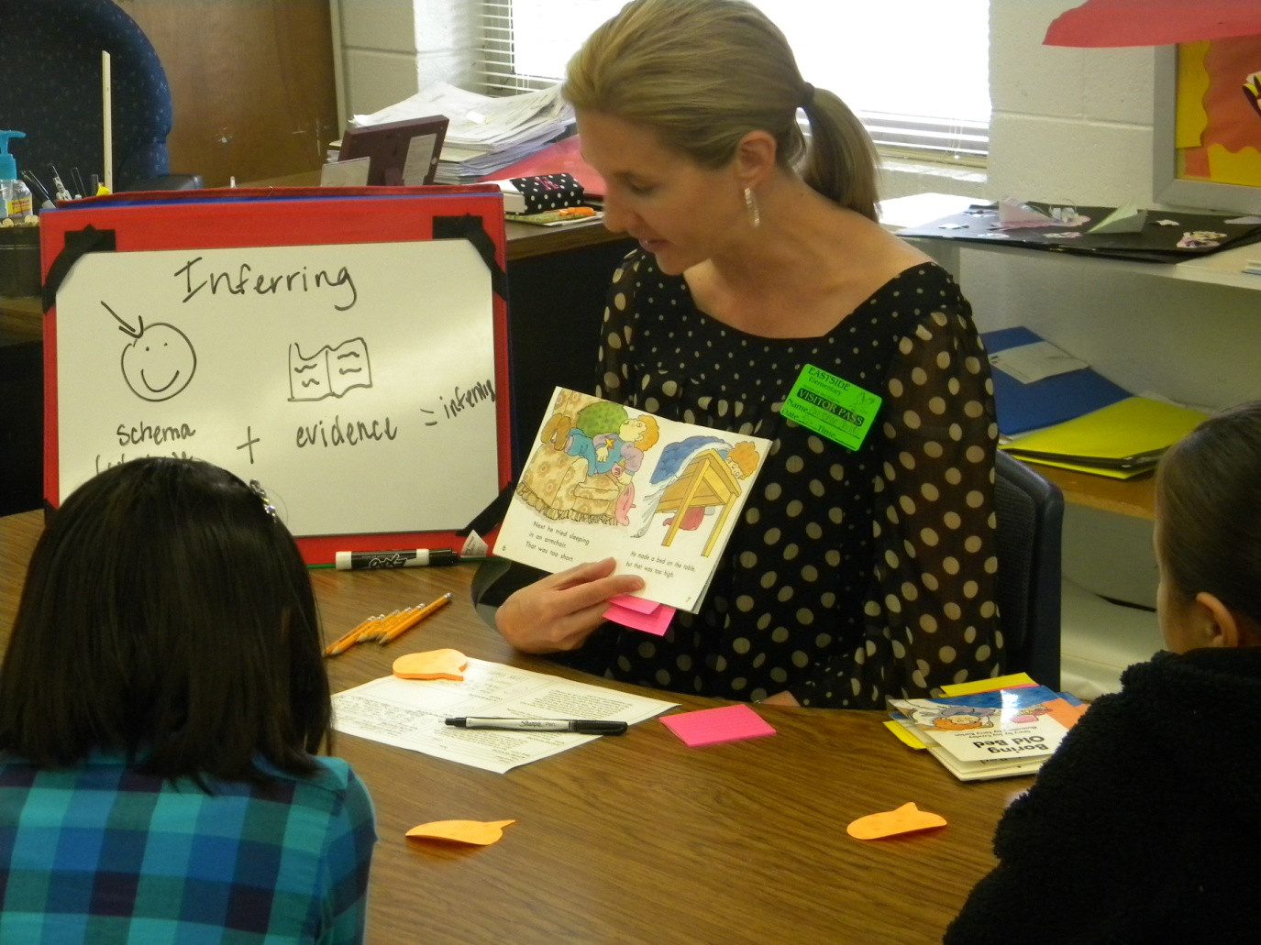
Before Reading
Book Introduction (APK)
Read the title
Boring Old Bed
Look at the front and back of the book
“Jim thinks his bed is boring so his dad lets him sleep in different places.”
Preview the book
Prior to the lesson, Gretchen placed post-it notes in two places in the text.

Slide 5
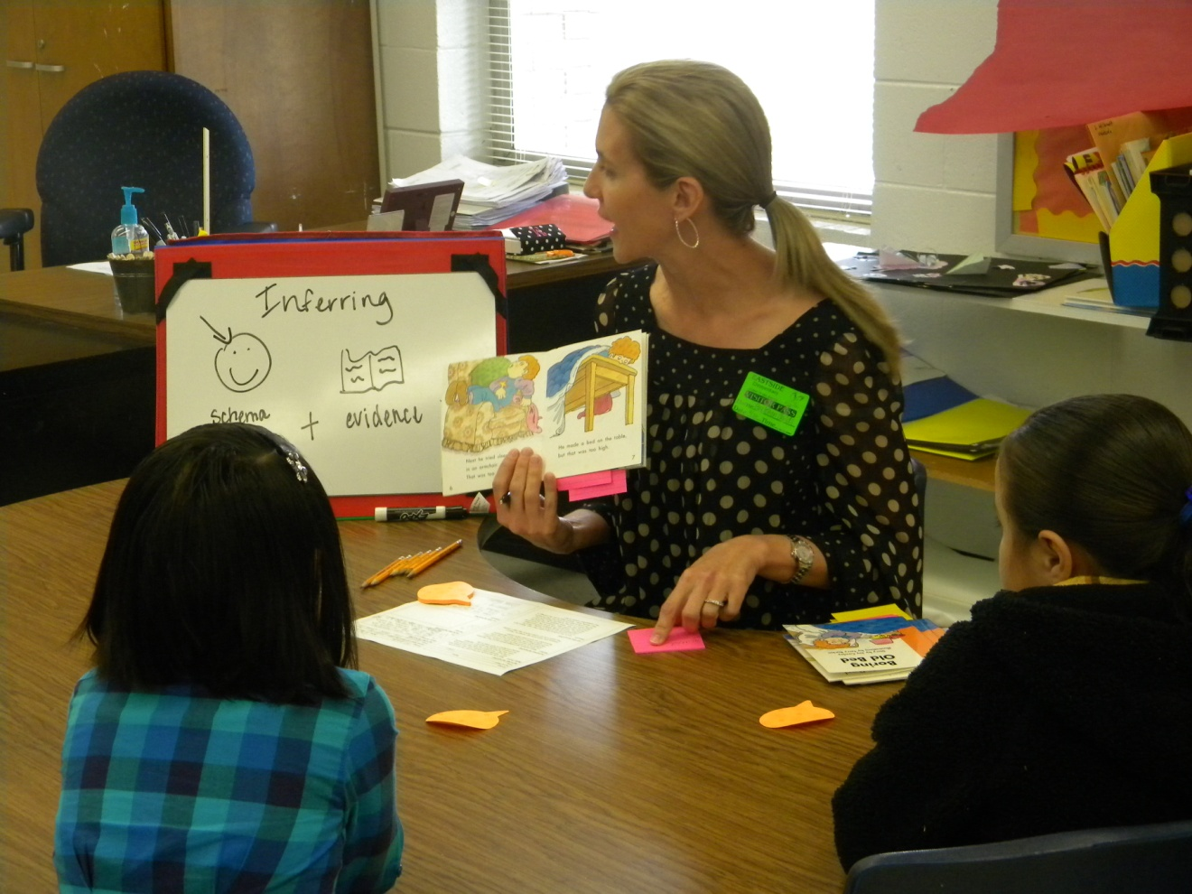
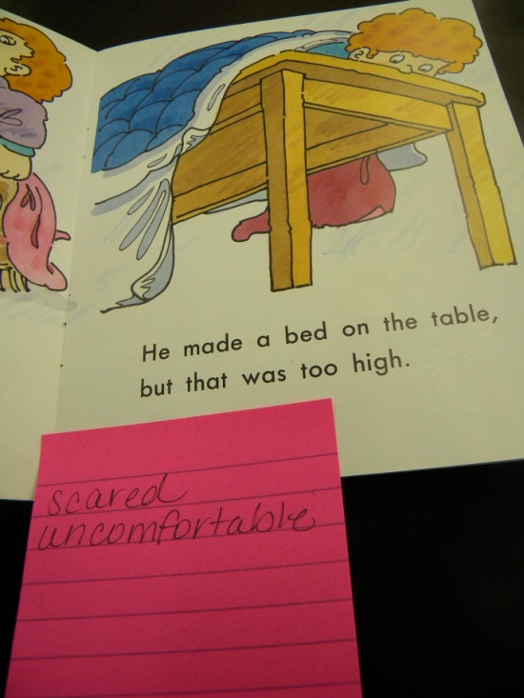
Before Reading
Goal:
“As you read, pay attention and infer how Jim is feeling.”
“I’ve put two sticky notes in your book. When you get to the sticky note, I want you to write down how you infer Jim is feeling.”
Gretchen modeled how to record her thinking on the sticky note.

Slide 6
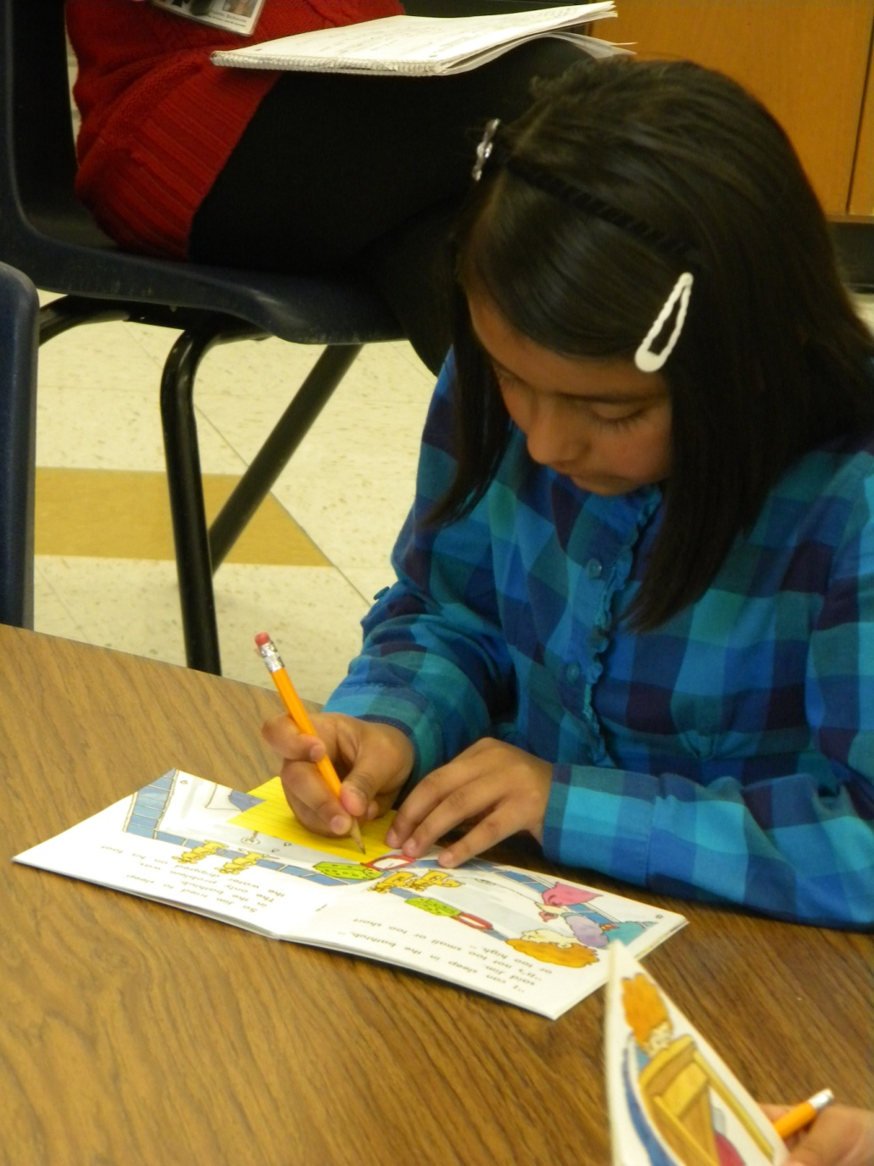
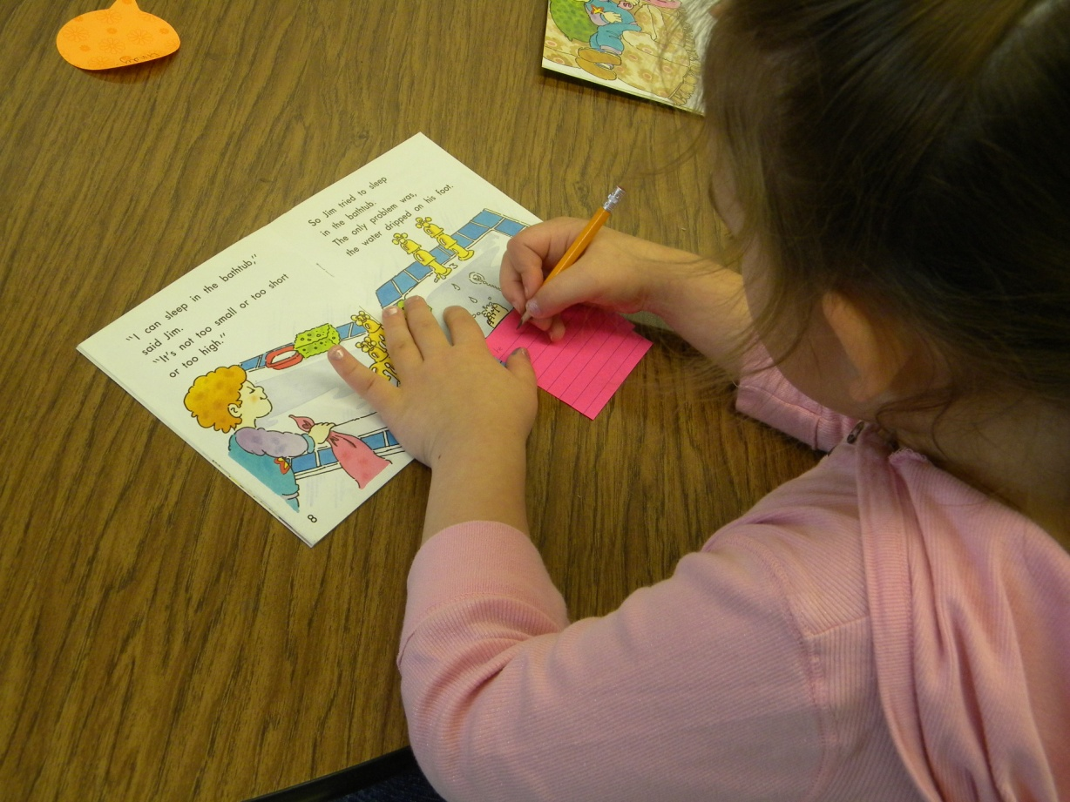
During Reading
The students:
Read silently or in a whisper voice
Recorded their inferences on sticky notes

Slide 7
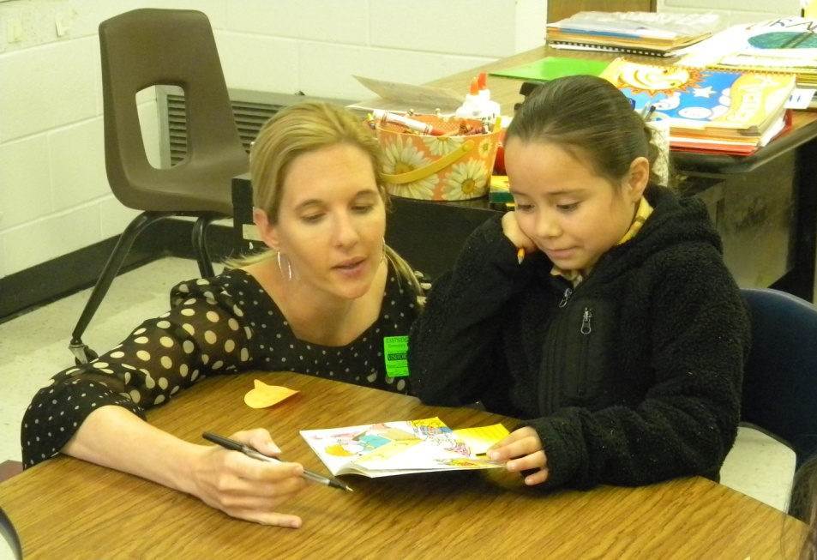
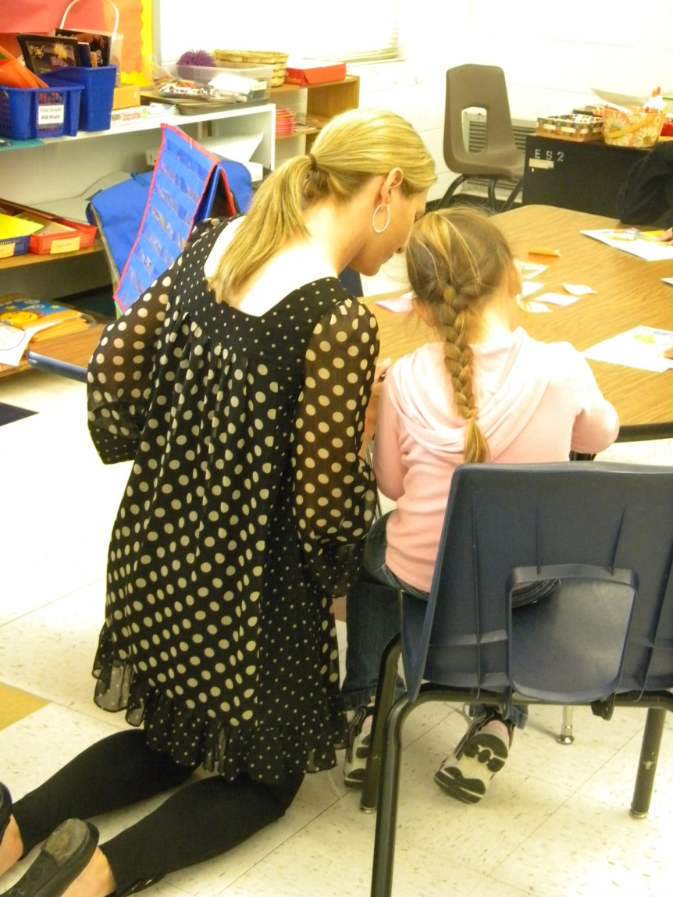
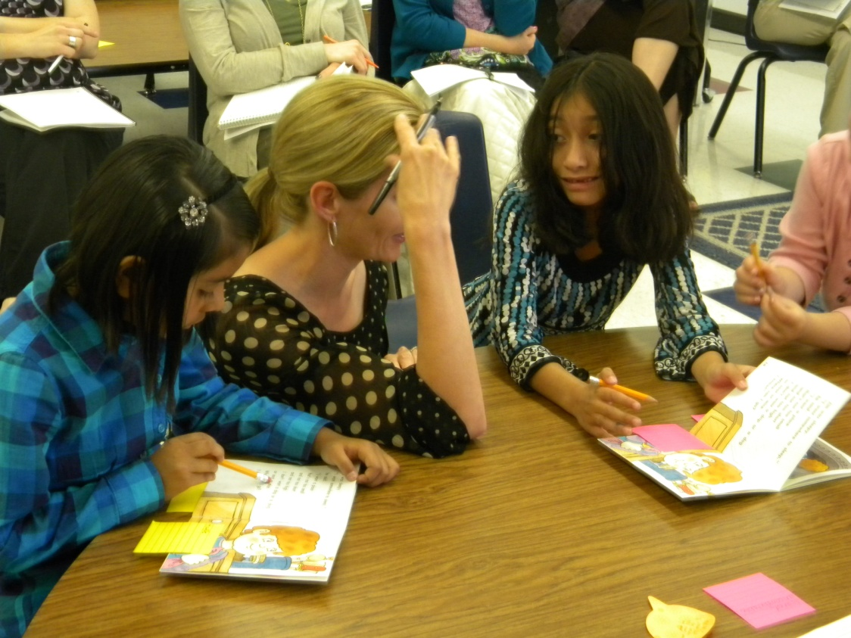
During Reading
Gretchen (the teacher):
listened to students read a portion of the text
prompted to the goals when necessary
jotted anecdotal notes about the students

Slide 8
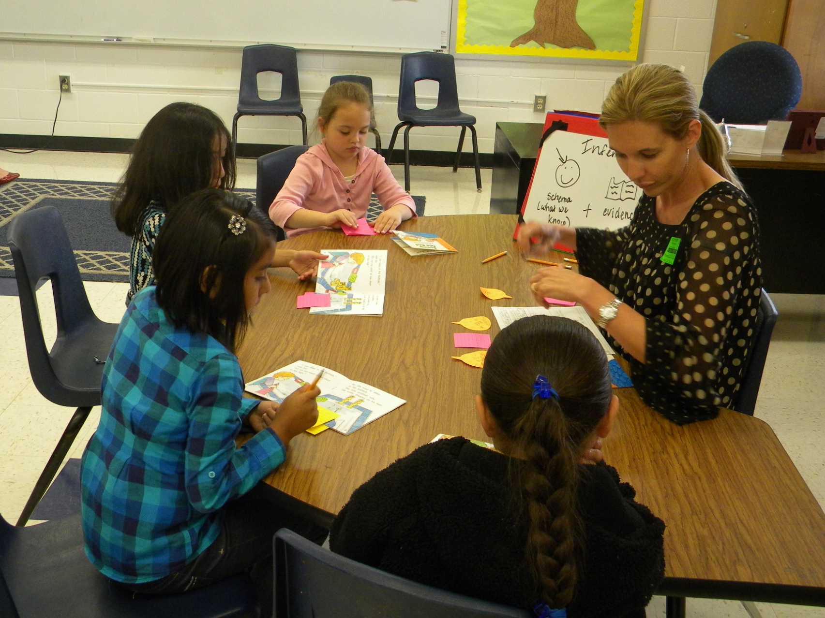
After Reading
Revisit the Goal:
The girls discussed their inferences about Jim’s feelings.

Slide 9
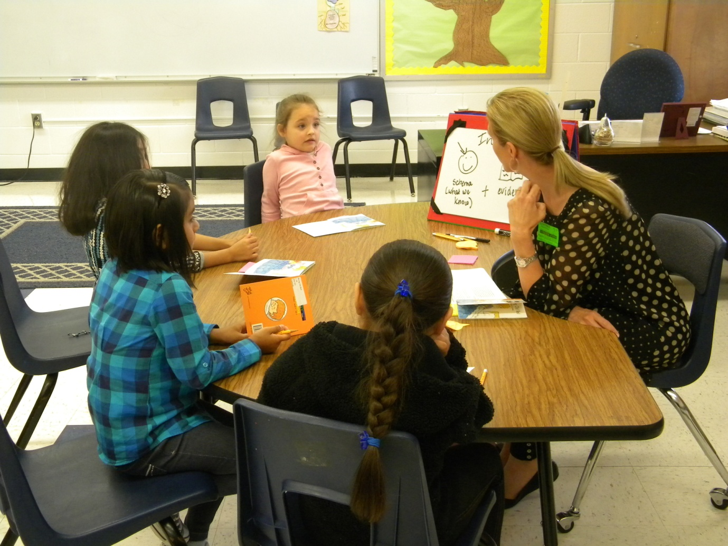
After Reading
Feedback from the students:
Gretchen asked the group, “How did you do inferring how Jim was feeling? Was it easy, tricky or hard?”
The group used thumbs up, sideways or down to respond.

Slide 10
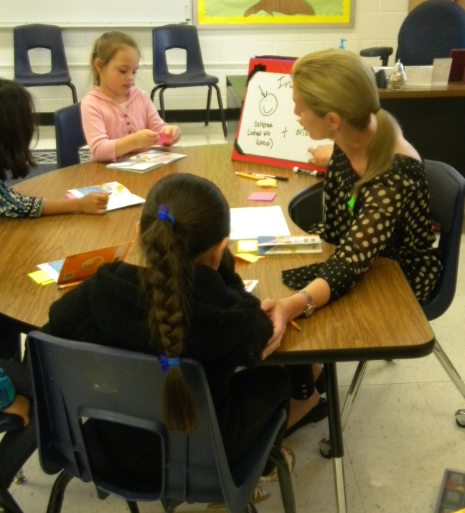
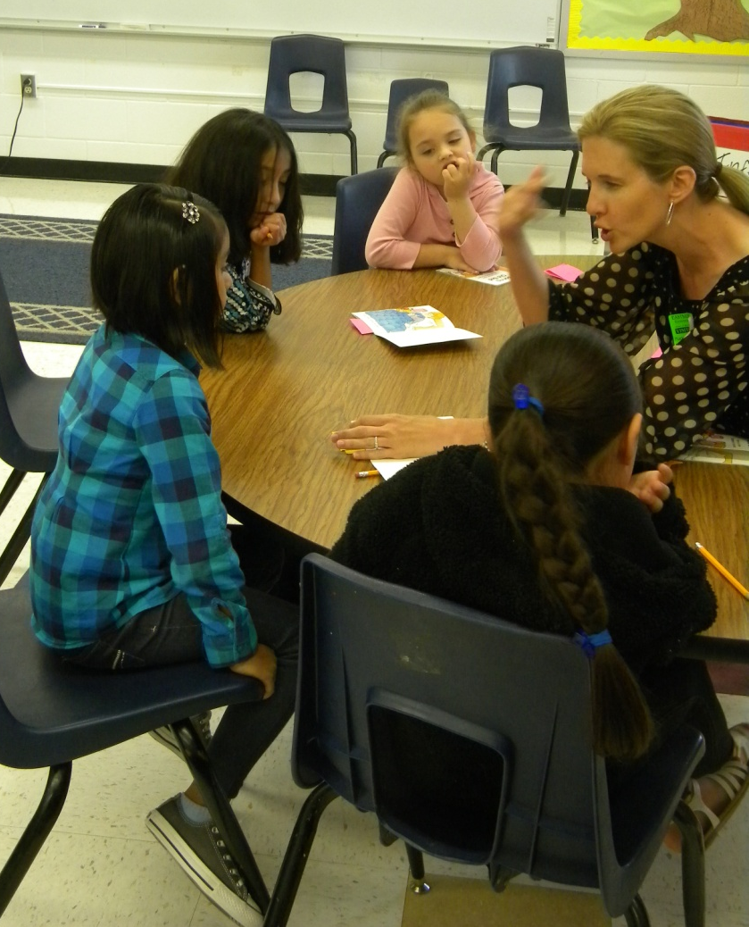
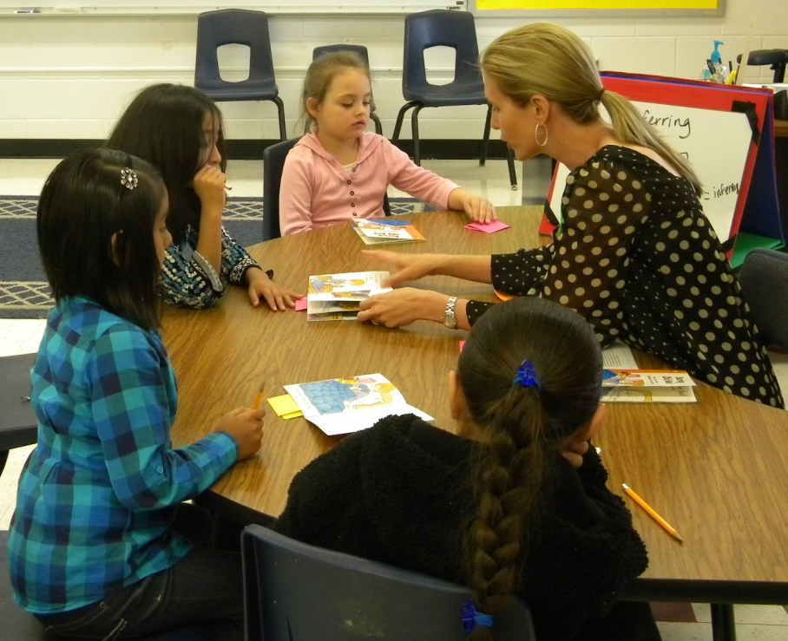
After Reading
Individual Feedback:
Gretchen gave each student individual feedback that was specific to the goal of the lesson.

Slide 11
Big Ideas from the debriefing session after the lesson:
Teach a skill or strategy, not the book.
Use activities and procedures that are specific to the focus of the lesson.
Students should be transitioning to silent reading at level 16.
Giving students a task (like taking notes on a sticky note) can help them slow down and pay attention to comprehension.

Slide 12
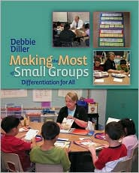
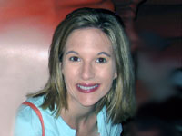
Diller, Debbie (2007). Making the Most of Small Groups; Differentiation for All. Portland, Maine: Stenhouse Publishers.
Gretchen Childs has been an educator for over 15 years. She has taught kindergarten and 2nd grade, as well as Special Education in Pre-K, 5th and 6th grades. She has been a District Literacy Coach, District Math Coach, and Reading Specialist. Gretchen has presented numerous workshops on literacy topics, and has traveled the country as a consultant for Debbie Diller & Associates since 2005. Gretchen earned her degree from Southwest Texas State University, with specializations in both Special Education and Reading. She also carries an Early Childhood Education endorsement. She resides in Pearland, Texas with her husband, Michael, and their three daughters.

