Slide 1
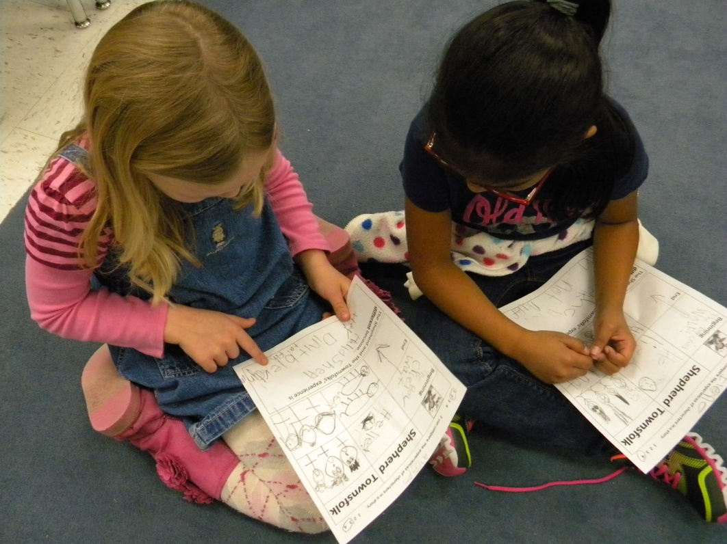
Comparing Experiences
Mrs. Felts’ First Grade Class
Eastside Elementary
12-6-12

Slide 2
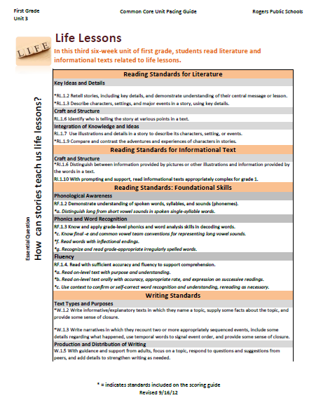
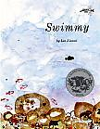
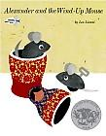
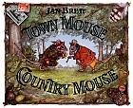
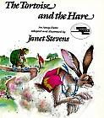
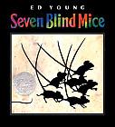
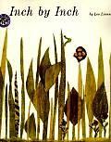
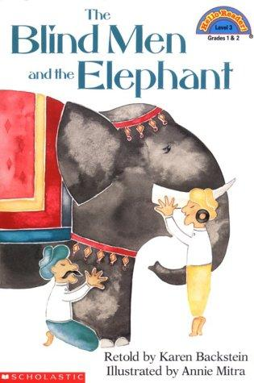
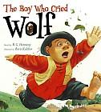
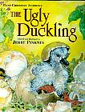
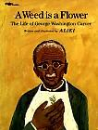
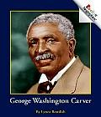
Unit Preparation:
Prior to beginning Unit 3, Mrs. Felts did the following:
Identified the standards to be taught- (she looked at the unit 3 pacing guide)
She asked herself-
“What will my students know and be able to do better at the end of this unit?”
3. She gathered and studied the resources in order to prepare the daily lessons.

Slide 3
Plan Daily Lessons:
Once she had the big picture for the unit, she began planning daily lessons.
The standard for this lesson is:
RL.1.9 Compare and contrast the adventures and experiences of characters in stories.
The resource she selected for the lesson is:
The Boy Who Cried Wolf

Slide 4
The students were introduced to the steps of comparing earlier in the week. They used The Tortoise and the Hare, and compared the Tortoise’s race experience to the Hare’s experience.
Comparing
I can find the items to compare.
I can choose the features to compare.
I can tell how the items are the same or different.

Slide 5
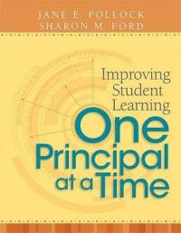
GANAG is a daily lesson structure that allows teachers to plan for student use of research based instructional strategies.
G= goal
A= access prior knowledge
N= new information
A= application
G= generalize the goal

Slide 6
GANAG provides students the opportunity to actively use the nine high-yield strategies:
(2) Identifying Similarities and Differences
(7) Cooperative Learning
(8) Setting Objectives and Providing Feedback
(3) Summarizing and Note Taking
(4) Reinforcing Effort and Providing Recognition
(9) Generating and Testing Hypotheses
(5) Homework and Practice
(10) Cues, Questions and Advance Organizers
(6) Nonlinguistic Representations

Slide 7
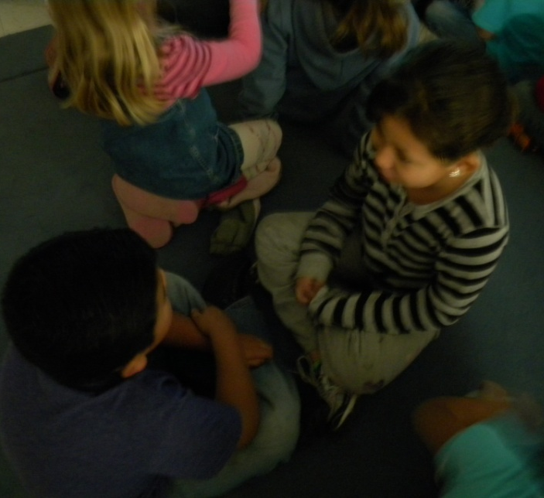
Access Prior Knowledge
The students were asked to look at the pictures and talk to their partners about what they saw.
(10) Cues, Questions and Advance Organizers
(6) Nonlinguistic Representations

Slide 8
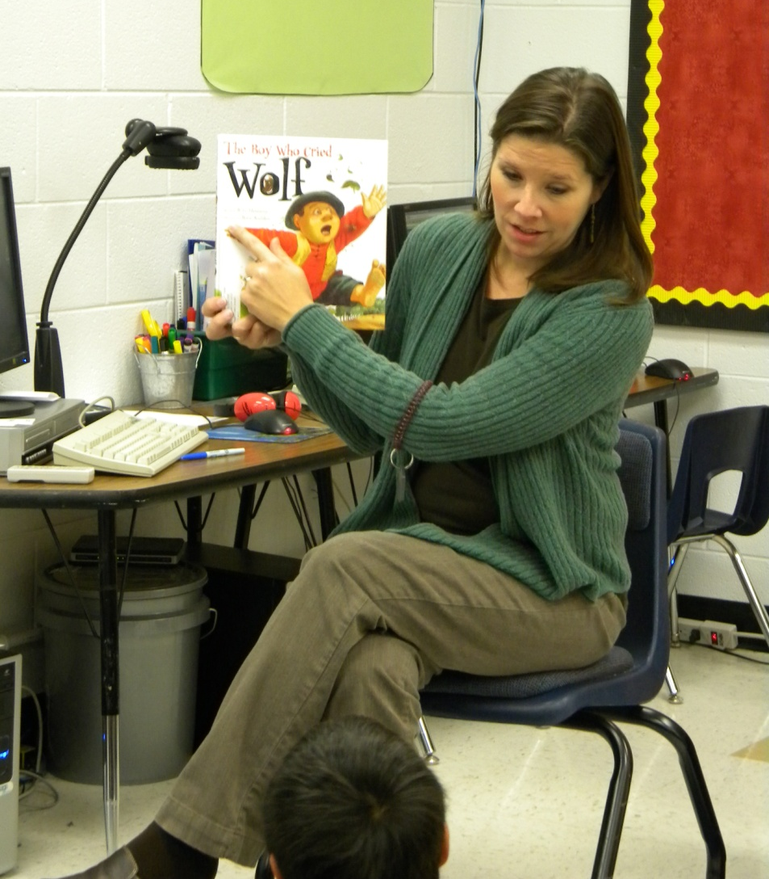
Mrs. Felts read The Boy Who Cried Wolf to the class.

Slide 9
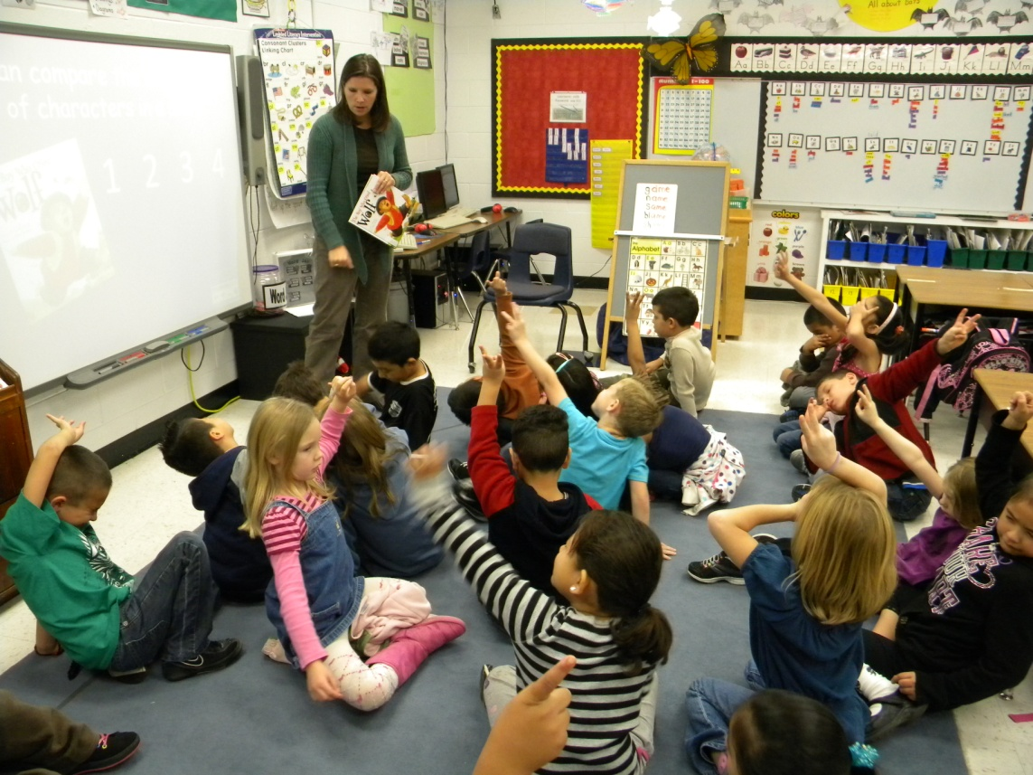
Goal
(8) Setting Objectives and Providing Feedback
I can compare the experiences of characters.
The students scored their understanding before the lesson by holding up the number of fingers of their score.
Notes:
Mrs. Felts asked the students to remember their score.

Slide 10
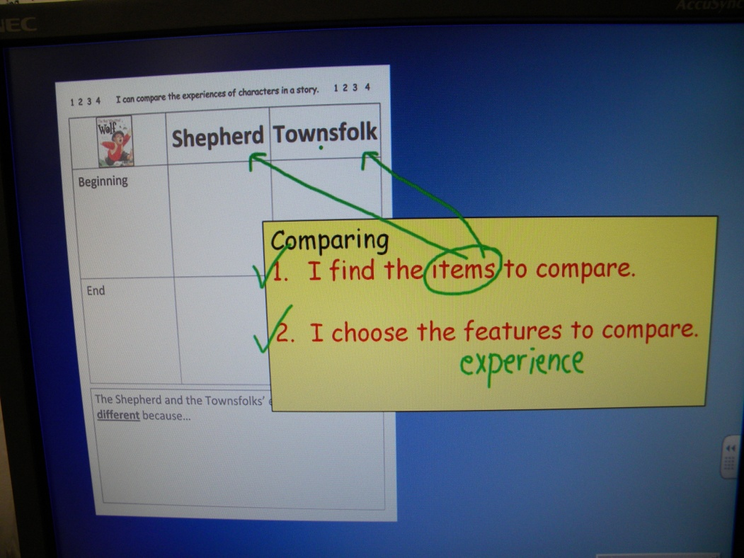
New Information
Mrs. Felts reminded the students of the first two steps of comparing. The class found the items to compare and chose the features to compare.

Slide 11
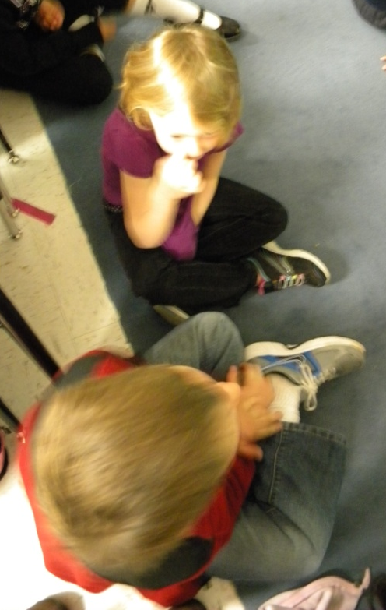
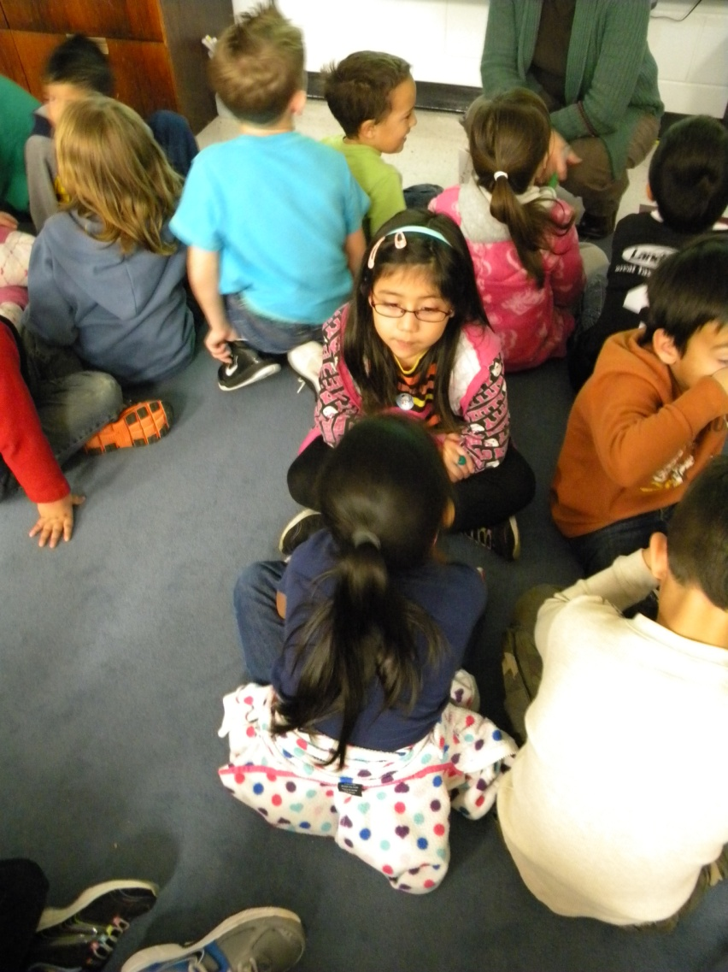
The students turned and talked about the boy’s experience of crying wolf.

Slide 12
The class recorded their understanding of the goal score at the top of the matrix.
This student said she was more than a two, but not quite a three.
Notes:
This student thought they were more than a 2 but not quite a 3.

Slide 13
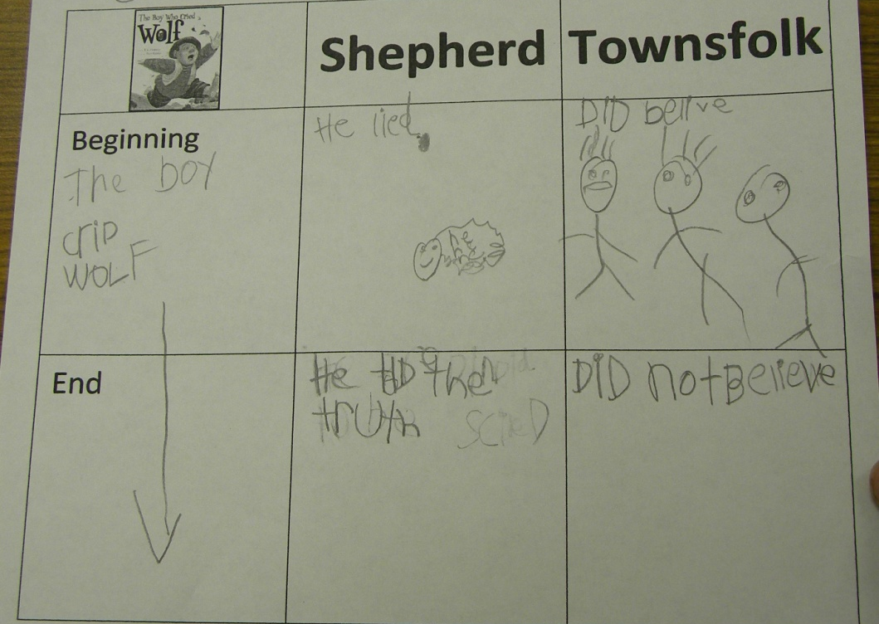
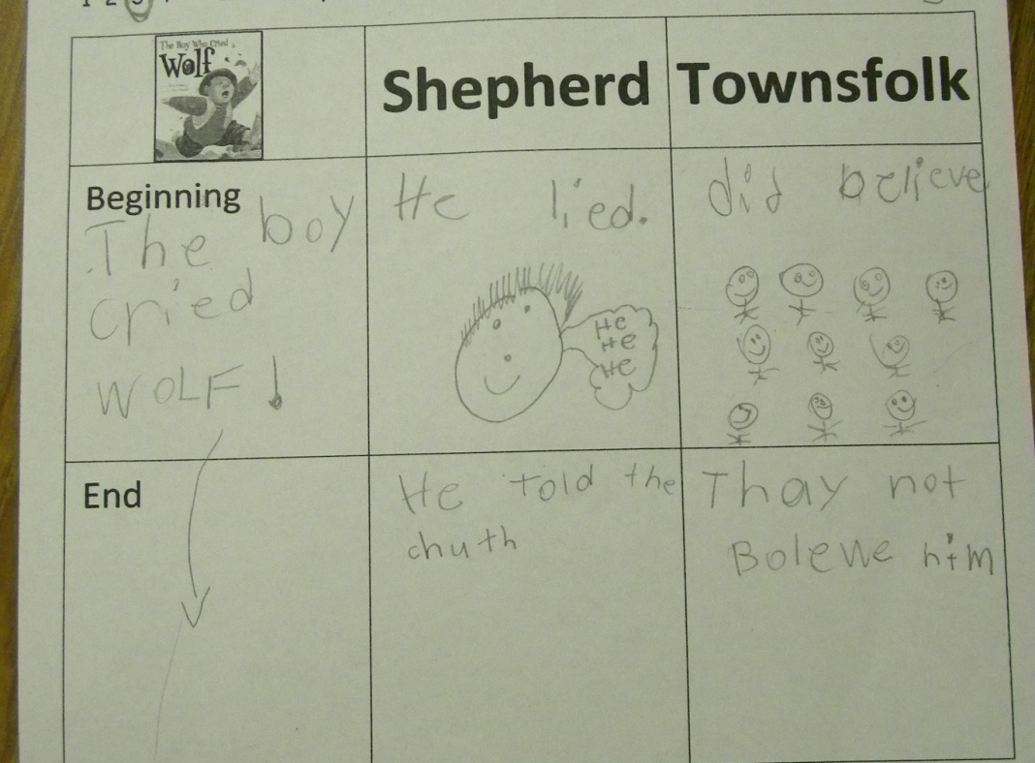
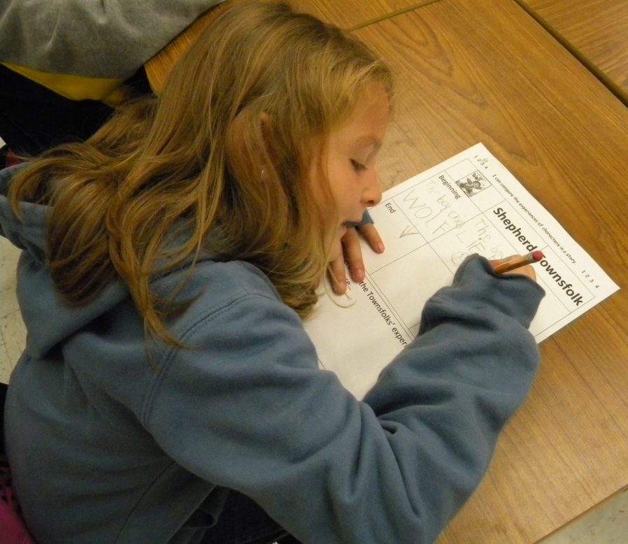
The students took notes on their matrix. (Mrs. Felts modeled on the board.)
(3) Summarizing and Note Taking

Slide 14
(2) Identifying Similarities and Differences
Application
The students wrote about how the experiences were different.
Comparing
I can find the items to compare.
I can choose the features to compare.
I can tell how the items are the same or different.
The shepherd boy was happy and the townsfolk were scared.
The boy was lying and the townsfolk were serious.
The boy lied. Townsfolk did not lie and the boy saw the wolf.

Slide 15
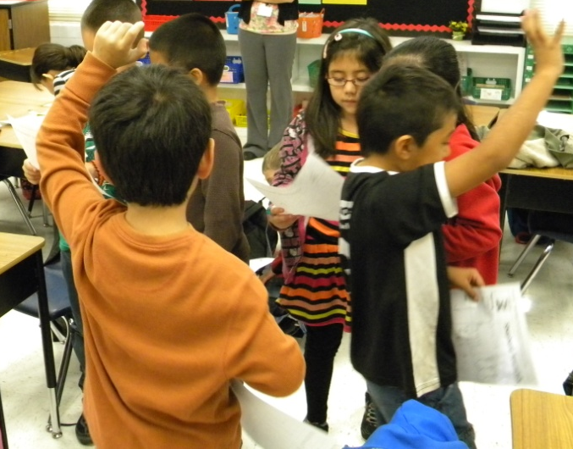
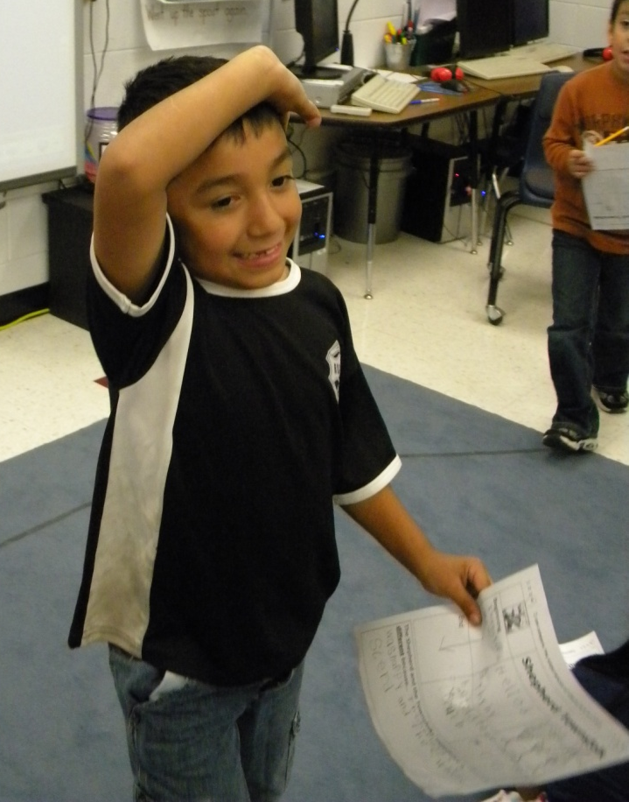
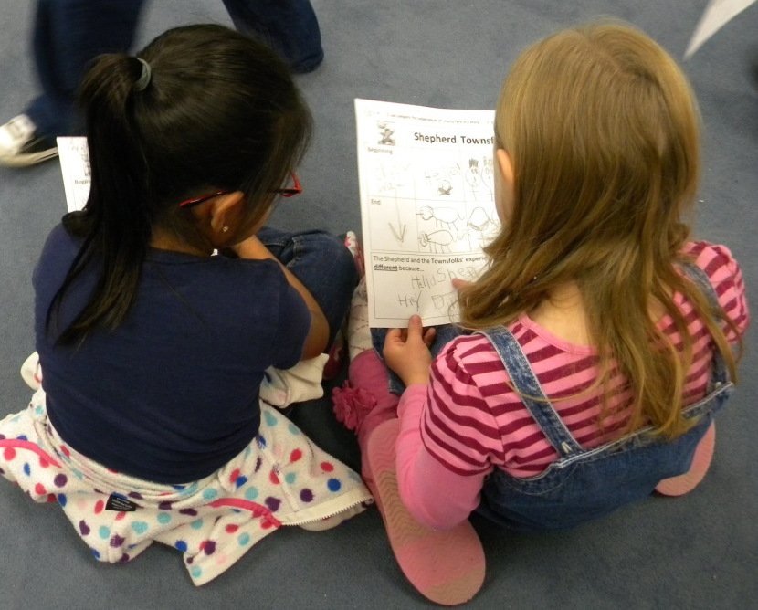
The class used the “Stand up, Hand up” structure to share their comparisons.
(7) Cooperative Learning

Slide 16
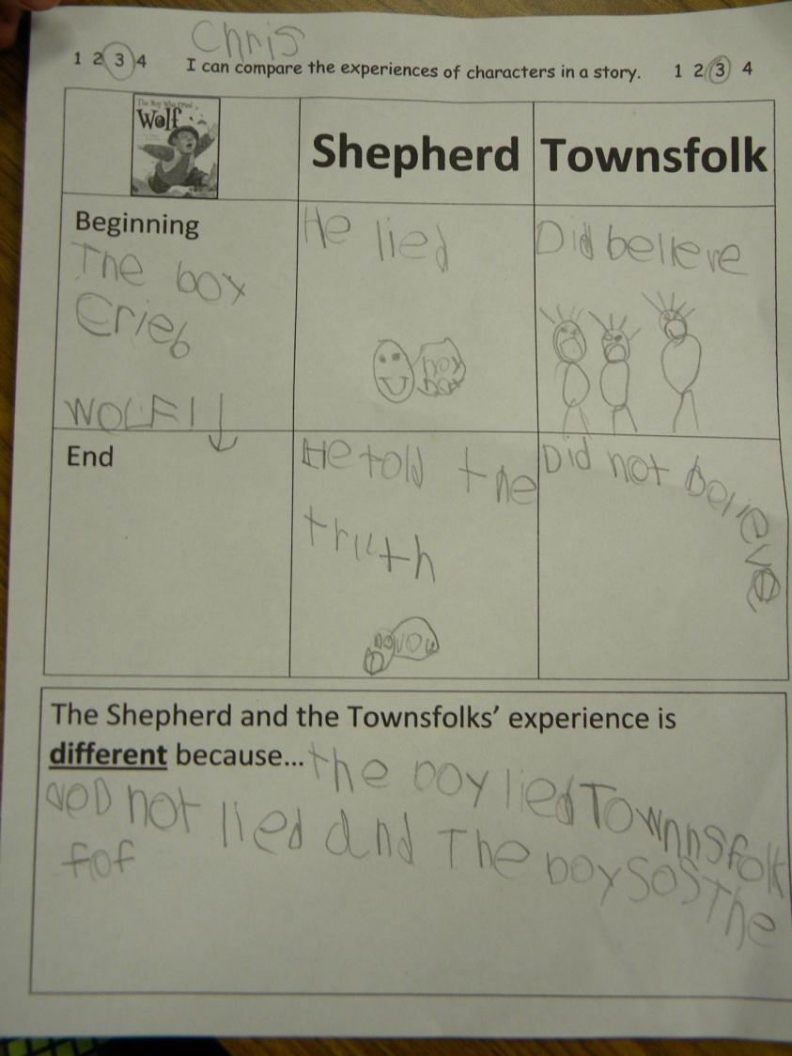
Revisit the Goal
I can compare the experiences of characters.
The students scored their understanding after the lesson.

Slide 17
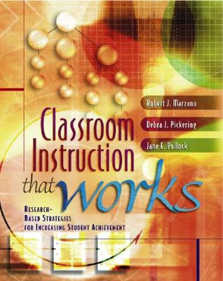
Marzano, R. J., Pickering, D. J., & Pollock, J. E. (2001). Classroom instruction that works: Research-based strategies for increasing student achievement. Alexandria, VA: Association for Supervision and Curriculum Development.
Pollock, J. E. (2007). Improving student learning one teacher at a time. Alexandria, VA: Association for Supervision and Curriculum Development.
Pollock, J. E., & Ford, Sharon M. (2009). Improving student learning one principal at a time. Alexandria, VA: Association for Supervision and Curriculum Development.
Pollock, J. E., Ford, Sharon M., & Black, Margaret M. (2012). Minding the Achievement Gap. Alexandria, VA: Association for Supervision and Curriculum Development.

