Slide 1
Fifth Grade Domain Specific Words A thru F
Adapted from:
Vocabulary for the Common Core (Marzano, 2013)
https://kids.wordsmyth.net/we/
http://www.wordcentral.com/
http://dictionary.reverso.net/english-cobuild/
www.google.com
https://images.google.com/
Vocabulary Team:
Jenny Felts, Susan Hensley, Andrea Hixon, Susan Huntington, Karla Magarin,
Karen Maloney, Renee Simpson

Slide 2
academic vocabulary
L.3.6
L.4.6
L.5.6
Words that are not usually common in casual conversation, but appear in the books we read. They often replace familiar words.
crouched
scurried
propped
3-5

Slide 3
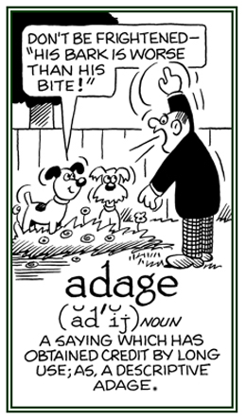
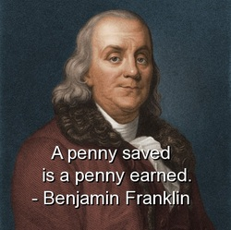
adage
L.4.5b
L.5.5b
an old saying that expresses a general truth about life
4-5

Slide 4
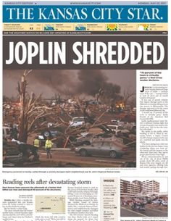
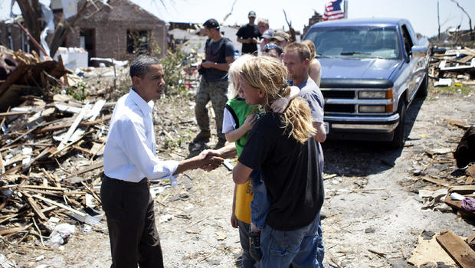
account
RI.5.6
A story or report
President Obama hears a firsthand account of the Joplin tornado.
A reporter wrote a secondhand account of the Joplin tornado.
5

Slide 5
affix
L.3.4b
L.4.4b
L.5.4b
A word part that is added to a word to change it’s
meaning or function
happy
unhappy
write
writer
3-5

Slide 6
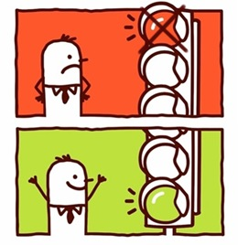
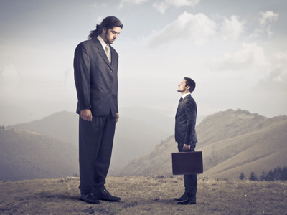
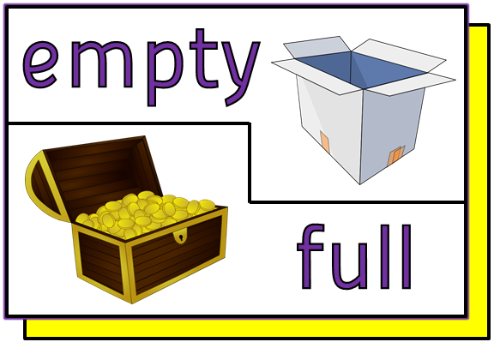
antonym
L.4.5c
L.5.5c
A word that means the opposite
4-5

Slide 7
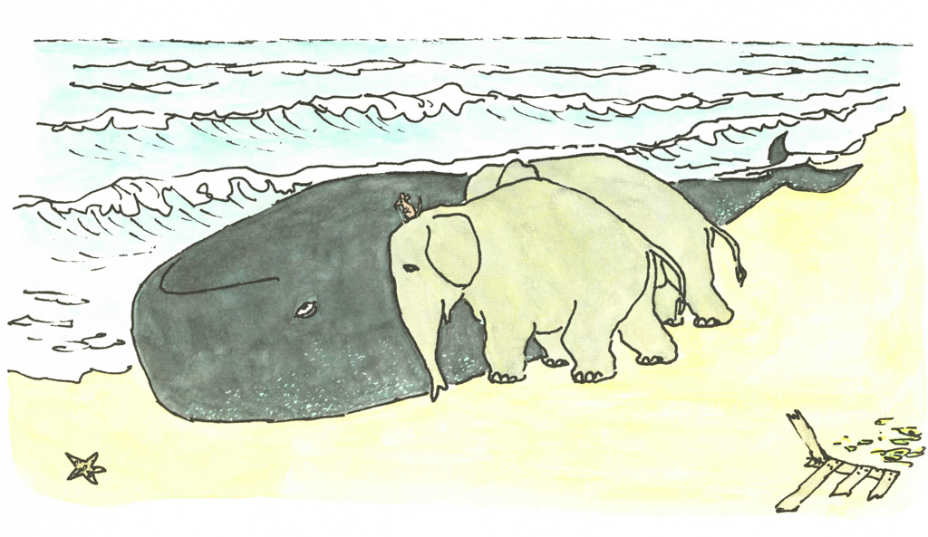
cause/effect
RI.3.3, RI.3.8
RI.4.5
RI.5.5
A connection between to events in which one causes the other to happen
The elephants pushed Boris’ huge body back into the ocean because he had washed ashore.
3-5

Slide 8
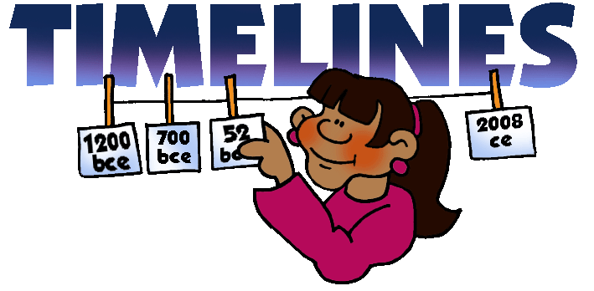
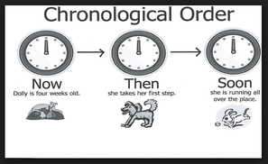
chronology
RI.4.5
RI.5.5
List of past events in the order that they happened
4-5

Slide 9
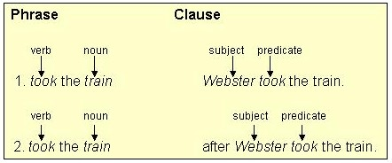
clause
W.5.1c, W.5.2c
A group of related words containing a subject and a verb
5

Slide 10
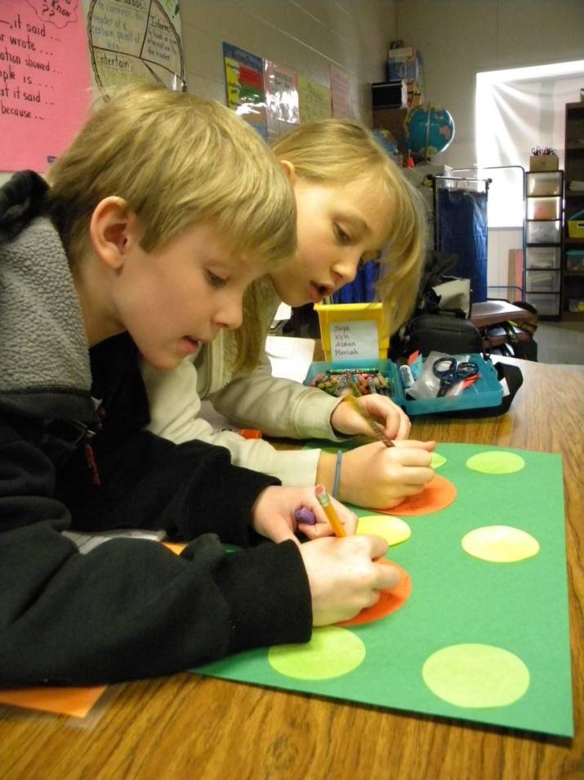
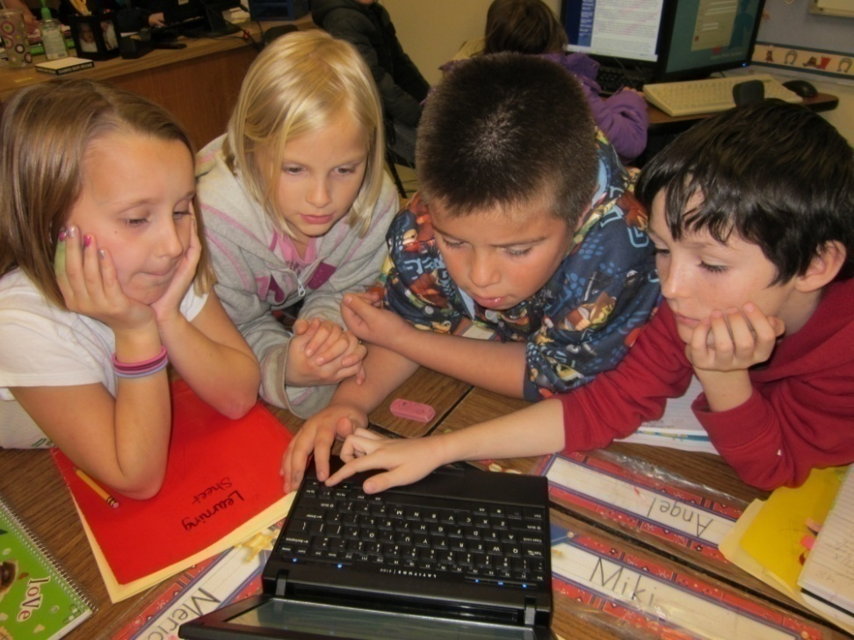
W.3.6, SL.3.1
W.4.6, SL.4.1
W.5.6, SL.5.1
collaborate
Work jointly on an activity, especially to produce or create something
3-5

Slide 11
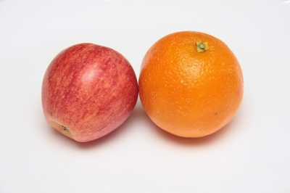
RL.3.9
RL.4.6, RL.4.9
RL.5.3, RL.5.9
compare and contrast
To describe how things are alike and how they are different
3-5

Slide 12
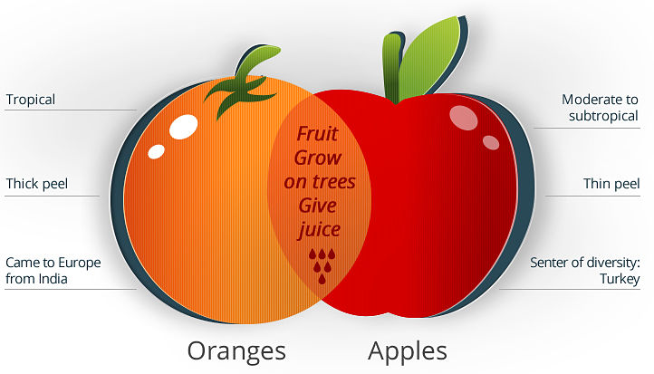
RI.3.8
RI.4.5
RI.5.5, L.5.4a
comparison
Consider two or more things and discover the differences between them
3-5

Slide 13
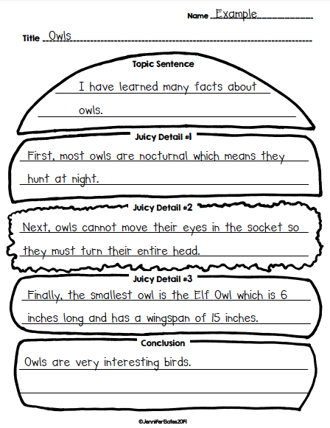
conclusion
W.4.3e
W.5.3e
The last part of a writing or speech
4-5

Slide 14
concrete
W.4.2b, W.4.3d
W.5.2b, W.5.3d
something definite and specific
4-5

Slide 15
confirm
RF.3.4c
RF.4.4c
RF.5.4c
Checking to make sure something is correct
3-5

Slide 16
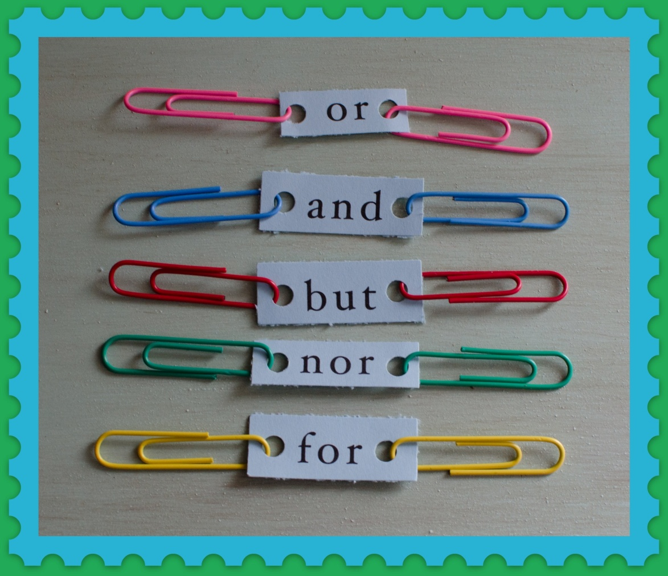
RF.3.4c
RF.4.4c
RF.5.4c
conjunction
A word that connects other words, phrases, clauses, or sentences.
3-5

Slide 17
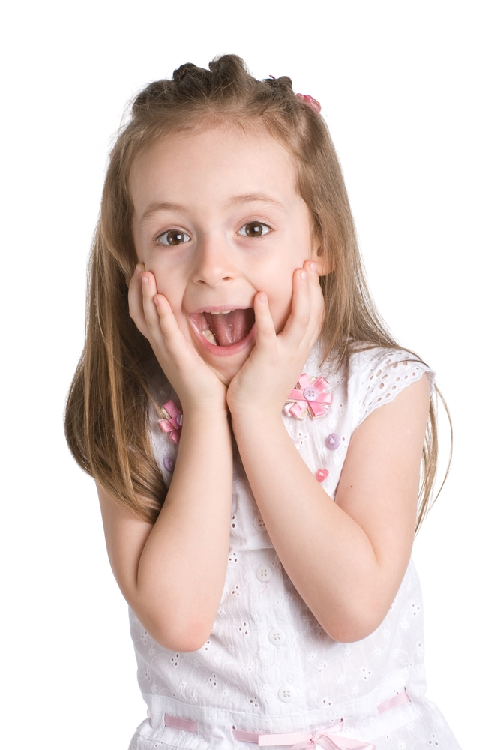
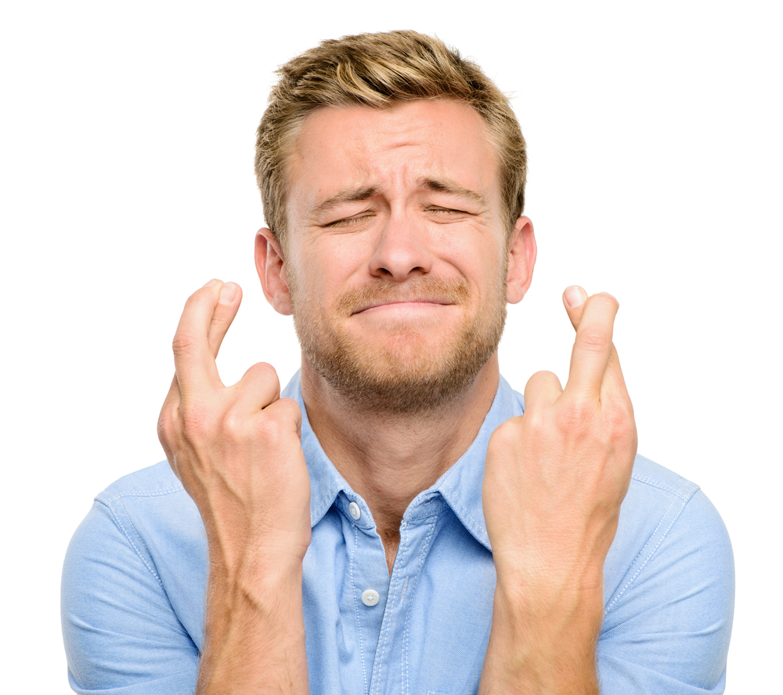
RF.3.2, RL.3.7, W.3.2
W.4.2, W.4.3d, L.4.1c, L.4.3a
W.5.2, W.5.3d, L.5.1c
convey
To show feelings or emotions
3-5

Slide 18
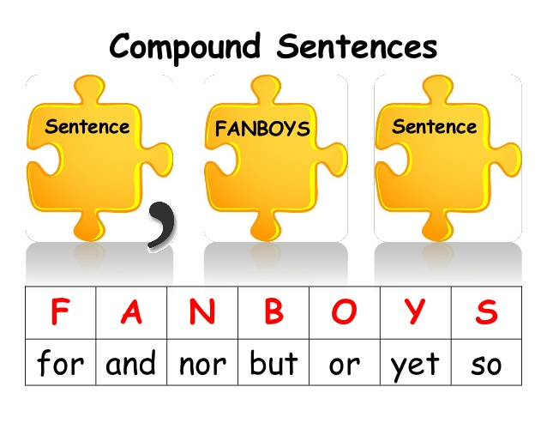
L.4.2c
coordinating conjunction
A conjunction that is used when you want to give equal emphasis to two main clauses
4

Slide 19
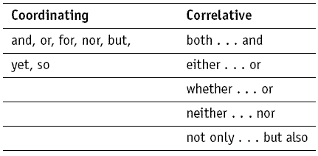
L.5.1e
correlative conjunction
A conjunction that is used when you want to connect a pair of ideas
5

Slide 20
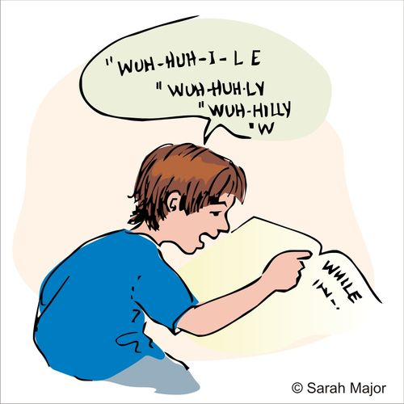
correspondence
RF.4.3a
RF.5.3a
matching printed letters with the sounds they make
4-5

Slide 21
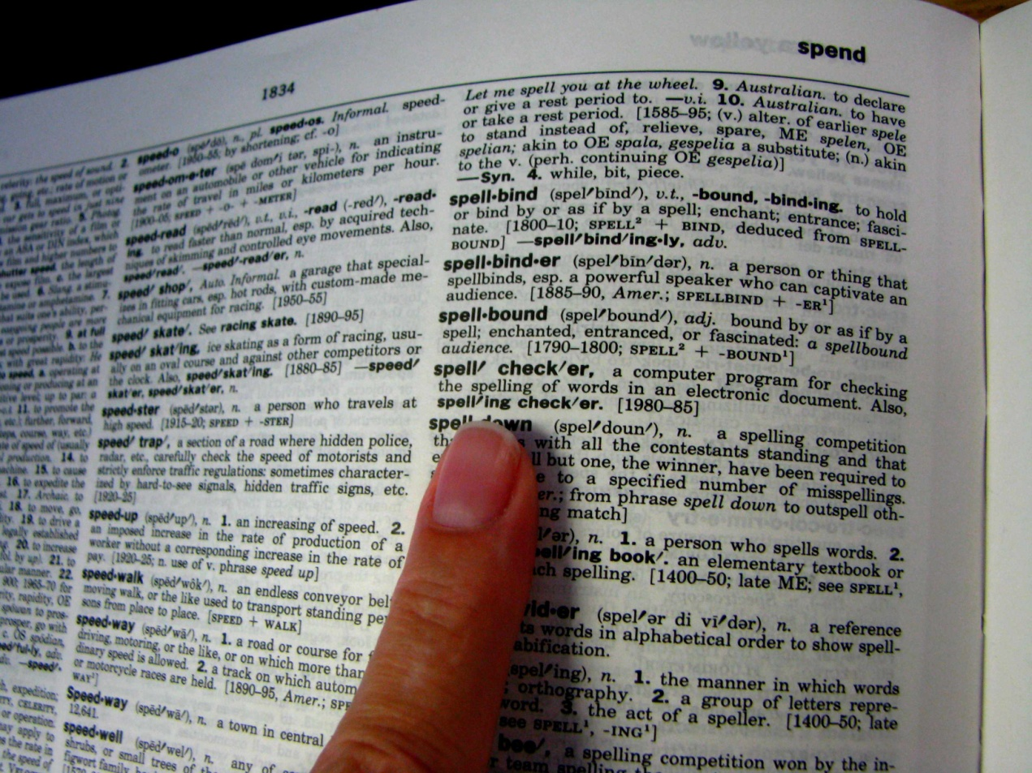
W.3.2b
W.4.2b, L.4.4a
W.5.2b
definition
A statement giving the meaning of a word or expression
(often found in a dictionary)
3-5

Slide 22
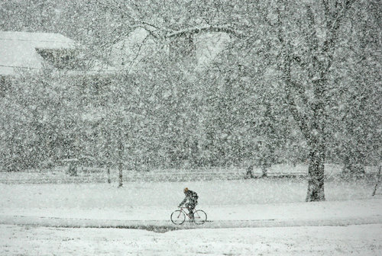
W.3.3b
RL.4.5, RL.4.7, W.4.3b
W.5.3b
description
Using details to explain how something looks, feels, smells, sounds or tastes
The snow was cold and wet.
3-5

Slide 23
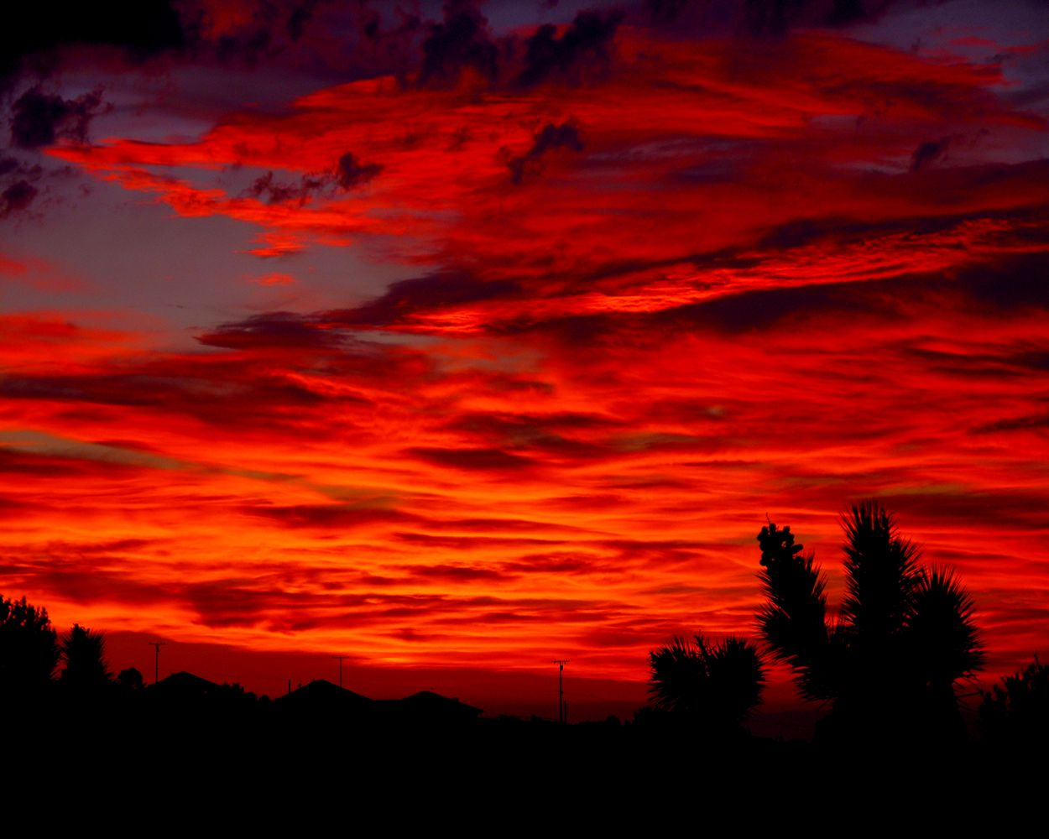
W.3.3b
RL.4.5, RL.4.7, W.4.3b
W.5.3b
descriptive detail
A detail that provides information about what something or someone is like
The sunset filled the entire sky with the deep color of rubies, setting the clouds ablaze.
3-5

Slide 24
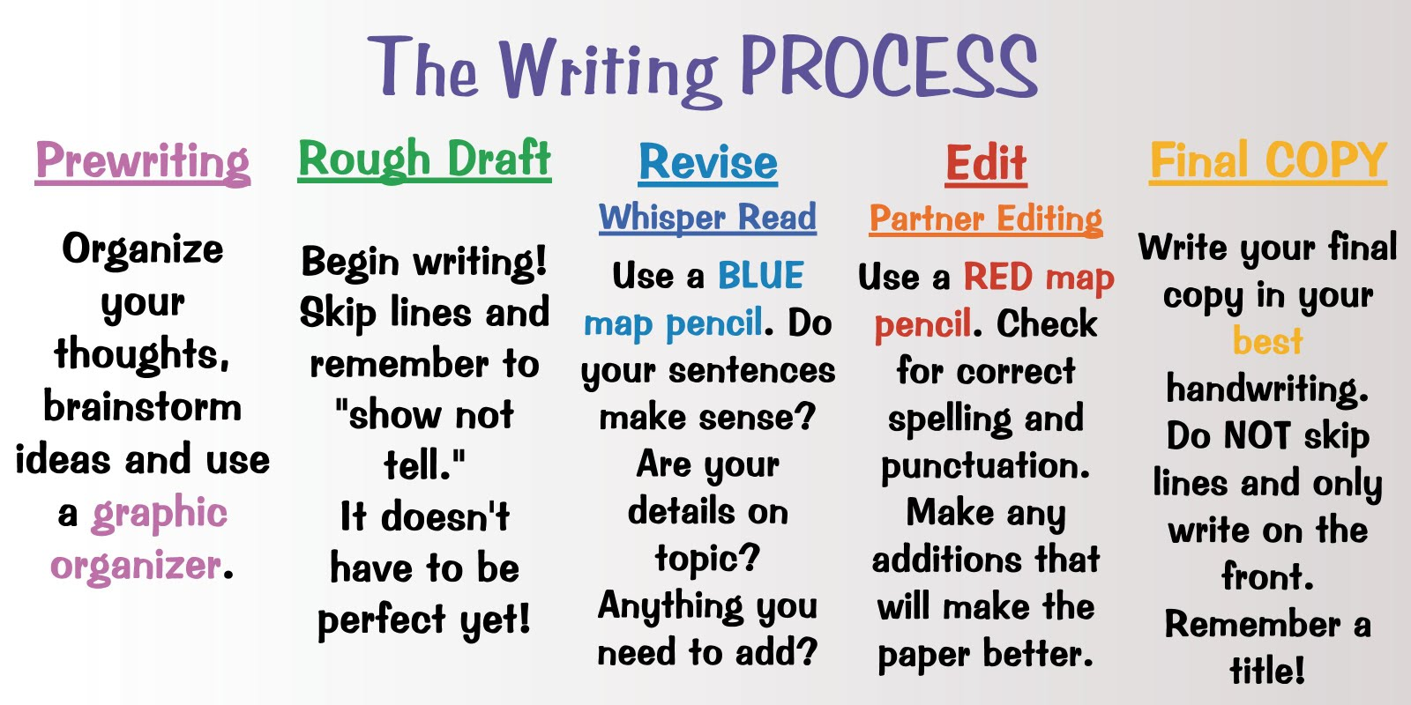
W.3.4
W.4.4, SL.4.5
W.5.4, SL.5.5
development
The growth and formation of a
piece of writing or a presentation
3-5

Slide 25
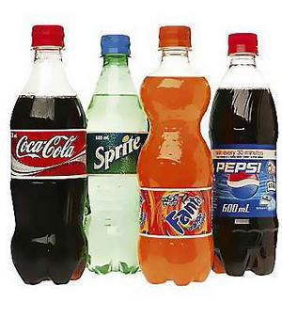
L.5.3b
dialect
A form of language that is spoken in a particular area
Soda
Pop
Coke
5

Slide 26
W.3.3b, L.3.2c
RL.4.5, W.4.3b
W.5.3b
dialogue
A talk between two or more people or between characters in a film, play or novel
3-5

Slide 27
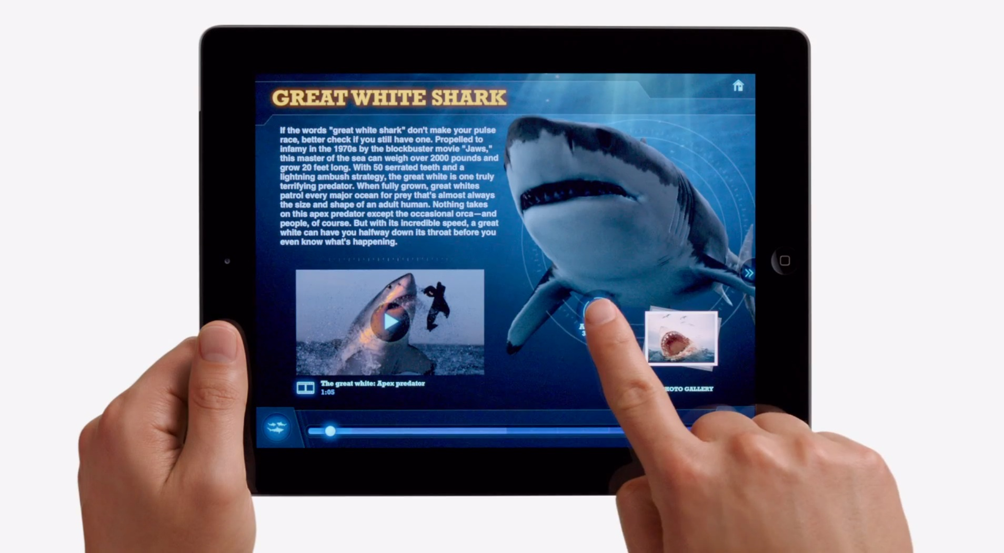
W.3.8
W.4.8
W.5.8
digital source
A piece of information you access through technology
3-5

Slide 28
SL.K.1a
SL.1.1a ,SL.1.1c
SL.2.1a ,SL.2.1c
SL.3.1 ,SL.3.1a ,SL.3.1b ,SL.3.1d
SL.4.1 ,SL.4.1a ,SL.4.1b ,SL.4.1c ,SL.4.1d
discussion
talking about something with another person or a group of people
2-4

Slide 29
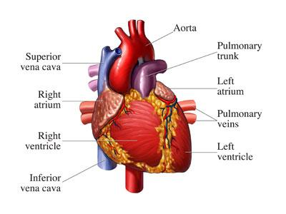
domain specific vocabulary
W.4.2d
W.5.2d
words found and used in particular contents and subjects
4-5

Slide 30
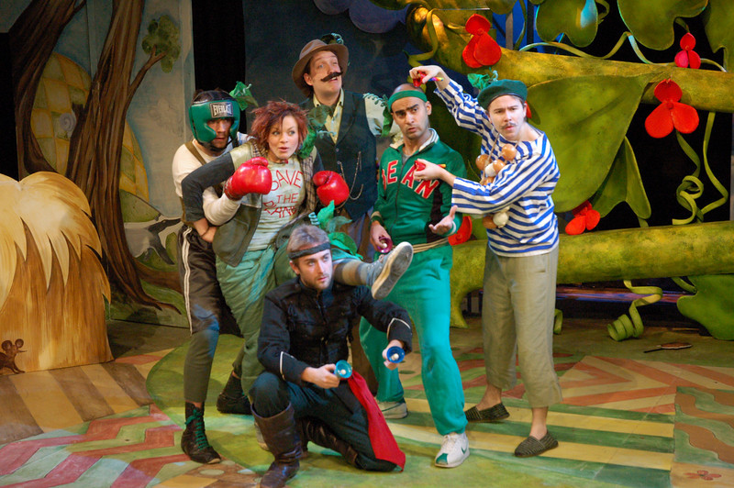
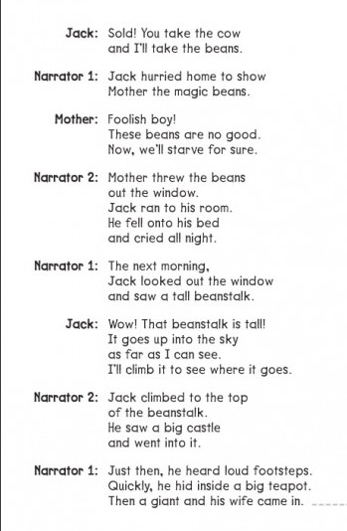
RL.3.5
RL.4.2, RL.4.5 RL.4.7
RL.5.2, RL.5.5, L.5.3b
drama
A story written so it can be acted out for an audience
3-5

Slide 31
evidence
RI.4.8, SL.4.3
RI.5.8, SL.4.3
proof that causes you to believe something is true
4-5

Slide 32
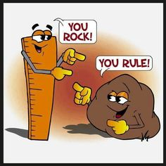
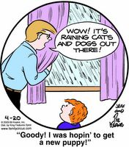
figurative language
RL.5.4, L.5.5a
When words mean something other than their literal meaning
5

Slide 33
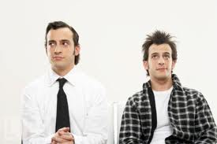
formal English
SL.4.6, L.4.3c
SL.5.6
Used in “serious” texts and situations — for example, in official documents, books, news reports, articles, business letters or official speeches.
Informal
Formal
4 -5

