Slide 1
Fourth Grade Domain Specific Words Q thru Z
Adapted from:
Vocabulary for the Common Core (Marzano, 2013)
https://kids.wordsmyth.net/we/
http://www.wordcentral.com/
http://dictionary.reverso.net/english-cobuild/
www.google.com
https://images.google.com/
Vocabulary Team:
Jenny Felts, Susan Hensley, Andrea Hixon, Susan Huntington, Karla Magarin,
Karen Maloney, Renee Simpson

Slide 2
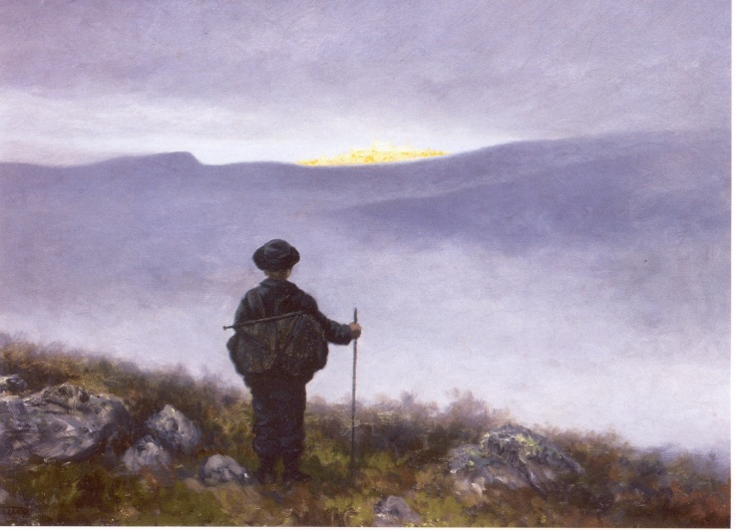
quest
RL.4.9
A long and difficult search for something
4-5

Slide 3
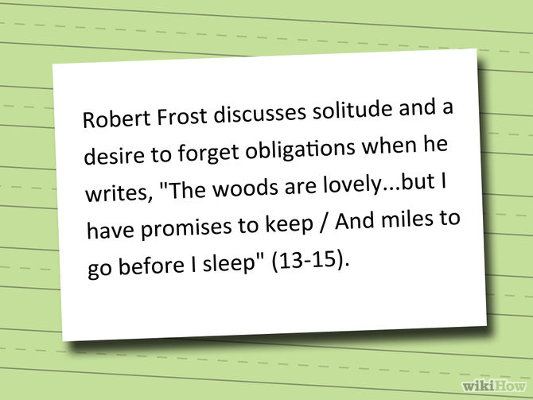
W.4.2b, L.4.2b
W.5.2b
quotation
Sentence or phrase
taken from a book,
poem, speech, or
play, which is
repeated by
someone else
4-5

Slide 4
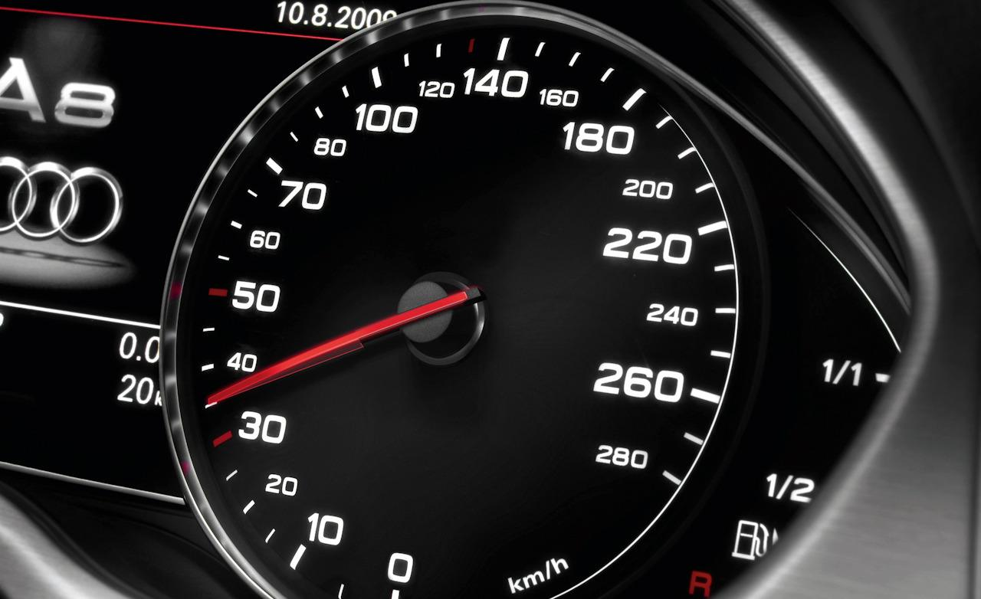
rate
RF.4.4b
RF.5.4b
The speed at which something happens
4-5

Slide 5
reason
RI.2.8, W.2.1
RI.4.8, W.4.1, W.4.1c, SL.4.3
A fact that explains why something happens or what causes it to happen
2-4

Slide 6
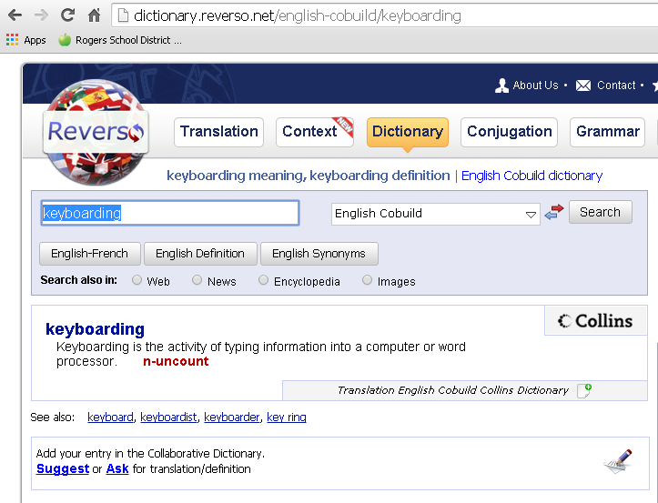
L.3.2g
reference
A source of information. The dictionary is an excellent reference for writers.
3-4

Slide 7
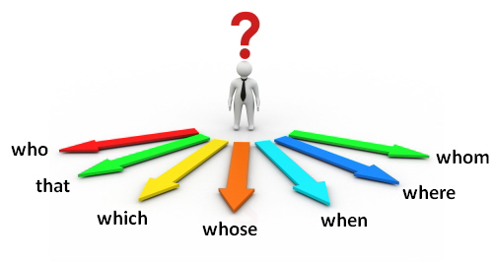
L.4.1a
relative pronoun
connects a clause or phrase to a noun or pronoun
4-5

Slide 8
SL.3.1c
remark
A comment or short statement
I think
that’s
great!
3-4

Slide 9
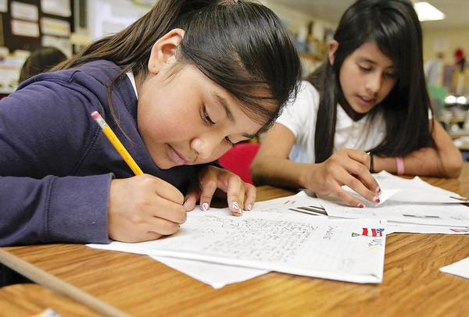
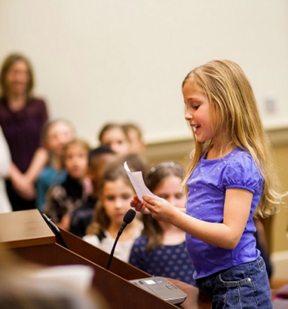
report
W.2.7
Written information to present to others
2

Slide 10
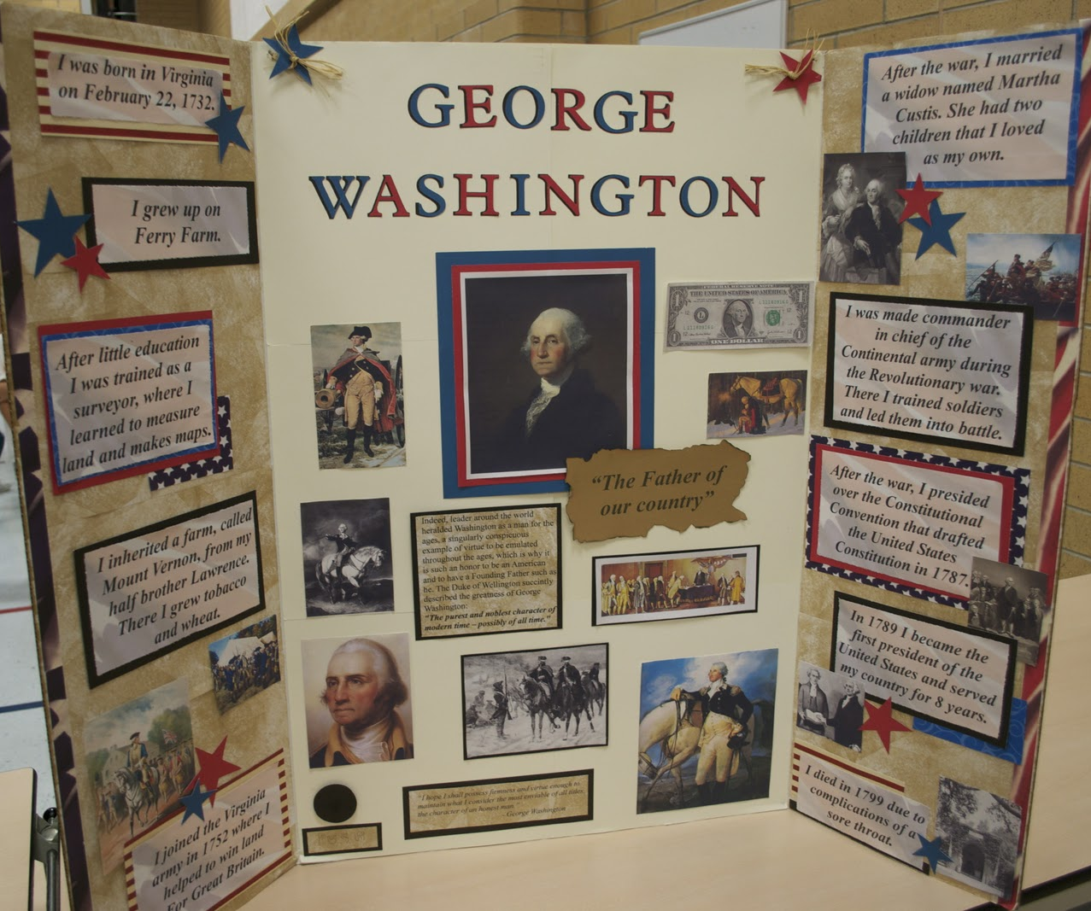
W.3.7
research project
Careful study of someone or something in order to find out information about it
3-4

Slide 11
W.3.3b
response
A written or spoken answer; reply
How are you?
I am great!
3-4

Slide 12
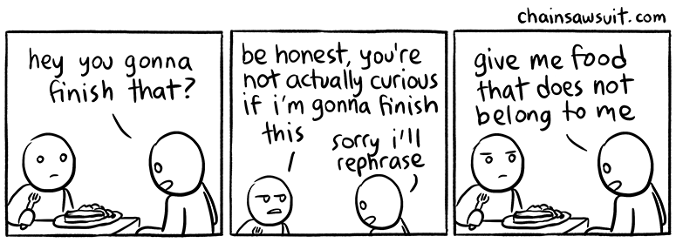
restatement
L.4.4a
To repeat what has been said, usually in a slightly different form
4-5

Slide 13
reveal
Unit 1
To make known
I think
that’s
great!
4

Slide 14
SL.4.1d
SL.5.1d
review
Consider carefully to see that what was presented, either orally or written, was understood
4-5

Slide 15
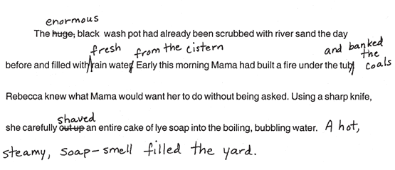
W.2.5
W.3.5
W.4.5
revise
Make changes to improve your writing
2-4

Slide 16
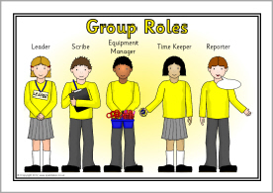
role
SL.4.1b
SL.5.1b
A particular position and function; a job to complete
4-5

Slide 17
root
L.3.4c
A root is the basis of a new word, but it does not typically form a stand-alone word on its own. Example: sciss in scissors; sciss means cut
3-4

Slide 18
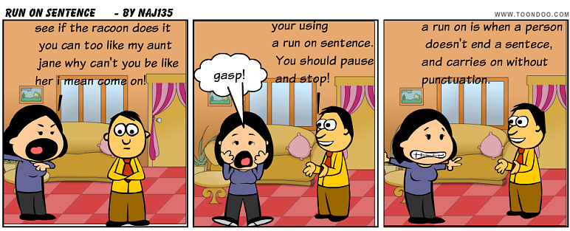
run-on sentence
L.4.1f
When two or more independent clauses (complete sentences) are joined without appropriate punctuation or conjunction
4

Slide 19
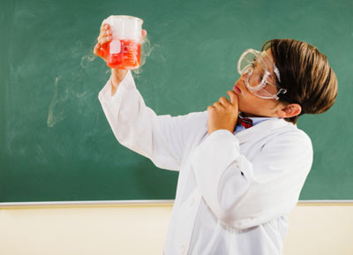
Scientific concept/idea
RI.3.3
An idea or thought having to do with science
3-4

Slide 20
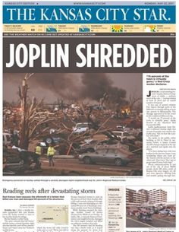
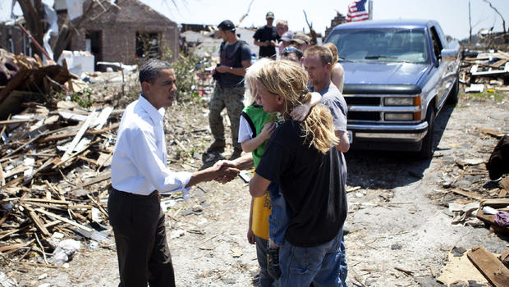
secondhand account
RI.4.6
A secondhand account of an event or topic is based on an author’s research, rather than personal experience.
President Obama hears a firsthand account of the Joplin tornado.
A reporter wrote a secondhand account of the Joplin tornado.
4

Slide 21
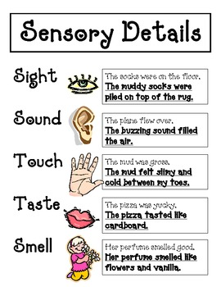
sensory detail
W.4.3d
W.5.3d
Words and/or phrases
that connect the reader
to the writer by drawing
attention to the five
senses-sight, sound,
touch, smell, and taste
4-5

Slide 22
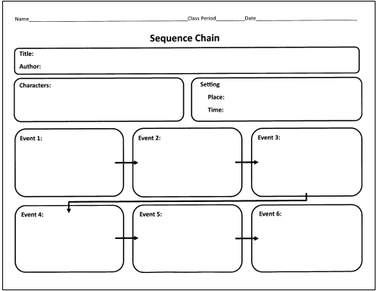
sequence
RL.3.3
RI.3.3
RI.3.8
A pattern or process in which items/events occur one after the other
3-4

Slide 23
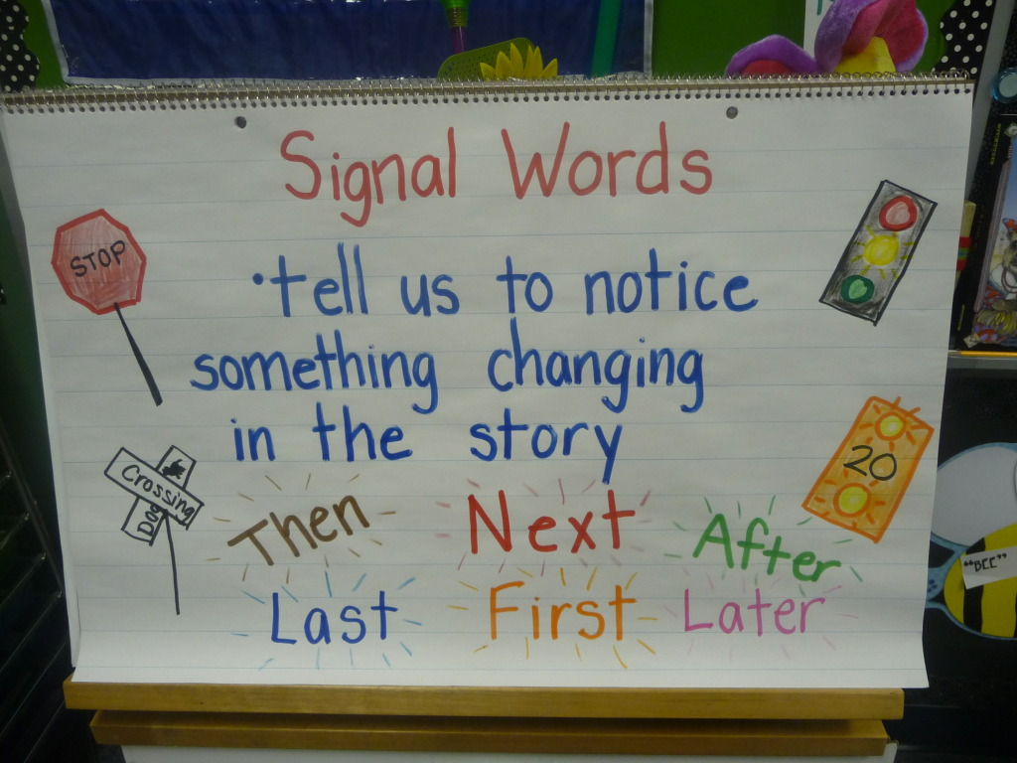
signal word
W.3.3.c, L.3.6
L.4.6
L.5.6
Transition words writers use to direct readers
3-5

Slide 24
simile
L.4.5a
L.5.5a, RL.5.4
Expression which describes a person or thing as being similar to someone or something else using the words “like” or “as’
4-5

Slide 25
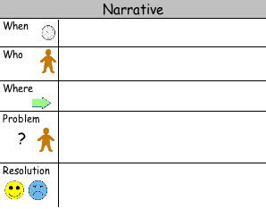
situation
W.3.3a
W.3.3b
SL.3.6
What is happening in a particular place at a
particular time
3-4

Slide 26
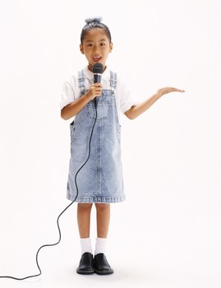
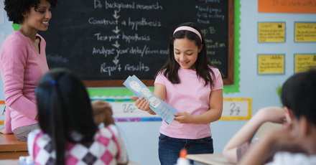
speaker
SL.2.3
SL.3.3
SL.4.3
A person who is talking
2-4

Slide 27
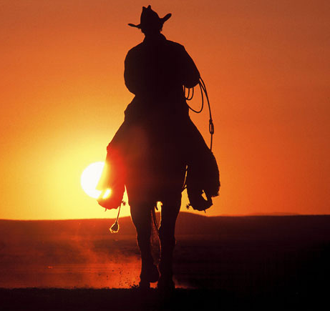
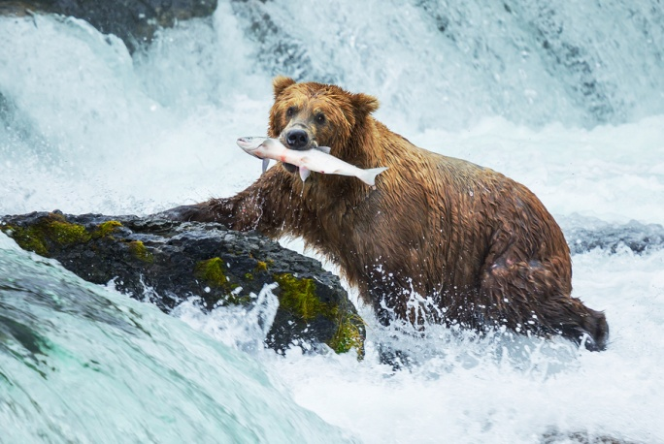
statement
W.2.1, W.2.2
W.3.1d, W.3.2d
W.4.1d, W.4.2d
Something you say or write that gives information
The cowboy rode
off into the sunset.
The bear caught
a fish.
2-4

Slide 28
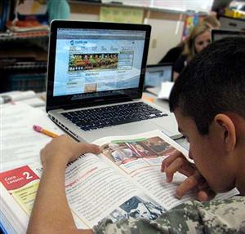
SL.3.1a
study
Research on a
subject or author
3-4

Slide 29
subject
RI.4.9
RI.5.9
The topic of what is said, written, or studied
hurricanes
tornadoes
earthquakes
4-5

Slide 30
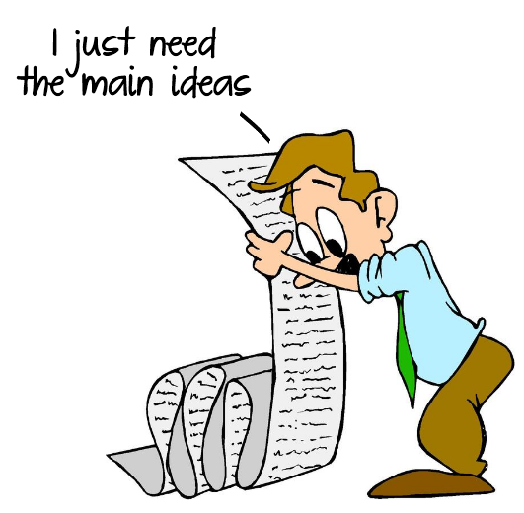
summarize
RL.4.2, RI.4.2
RL.5.2, RI.5.2, W.5.8, SL.5.2, SL.5.3
To tell in your own words what happened in the story
4-5

Slide 31
support
To provide proof or evidence
RI.3.2
W.3.1
W.3.1b
3-4

Slide 32
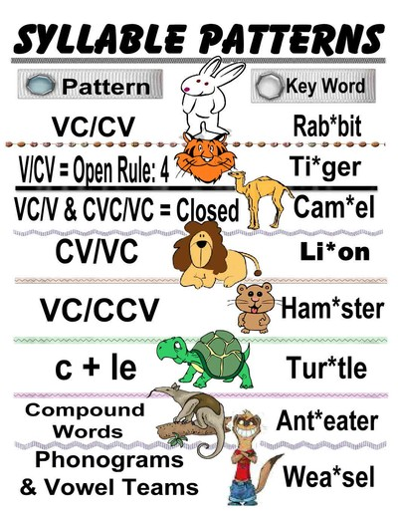
L.3.2f
RF.4.3a
RF.5.3a
syllabication pattern
Rules for dividing words into syllables
3-5

Slide 33
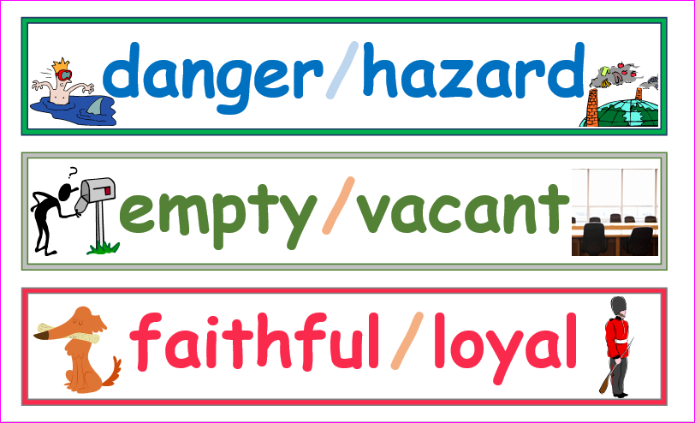
synonym
L.4.5c
L.5.5c
A word or expression which means the same as another word or expression
4-5

Slide 34
tale
An account of a real or made up event
A lie
Unit 1
4

Slide 35
task
W.3.4
SL.3.6
Work or an assignment that needs to get done
3-4

Slide 36
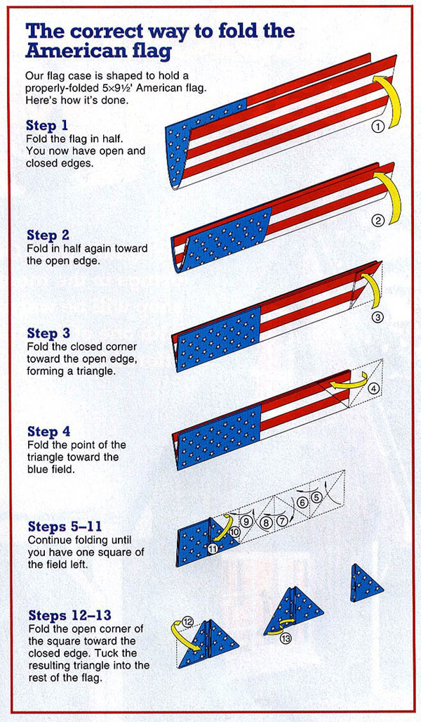
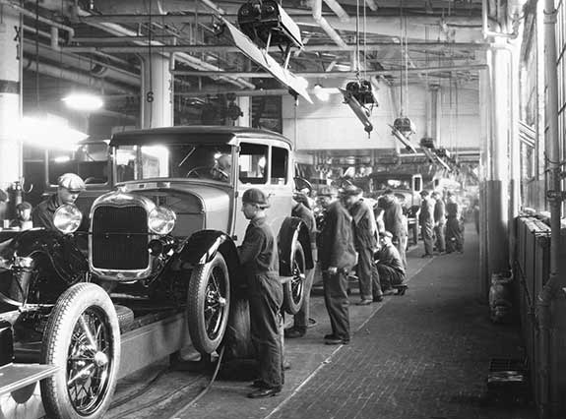
technical procedure
Special skills or steps that must be taken in order to complete something
RI.3.3
3-4

Slide 37
theme
RL.3.9
What the story teaches readers
about life or human nature
3-4

Slide 38
third person
RL.4.6
when the story is told from the point of view of someone NOT in the story
4-5

Slide 39
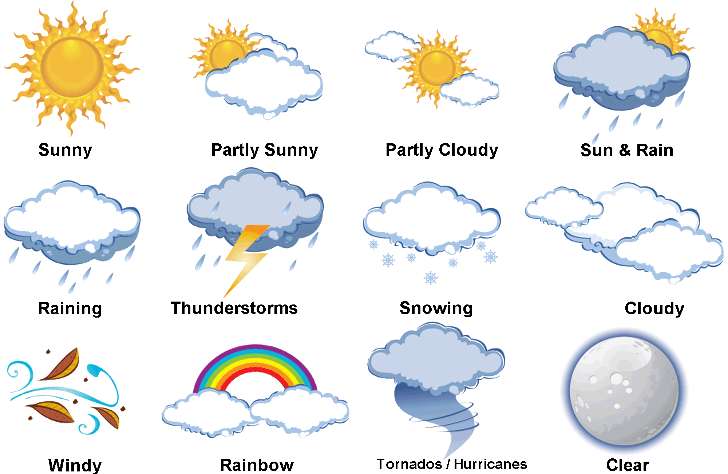
weather
The conditions outside at a particular place and time
Unit 2
4

