Slide 1
Fourth Grade Domain Specific Words G thru P
Adapted from:
Vocabulary for the Common Core (Marzano, 2013)
https://kids.wordsmyth.net/we/
http://www.wordcentral.com/
http://dictionary.reverso.net/english-cobuild/
www.google.com
https://images.google.com/
Vocabulary Team:
Jenny Felts, Susan Hensley, Andrea Hixon, Susan Huntington, Karla Magarin,
Karen Maloney, Renee Simpson

Slide 2
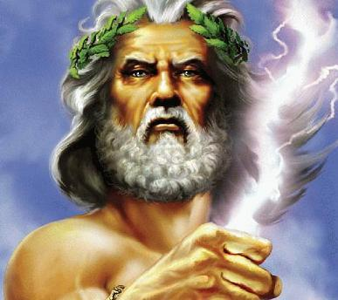
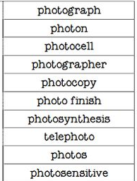
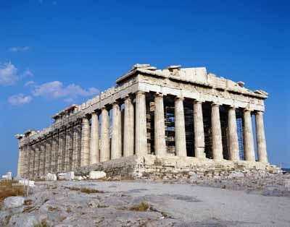
Greek
L.4.4b
L.5.4b
Coming from the language, people, or culture of ancient Greece, or any of the languages that later evolved from it
Words containing Greek roots
4 -5

Slide 3
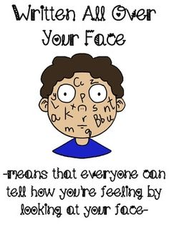
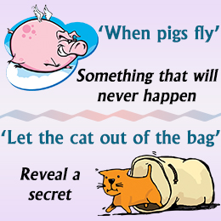
idiom
L.4.4b
L.5.4b
Group of words that have a different meaning when used together from the one they would have if you took the meaning of each word separately
4 -5

Slide 4
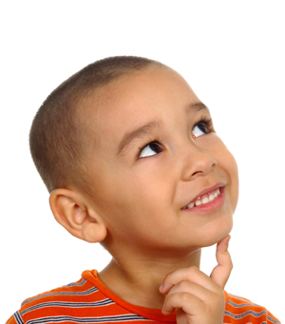
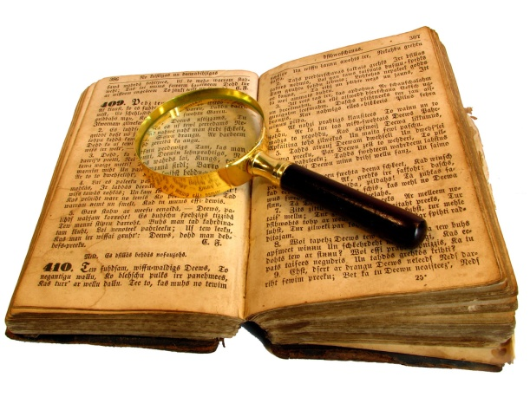
inference
RL.4.1, RI.4.1
RL.5.1, RI.5.1
Making a conclusion about something by using information that you already have about it
I
+
=
Background
knowledge
(what I know)
Text clues
(what I read)
Inference
4 -5

Slide 5
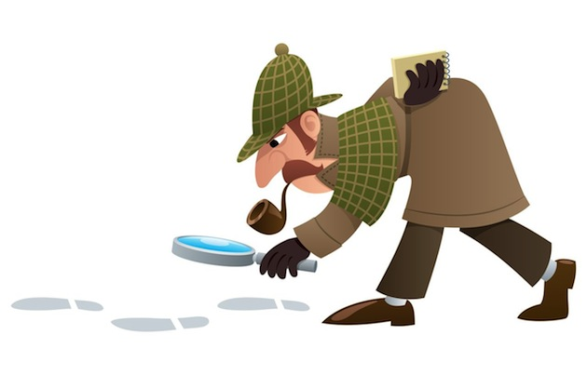
investigation
W.4.7
W.5.7
Investigate means to develop facts to try to find out what happened or what is the truth.
Investigation is the
act of investigating.
4 -5

Slide 6
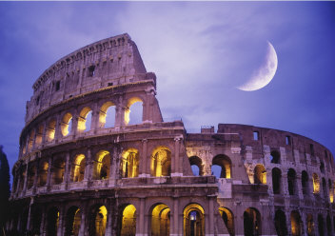
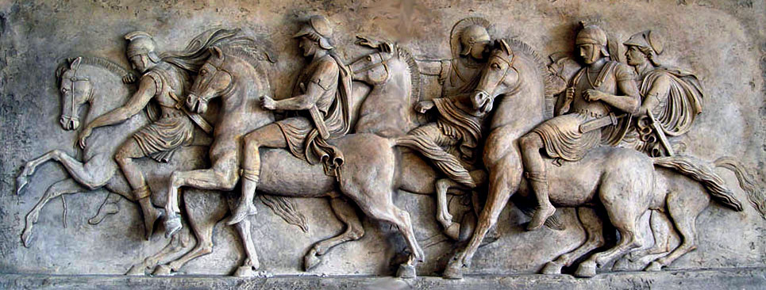
Latin
L.4.4b
L.5.4b
Coming from the language, people, or culture of ancient Rome
4 -5

Slide 7
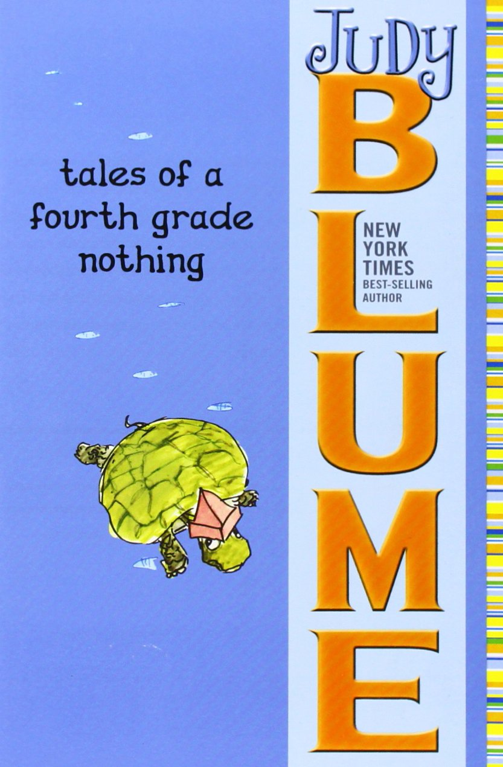
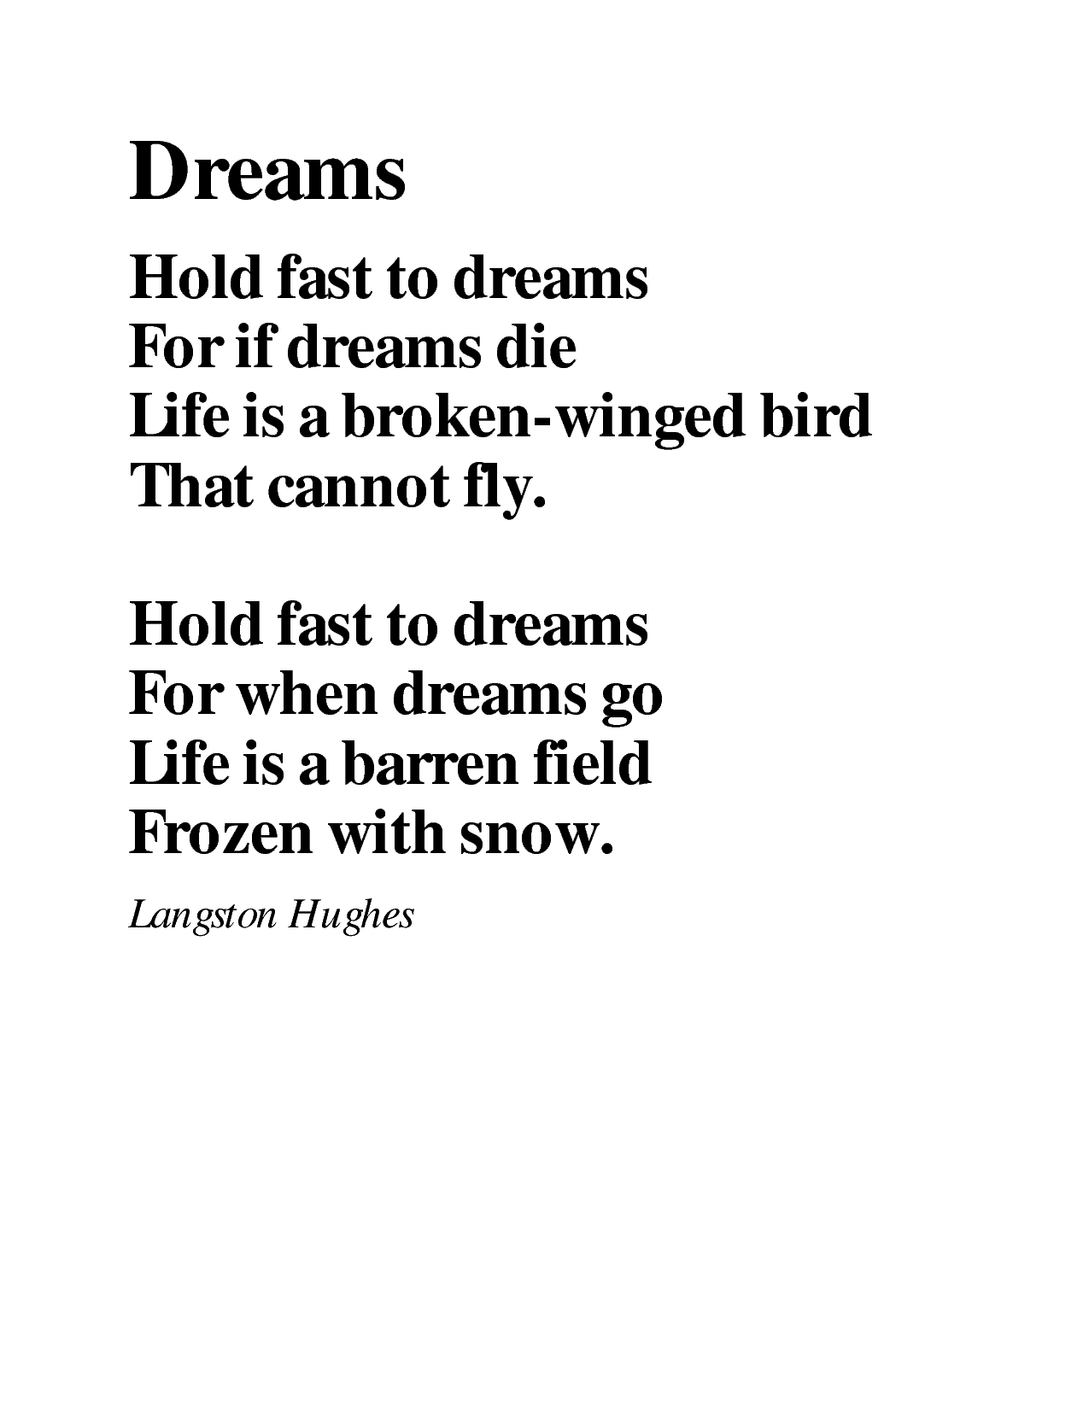
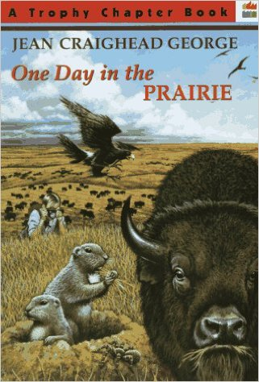
literature
Unit 2
Stories, poems, plays and essays
4

Slide 8
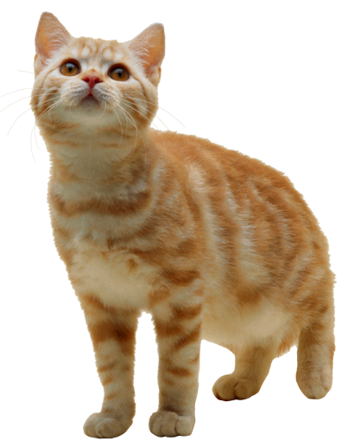
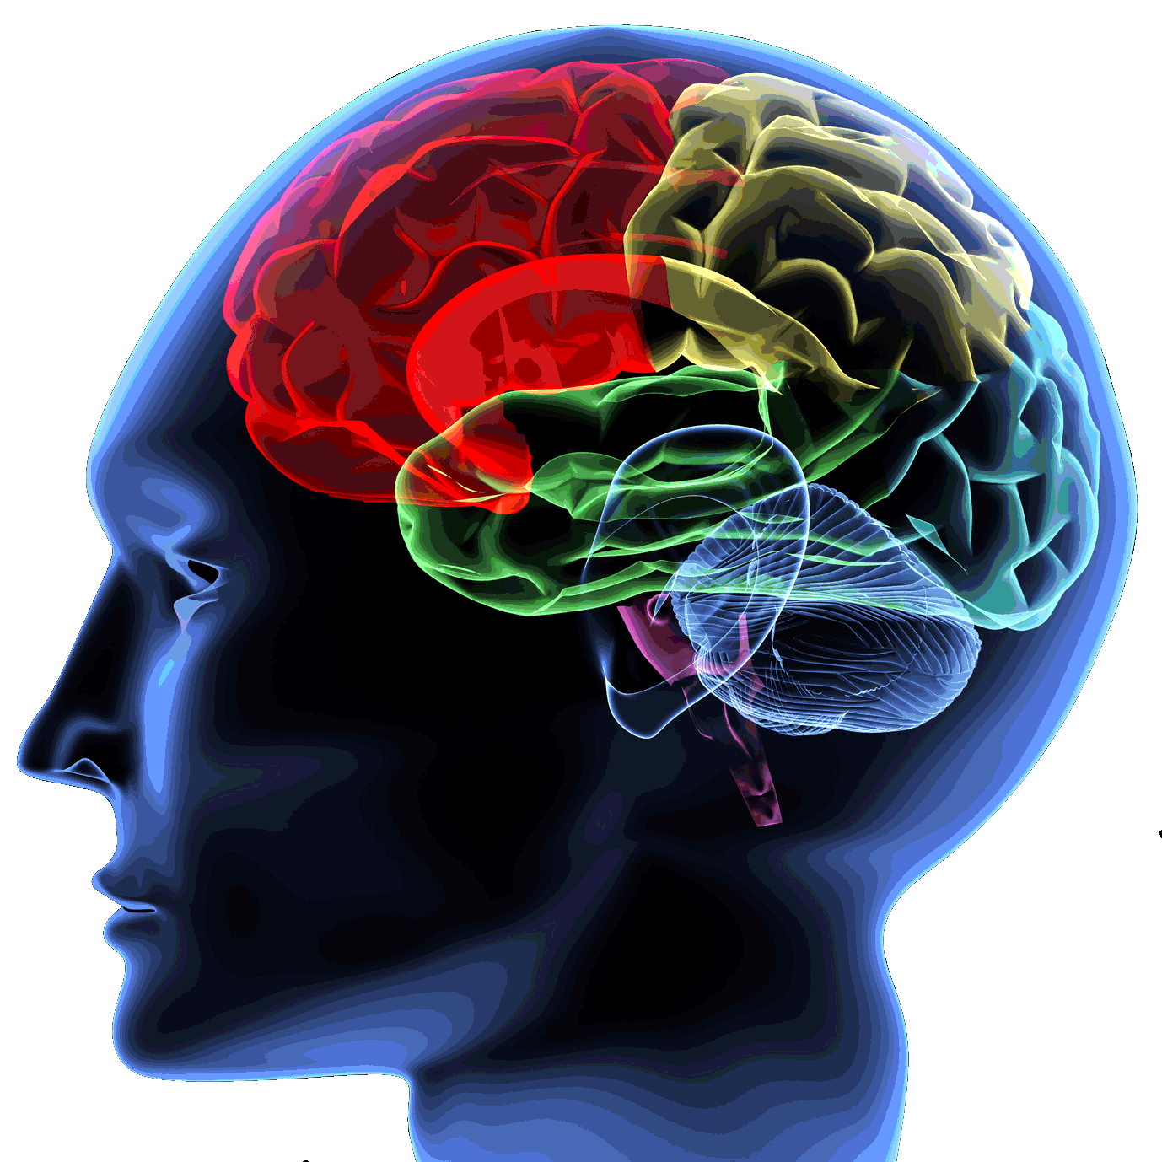
meaning
The thing or idea that
words represent
cat
RL.2.4
RL.3.4
RL.4.4
2-4

Slide 9
L.4.5a
L.5.4a, RL.5.4
metaphor
imaginative way of describing by referring one thing to something else which is the same in a particular way
4 -5

Slide 10
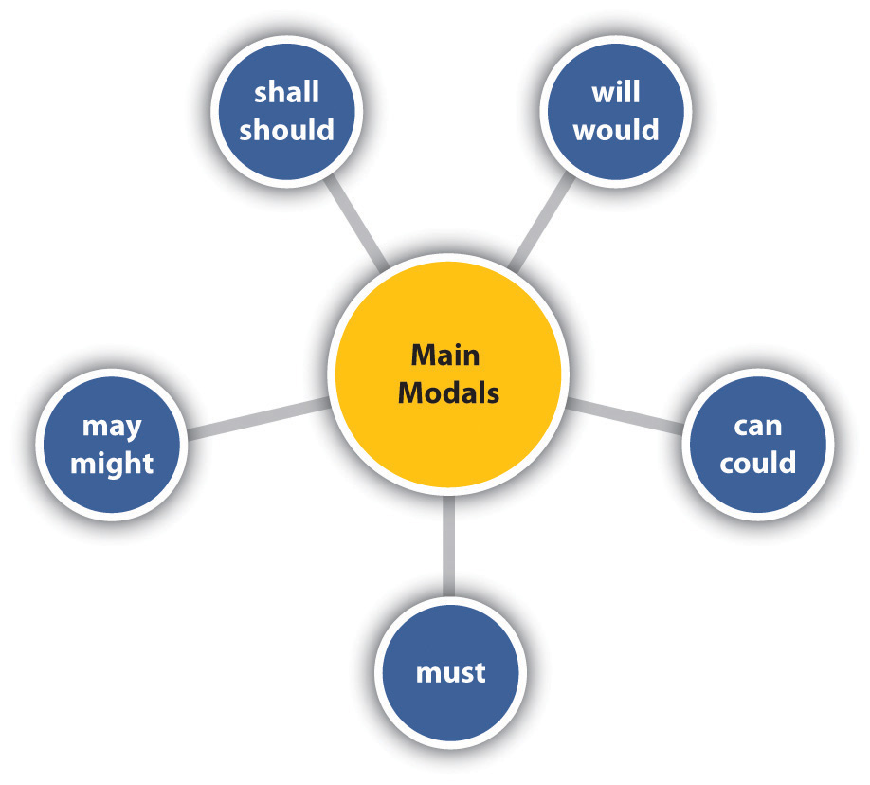
modal auxiliary
L.4.1c
used in conjunction with main verbs to express shades of time and mood; also called helping verbs
4

Slide 11
W.4.2a
W.5.2a, RL.5.7
multimedia
Computer programs and
Products which involve sound,
pictures, and film, as well as text
4

Slide 12
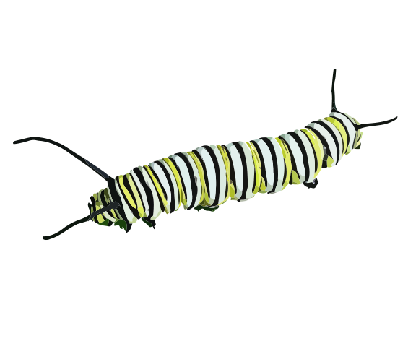
multisyllabic
RF.3.3c
RF.4.3a
RF.5.3a
Having more than one syllable, or break, in a word. The breaks involve a single vowel sound with or without surrounding consonants.
cat/er/pill/ar
bas/ket/ball
3-5

Slide 13
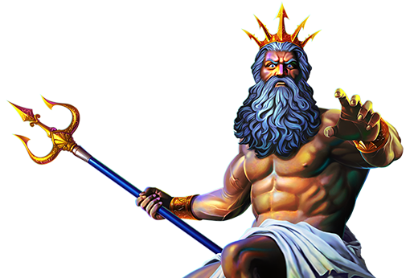
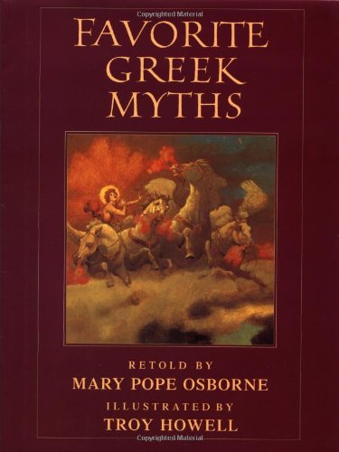
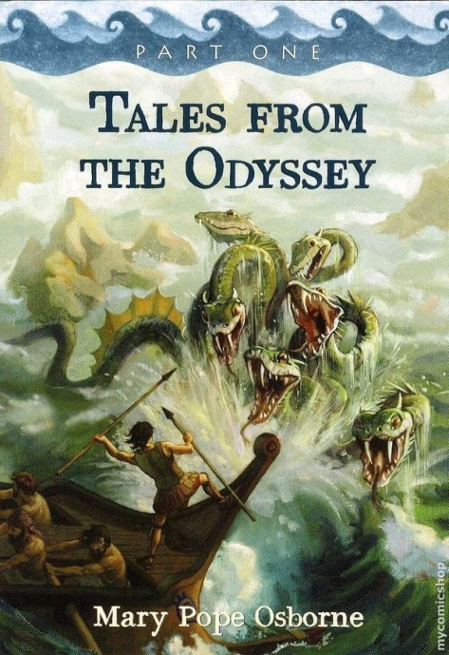
myth
RL.3.2
RL.4.9
RL.5.7
A story using imaginative plots and characters to explain how the world began and why nature and people behave the way they do
3-5

Slide 14
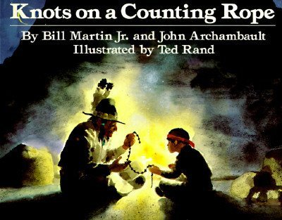
narrative
W.3.3
W.4.3
W.5.3
A story or tale involving a description of events; an account of events from the beginning, middle, and end
3-5

Slide 15
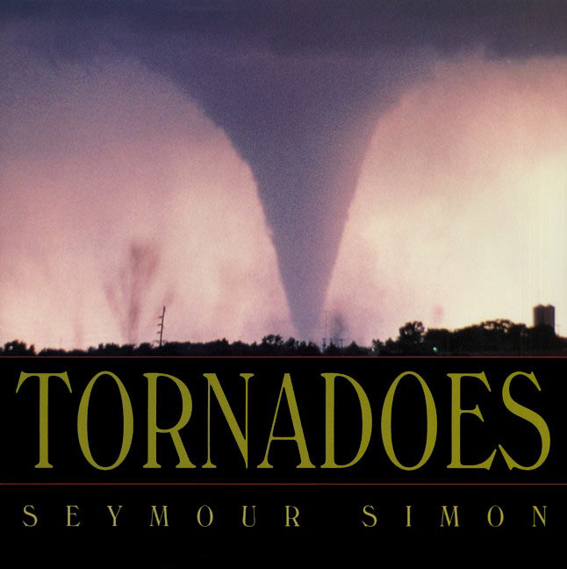
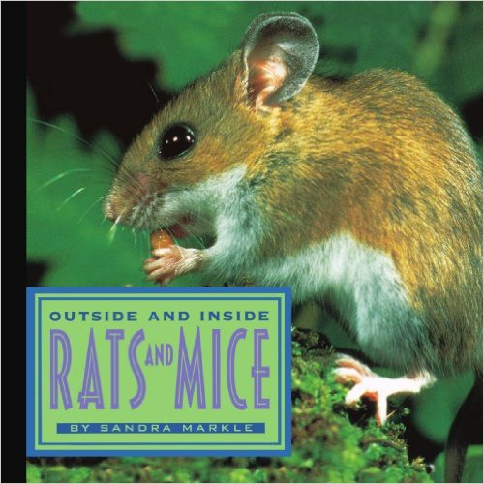
Unit 3
non-fiction
Writing that gives information and describes real events, rather than telling a story
4

Slide 16
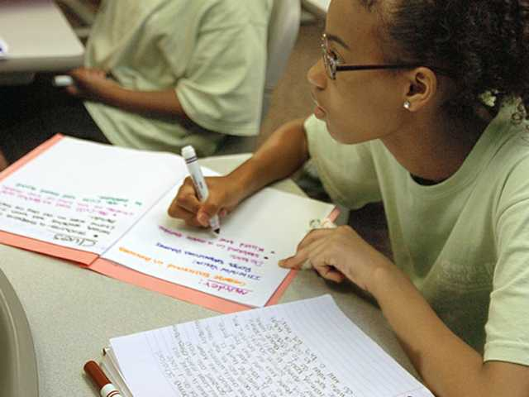
W.3.8
W.4.8
RI.5.6, W.5.8
notes
words written down to help you remember something you have learned or something you need to do
3-5

Slide 17
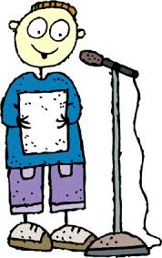
RL.4.7
oral presentation
Reading or presenting to a
class or audience
4

Slide 18
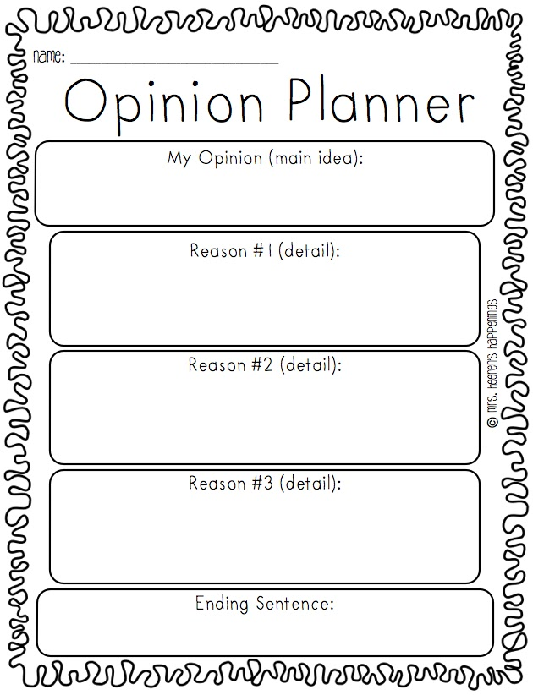
W.3.4
W.4.4
W.5.4
organization
The structural framework for writing
3-5

Slide 19
origins
Unit 5
The beginning of something, the cause of something or the source of something
4

Slide 20
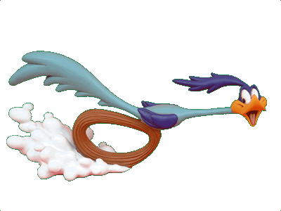
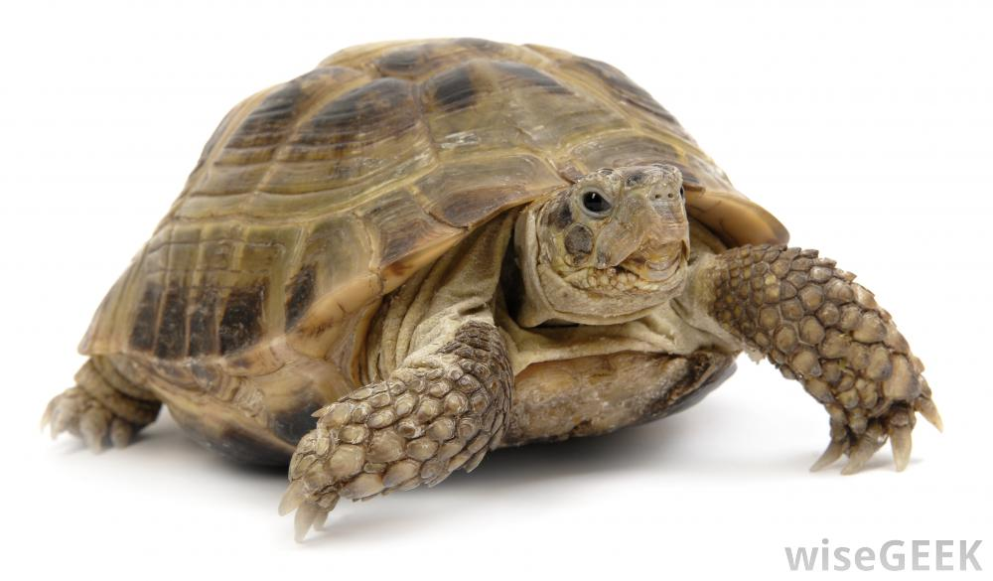
pace
SL.3.4
SL.3.5
Rate or speed of something
Fast!
Slow
3-4

Slide 21
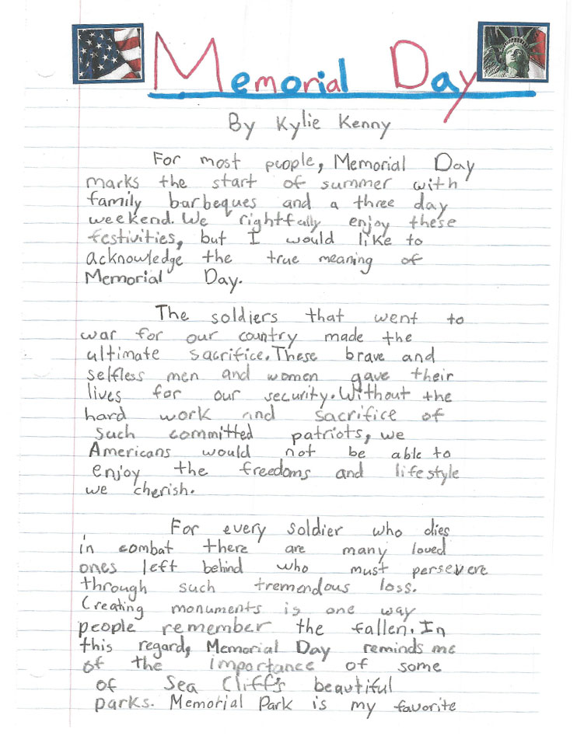
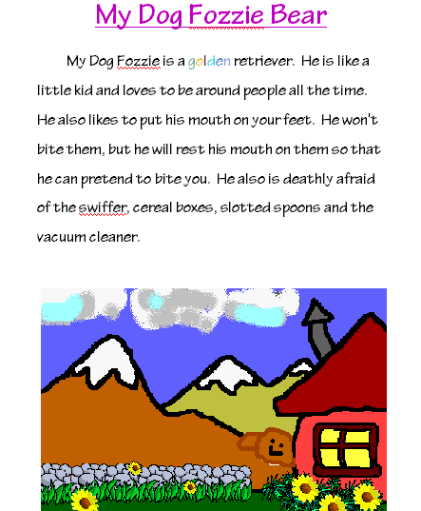
paragraph
RI.2.2
RI.3.8
W.4.2a
A collection of sentences
about one main topic
2-4

Slide 22
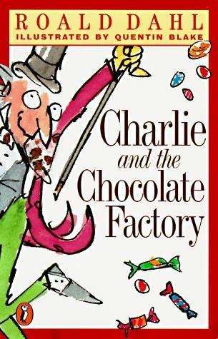
SL.4.2
W.5.8
paraphrase
To say or write what someone else has
said or written in a different way
Original text
“Willy Wonka was famous for his delicious candy. Children and adults loved to eat it.”
Paraphrase
“Willy Wonka was known throughout the world because people enjoyed eating the tasty candy he made.
4

Slide 23
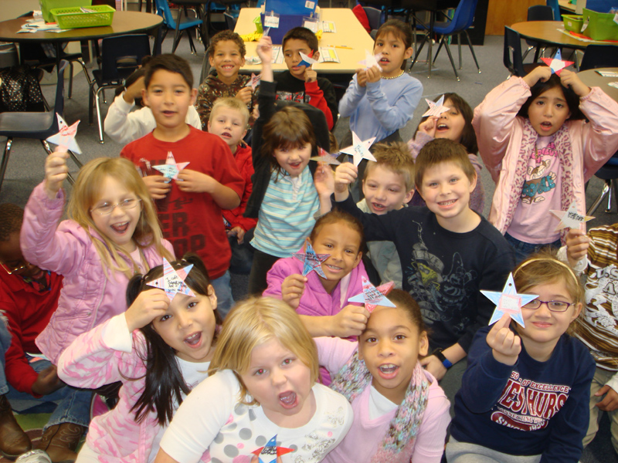
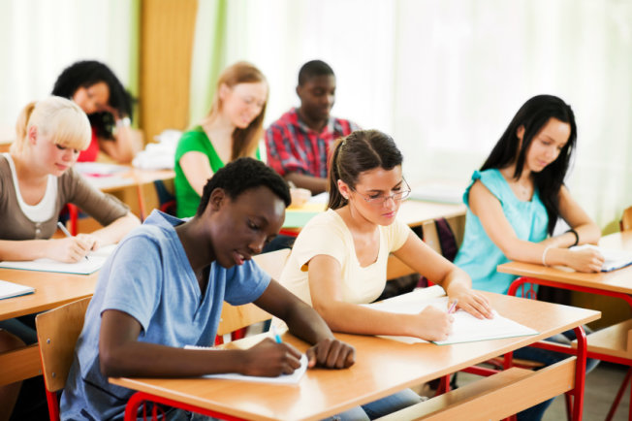
peer
W.2.6, SL.2.1
A classmate, or someone who is the same age as you
Second grade peers
high school peers
2

Slide 24
phrase
RI.3.4, RL.3.4
W.3.1c,
L.3.3a, L.3.4a, L.3.4d,, L.3.5a, L.3.6
A part of a sentence that has meaning but does not have both a subject and a verb
Bert wants to see
the horror movie again.
3-4

Slide 25
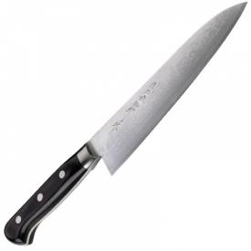
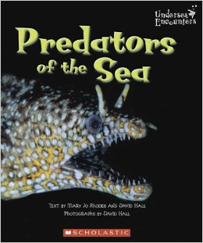
point
RI.3.9
The sharp end of something
The meaning or purpose
of something someone
has said or written
“Most animals
in the sea are
predators.”
3-4

Slide 26
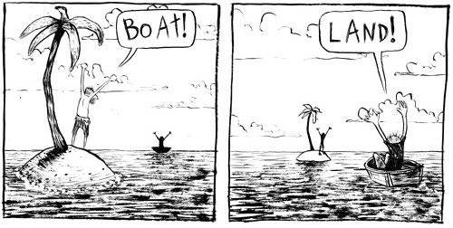
point of view
RL.3.6
RI.3.6
W.3.1
A way of looking at or thinking about something
3-4

Slide 27
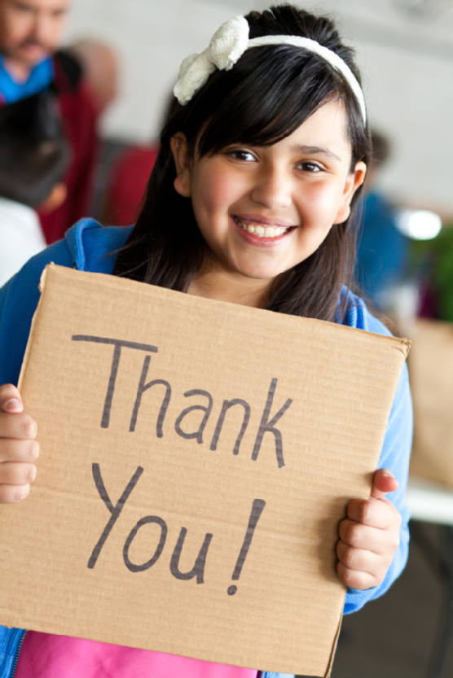
precise
L.3.4d
Clearly stated or communicated;
accurate
3-4

Slide 28
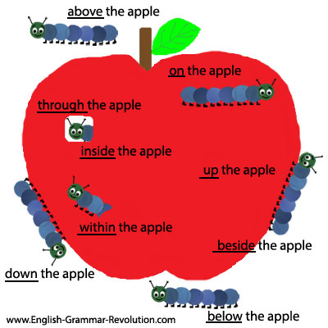
prepositional phrase
L.4.1e
A series of words that
tell more about a noun,
verb, or adjective
Prepositional phrases
are made up of a
preposition and its
object.
4

Slide 29
presentations
SL.4.5
SL.5.5
Formal talks, usually done orally
4

Slide 30
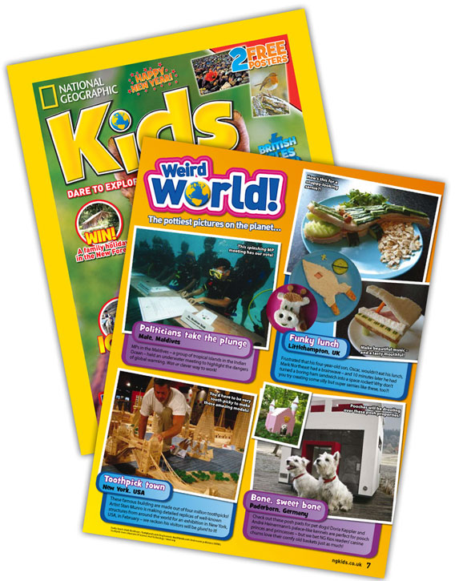
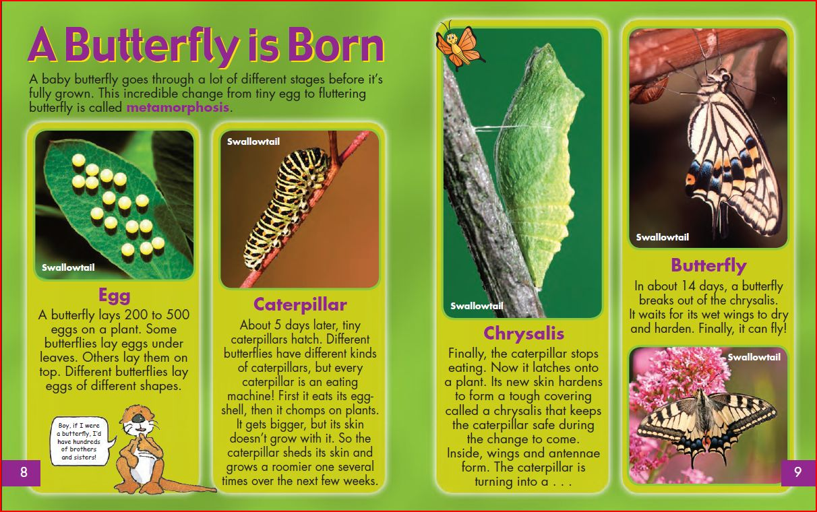
print source
Information found in text
W.3.8
3-4

Slide 31
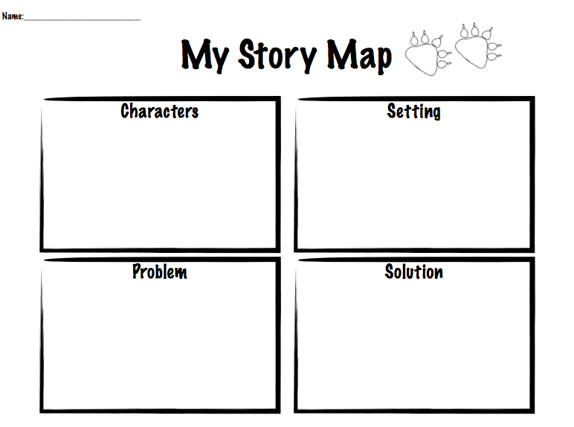
problem/solution
RI.4.5
RI.5.5
A text structure that describes a problem and solution
4-5

Slide 32
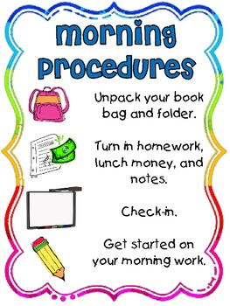
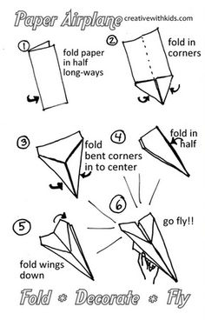
procedure
RI.4.3
A way of doing something;
a series of actions, usually
carried out in a set order, to
accomplish a particular goal
4

Slide 33
progressive verb tense
L.4.1b
Describe ongoing actions in the
present, past or future
4

Slide 34
pronunciation
L.4.4c
L.5.4c
The particular way that a word or phrase sounds when said out loud
4-5

Slide 35
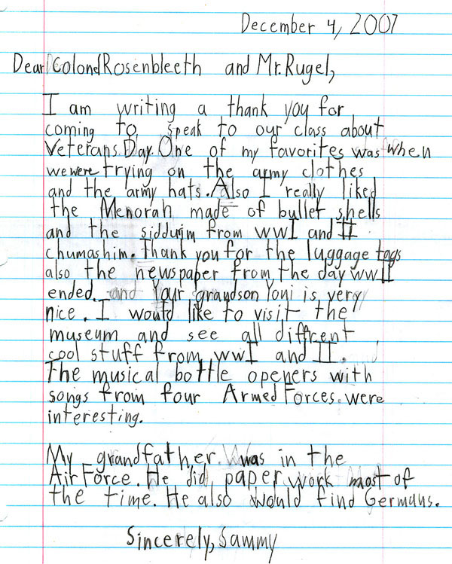
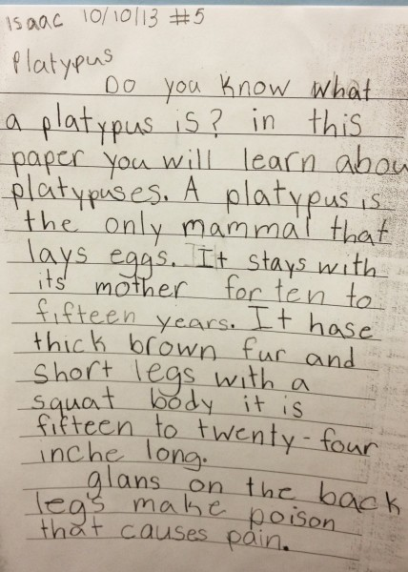
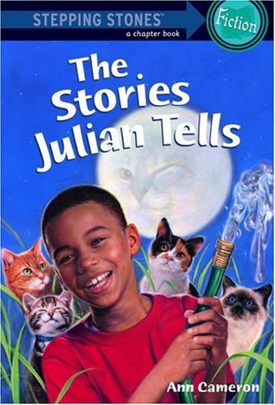
prose
RF.3.4b
Most language that is not poetry can be described as prose. Novels, short stories, essays, and letters are examples of writing done in prose.
3-4

Slide 36
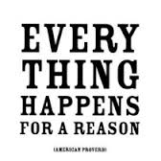
L.4.5b
L.5.5b
proverb
Short sentence that people often quote, because it gives advice or tells you something about life
4-5

