Slide 1
First Grade ELA Domain Specific Words S thru Z
Adapted from:
Vocabulary for the Common Core (Marzano, 2013)
https://kids.wordsmyth.net/we/
http://www.wordcentral.com/
http://dictionary.reverso.net/english-cobuild/
www.google.com
https://images.google.com/
Vocabulary Team:
Jenny Felts, Susan Hensley, Andrea Hixon, Susan Huntington, Karla Magarin,
Karen Maloney, Renee Simpson

Slide 2
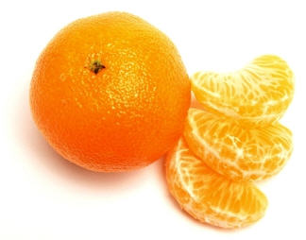
segment
RF.K.2b, RF.K.2c
RF.1.2d
Separate or break something into parts
K-1

Slide 3
self-correct
RF.1.4c
RF.2.4c
Fixing a mistake while you are reading without getting help from anyone else
1-2

Slide 4
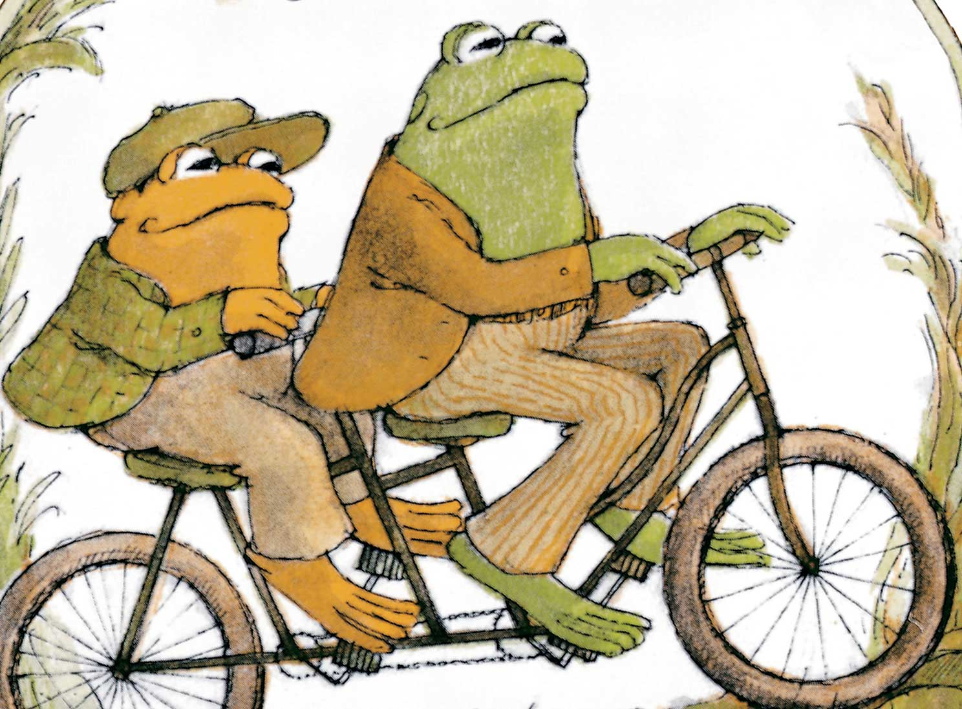
sentence
L.K.2a
RF.1.1a, L.1.1c, L.1.2b
SL.2.5
A set of words that expresses a complete thought
I see a bike.
K-2

Slide 5
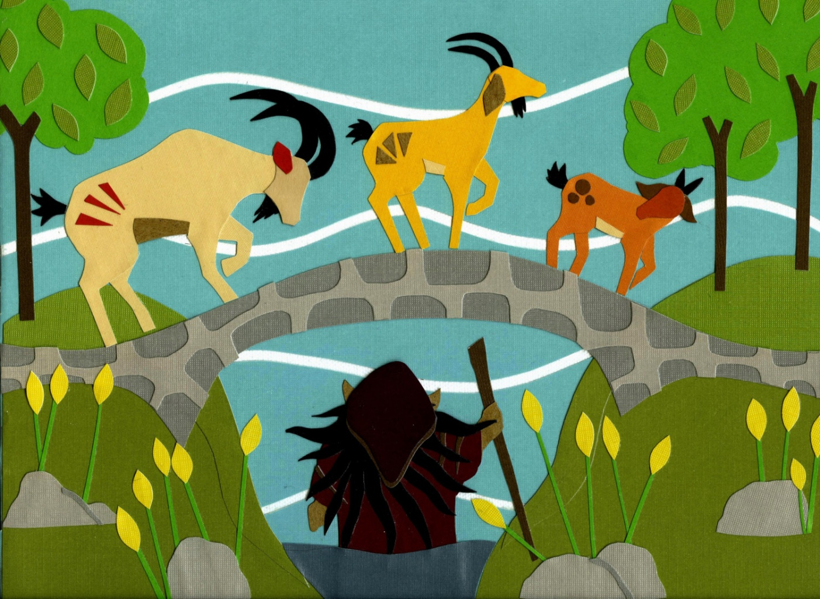
setting
RL.K.2
RL.1.2
RL.2.7
RL.3.7, RL.3.9
The place where something happens
K- 3

Slide 6
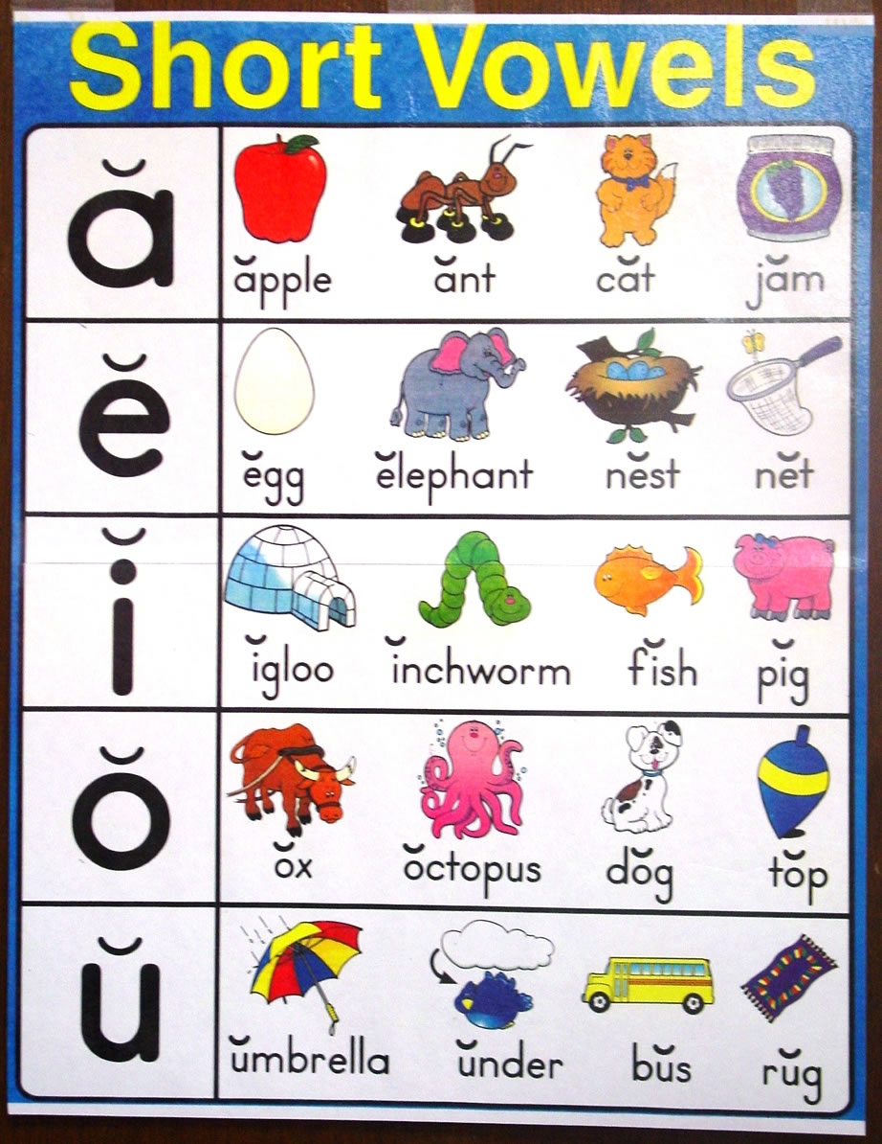
short vowel
RF.K.3b
RF..1.2a
RF.2.3a
A vowel sound that does not sound like the letter name
K-2

Slide 7
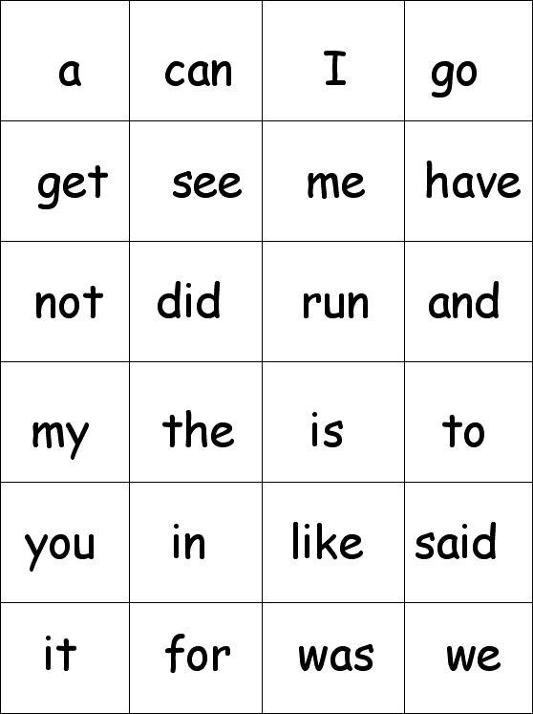
sight word
Commonly used words that children recognize by sight
K-1

Slide 8
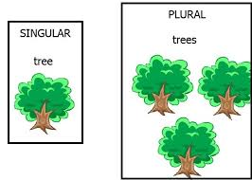
singular
L.1.1c
A word used that means only one of something
1

Slide 9
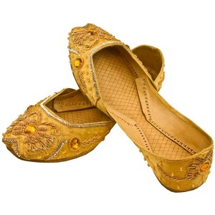
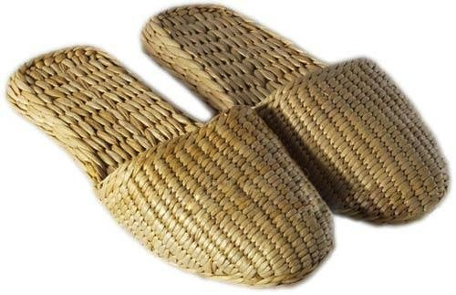
slipper
1st Grade Unit 6
A light shoe that is easy to put on and take off
1

Slide 10
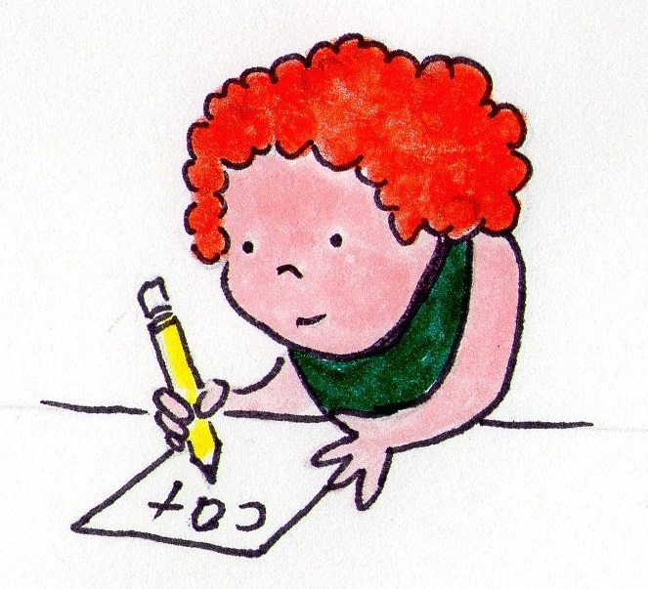
spell
RF.1.3b, RF.1.3g
L.1.2, L.1.2e
To name or write the letters of a word in correct order, as in “c-a-t” spells “cat”
1

Slide 11
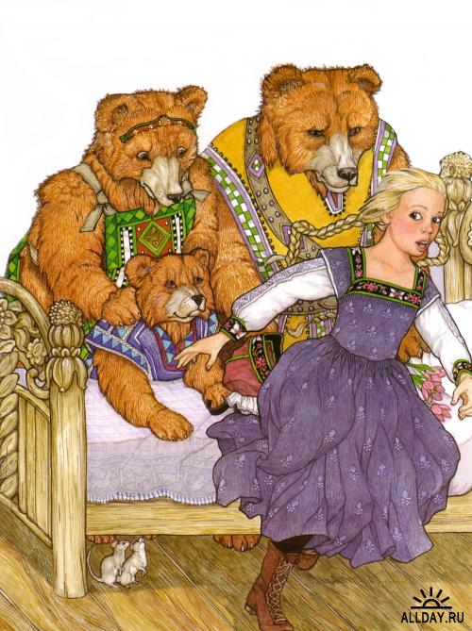
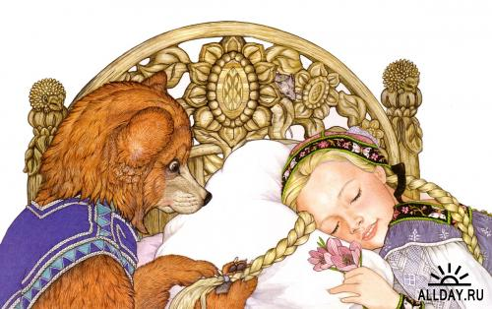
story
L.K.2, RL.K.6, RL.K.7, RL.K.9
RL.1.2, RL.1.4, RL.1.5, RL.1.6, RL.1.7, RL.1.9
RL.2.2, RL.2.4, RL.2.5, RL.2.9, RI.2.10, SL.2.4,Sl>2.5
A story is a description of an event or something that happened to someone
K-2

Slide 12
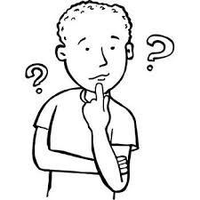
suggestion
W.K.5
W.1.5
If you make a suggestion, you put forward an idea or plan for someone to think about
K-1

Slide 13
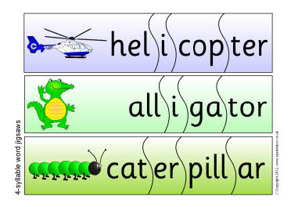
RF.K.2b, RF.K.2c, RF.K.2e
RF.1.2a, RF.1.2b, RF.1.2c, RF.1.2d, RF.1.3b, RF.1.3d, RF.1.3e
RF.2.3a, RF.2.3c
syllable
A syllable is a part of a word that contains one vowel sound and that is pronounced as a unit
K-2

Slide 14
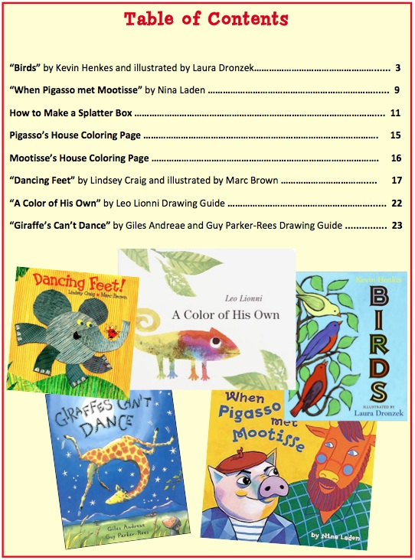
table of contents
RI.1.5
A list of chapters or sections
of a book with the pages
each one starts on
1

Slide 15
talk
SL.1.b
SL.2.b
When you talk, you use spoken language to express your thoughts, ideas, or feelings
K-2

Slide 16
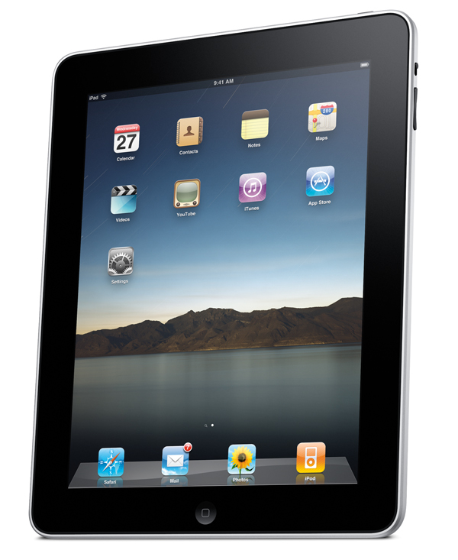
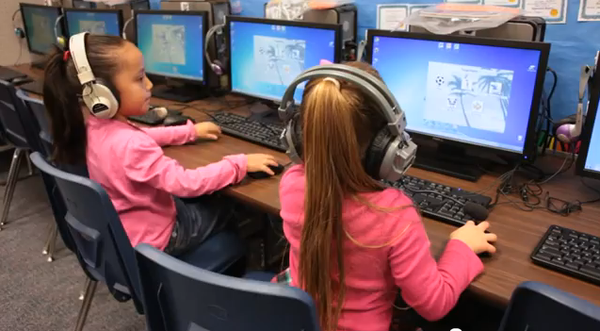
technology
Systems and devices that have been created with scientific knowledge to help us
K-2

Slide 17
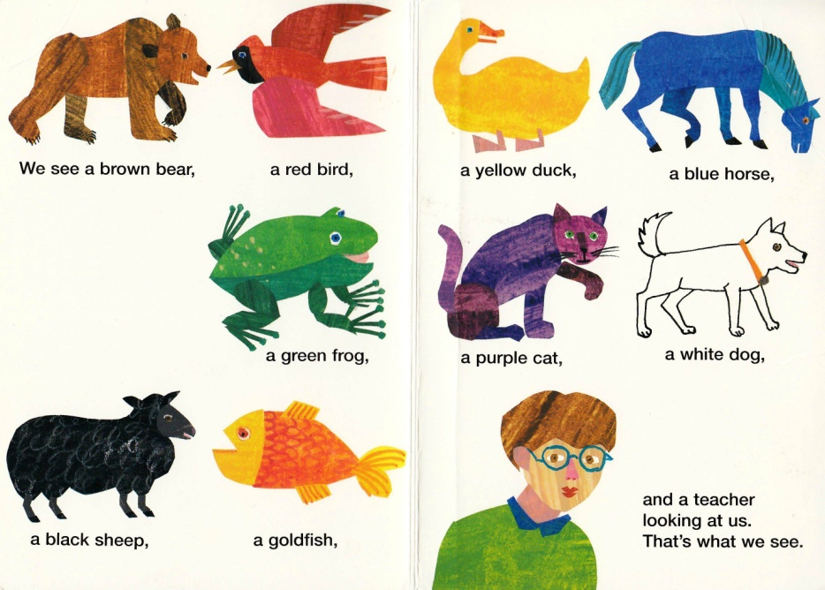
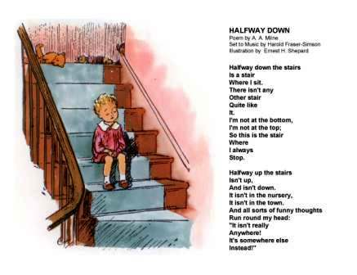
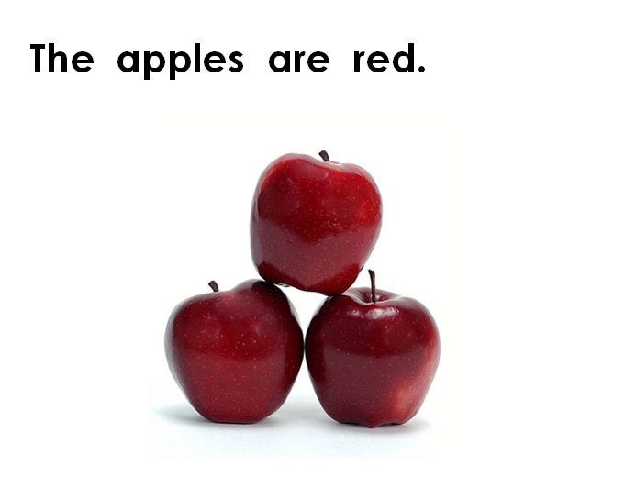
text
RL.K.1,4,5, RI.K.1,2,3,4,6,7,8,9, SL.K.1a, L.K.6
RL.1.1,5,6, RI.1,2,3,4,5,6,7,8,9, RF.1.4a, RF.1.4b, SL.1.1a, SL.1.1c, L.1.6
RL.2.1,7,RI.2.1,2,3,4,5,6,7,8,9, RF.2.4a, RF.2.4b, SL.2.1a, SL.21c, L.2.6
Any written material
K-2

Slide 18
text feature
RI.1.5
RI.2.5
Parts of a book or article that help the reader find information or understand the text. Text features can include headings, index, and photographs.
1-2

Slide 19
1st Grade Unit 1
thoughts
Ideas that result from thinking
1

Slide 20
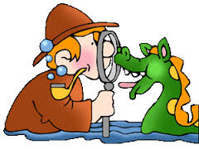
topic
RI.1.9, SL.1.1a, SL.1.1c, W.1.1, W.1.7
RI.2.9, SL.2.1a, SL.2.1c, SL.2.3, W.2.1, W.2.2, W.2.5, W.2.7
RI.3.4, RI.3.5, RI.3.9, SL.3.1a, SL.3.1b, SL.3.1c, SL.3.4, W.3.1a, W.3.2a, W.3.2b, W.3.7
The subject a writer is telling about.
The idea or thing an informational book is about.
1-3

Slide 21
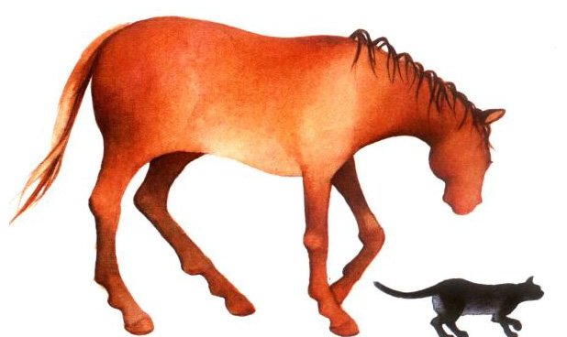
verb
LK.1b, L.K.5b, L.K.5d
L.1.1e, L.1.5d
L.2.5b
A word that tells about an action
I went walking.
K-2

Slide 22
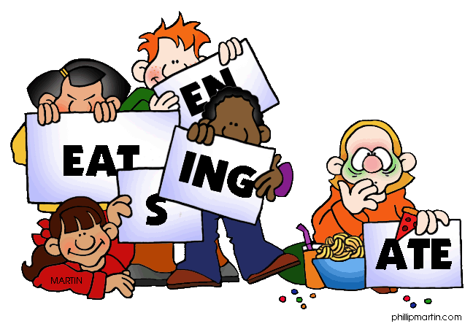
verb tenses
1st Grade Unit 1
The form of verbs that show when an action takes place – past, present, future
I will eat the apple.
I am eating the apple.
I ate the apple.
I have eaten the apple.
1-3

Slide 23
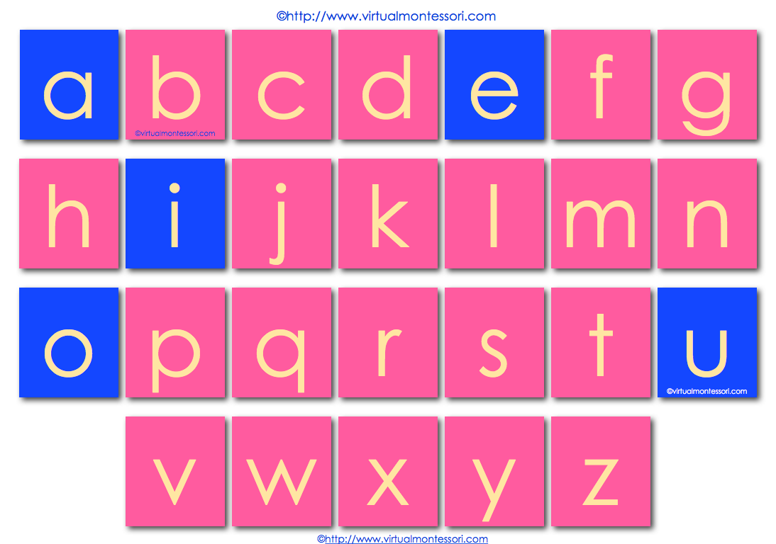
vowel
RF.K.3b, RF.K.2d
A sound represented by a, e, i, o or u which is pronounced with your mouth open, allowing air to flow through it
K-2

Slide 24
vowel team
RF.1.3c
RF.2.3b
Two vowels together that make one sound in a word.
1-2

Slide 25
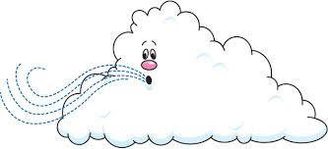
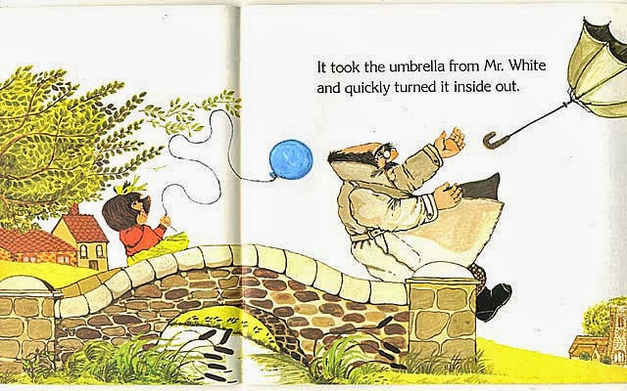
1st Grade Unit 4
wind
A movement of air
1

Slide 26
winds of change
1st Grade Unit 4
A change is on its way, whether it is for good or bad
1

