Slide 1
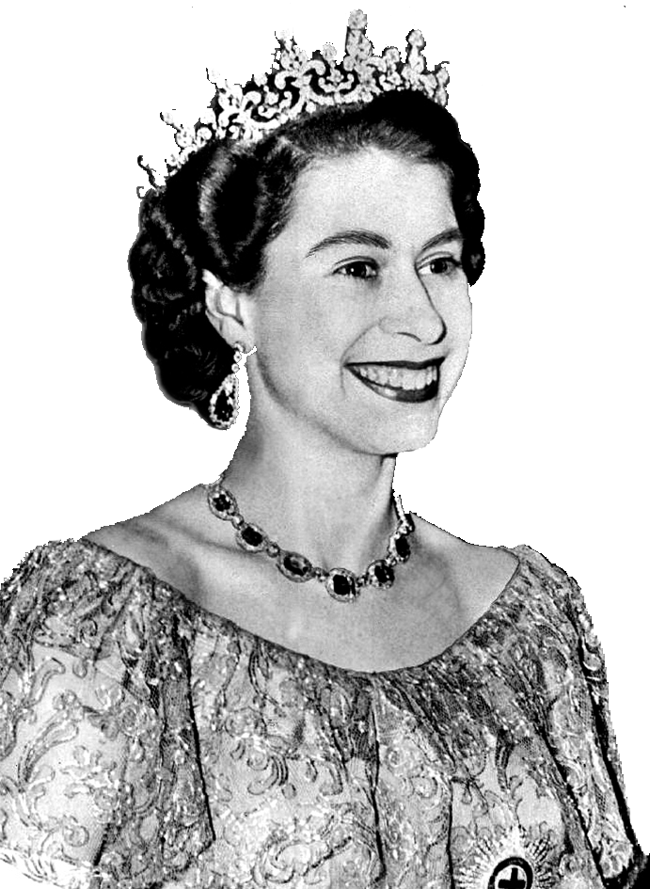
Queen

Slide 2
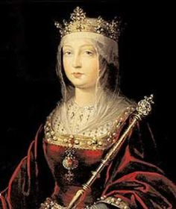
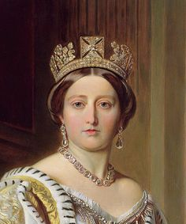
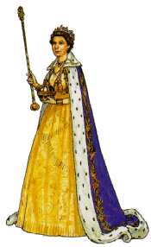

Slide 3
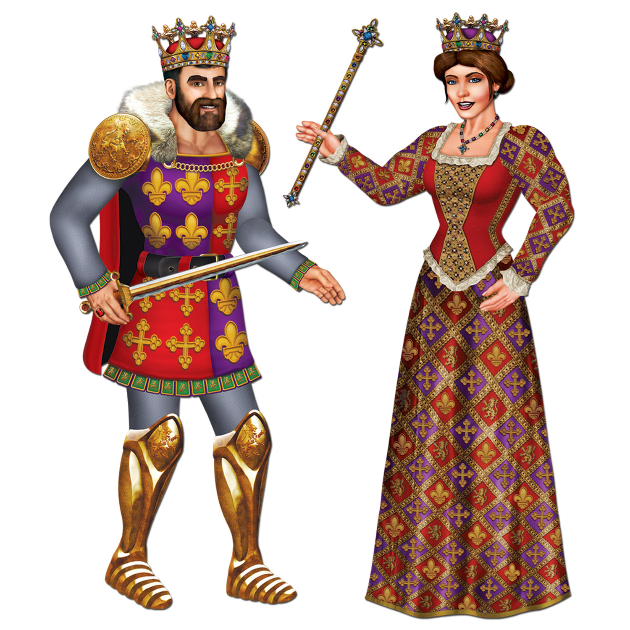

Slide 4
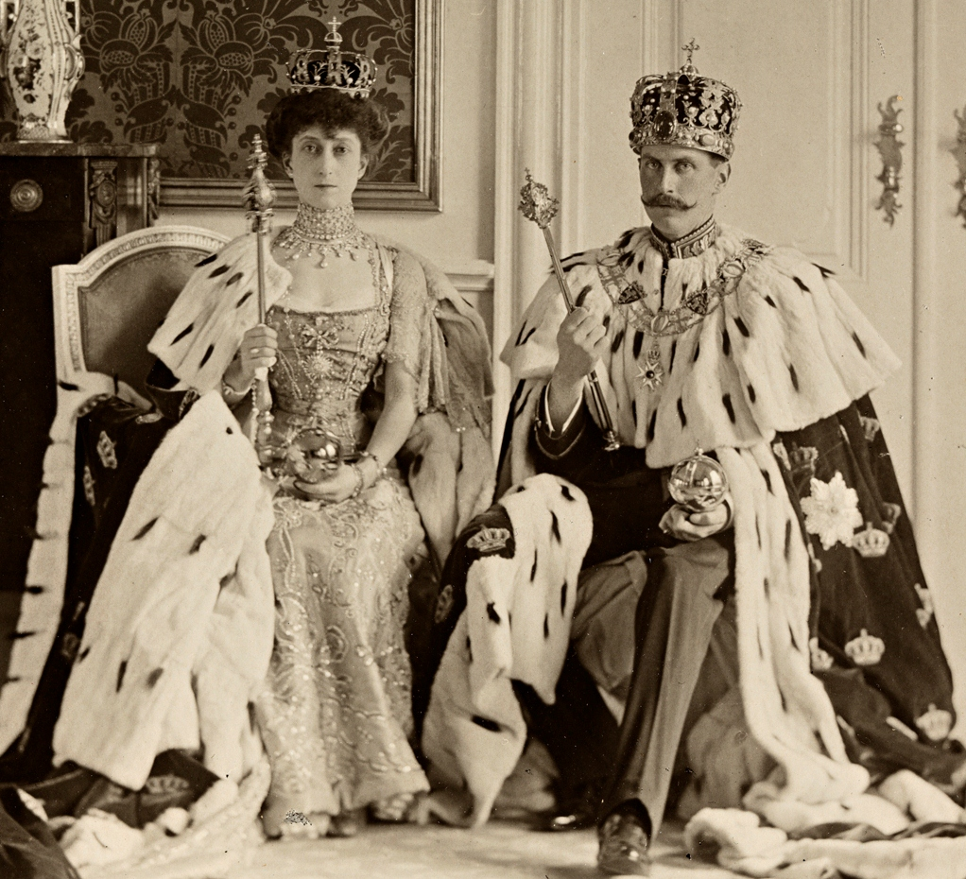

Slide 5
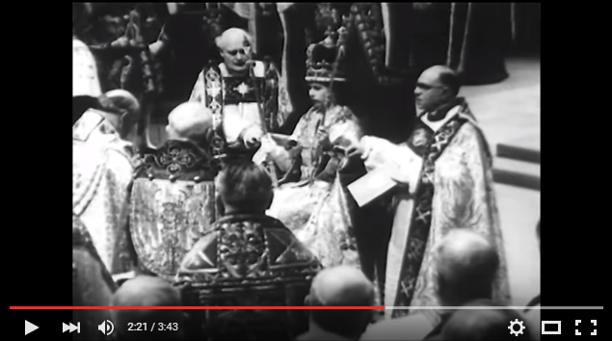
Queen Elizabeth II Coronation Ceremony
(Black and white version, no sound, short)
https://www.youtube.com/watch?v=S48JcNH1SRM

Slide 6
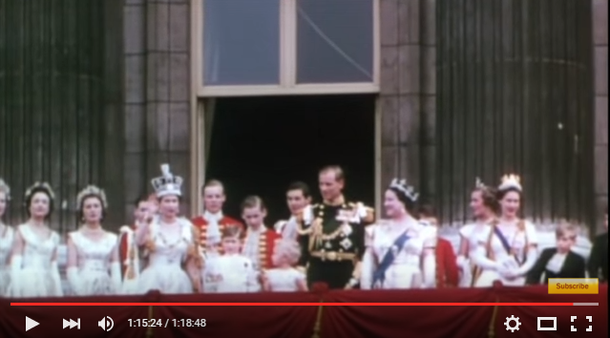
Queen Elizabeth II Coronation Ceremony
(This version is in color with music and narration. It is very long, but portions could be viewed.)
https://www.youtube.com/watch?v=Ssh8NEltCac&nohtml5=False&nohtml5=False#t=1346.648454

