Slide 1
Variant Vowels
Unit 27

Slide 2
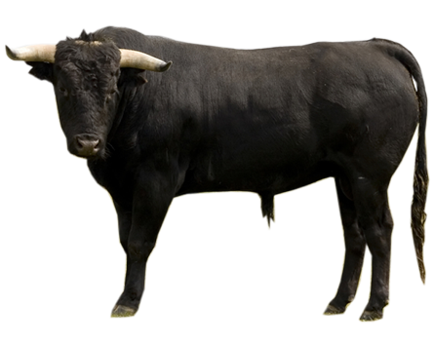
bull
book

Slide 3
bull

Slide 4
book

