Slide 1
Variant Vowels
Unit 26

Slide 2
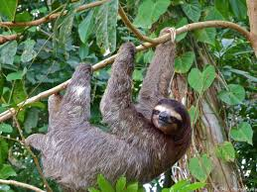
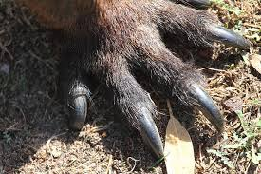
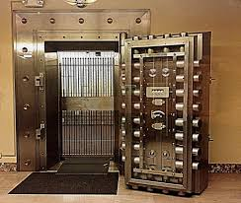
sloth
claw
vault

Slide 3
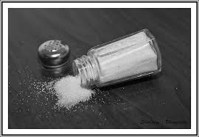
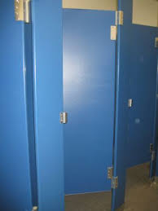
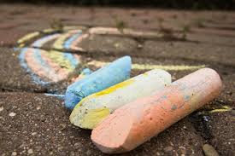
salt
stall
chalk

Slide 4
sloth

Slide 5
claw

Slide 6
vault

Slide 7
salt

Slide 8
stall

Slide 9
chalk

