Slide 1
Open Syllables
Unit 11

Slide 2
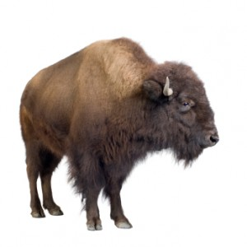
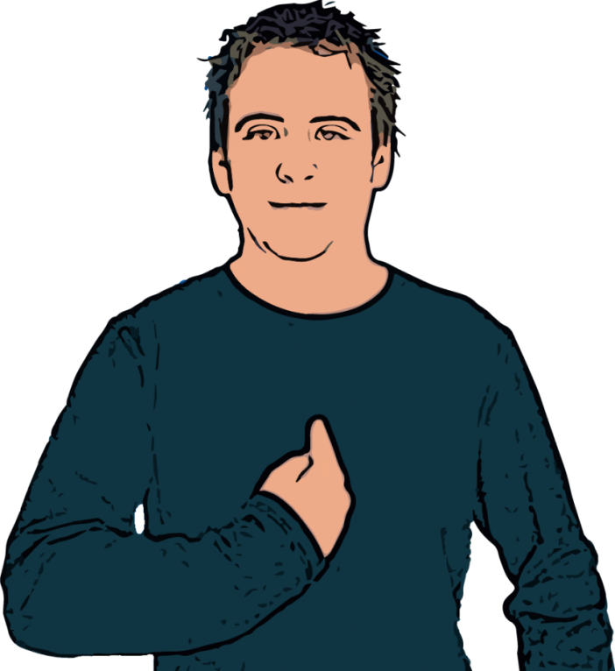
buffalo
me

Slide 3
buffalo

Slide 4
me

