Slide 1
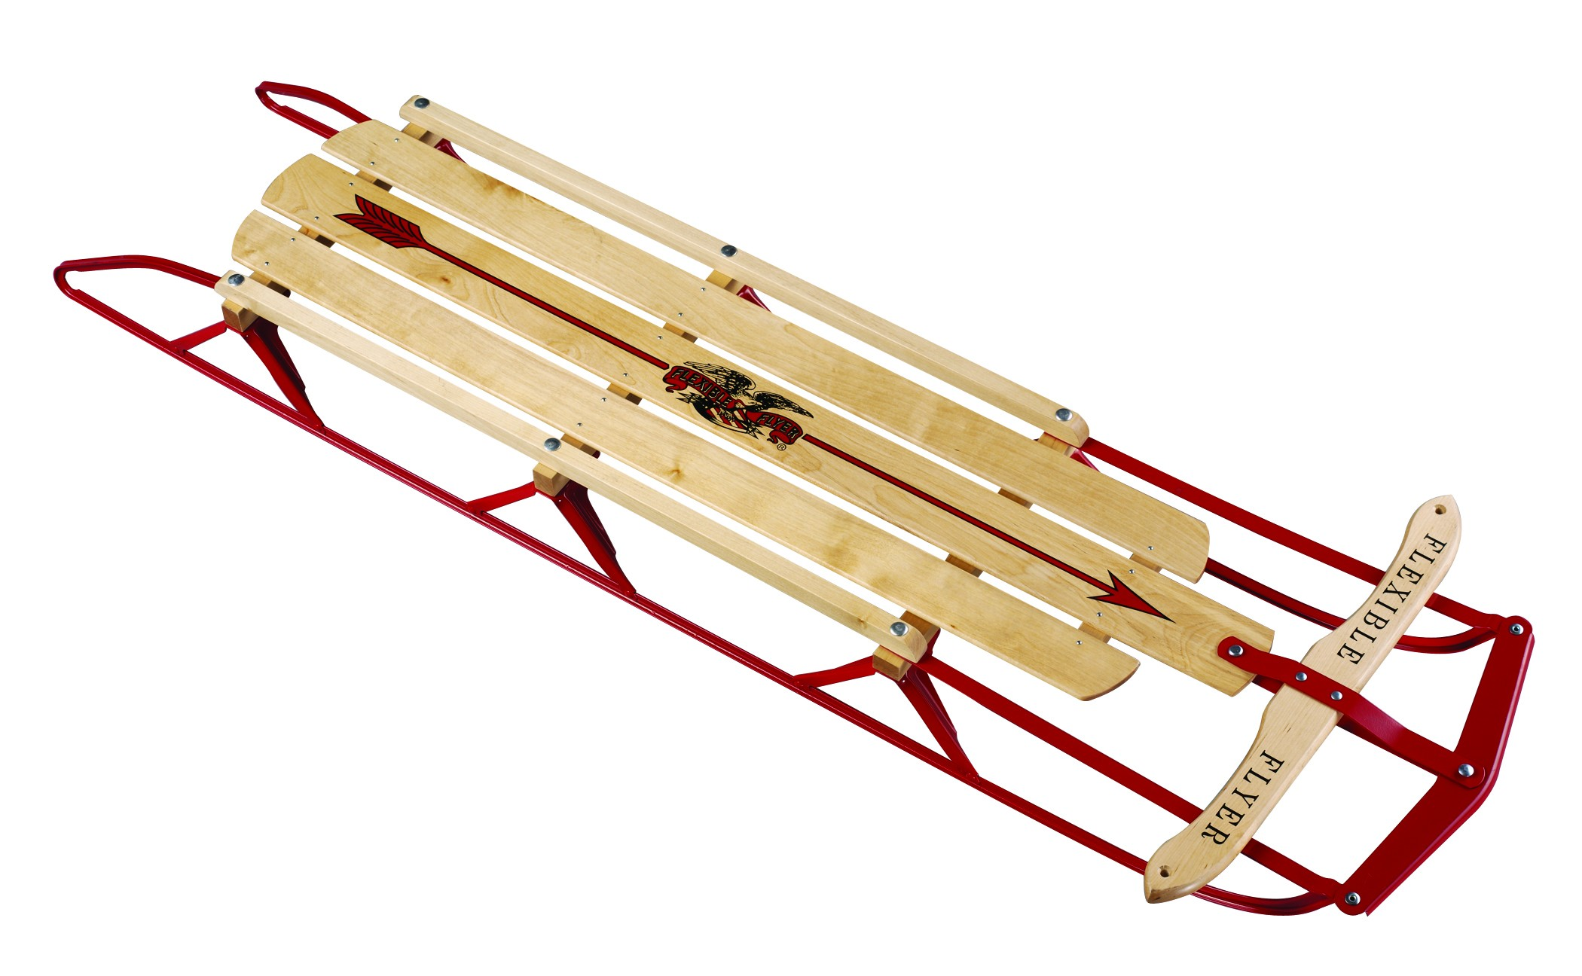
Sled

Slide 6
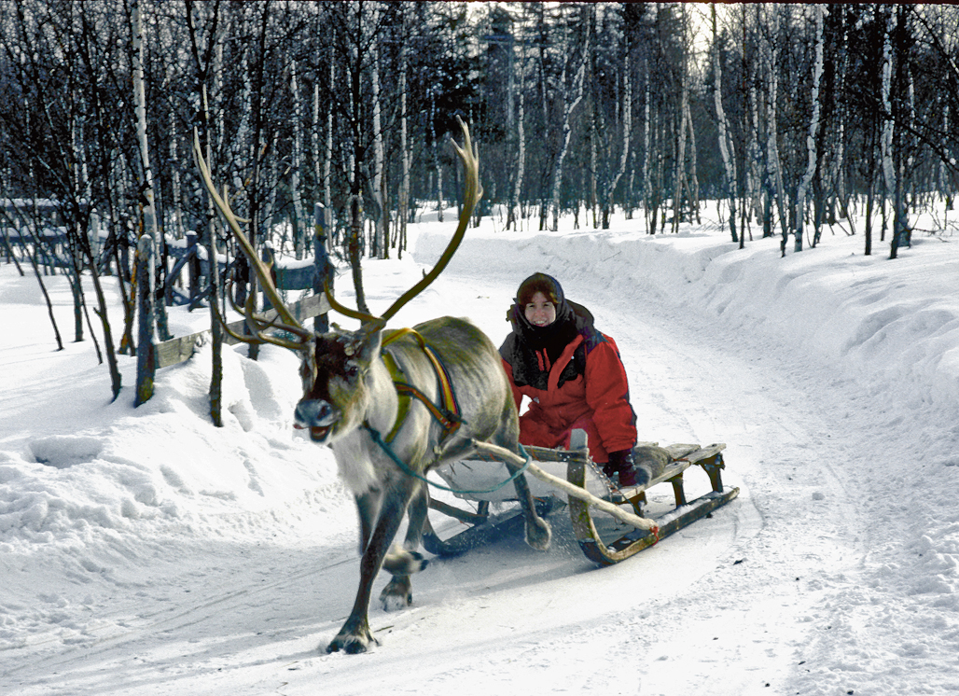

Slide 7
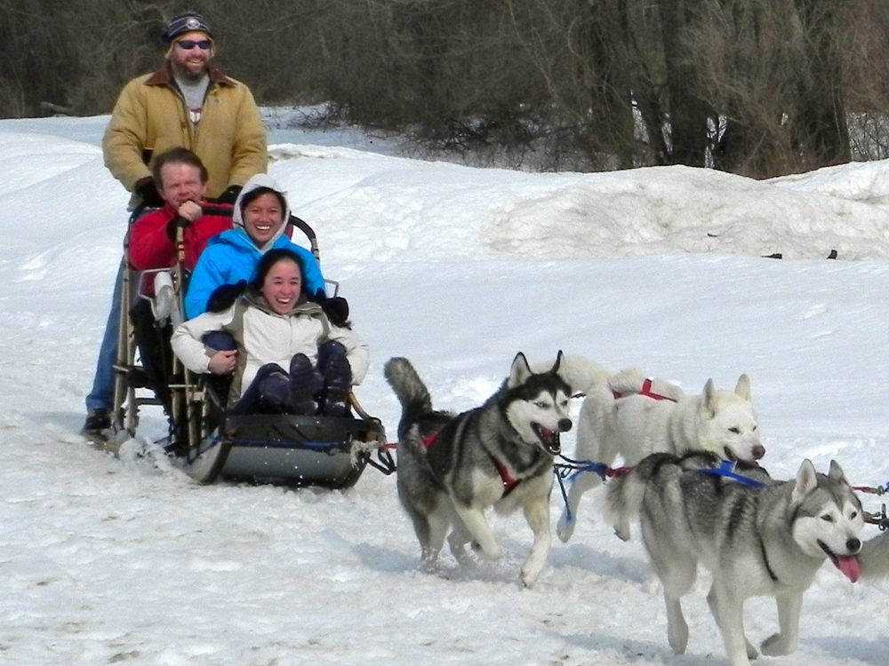

Slide 8
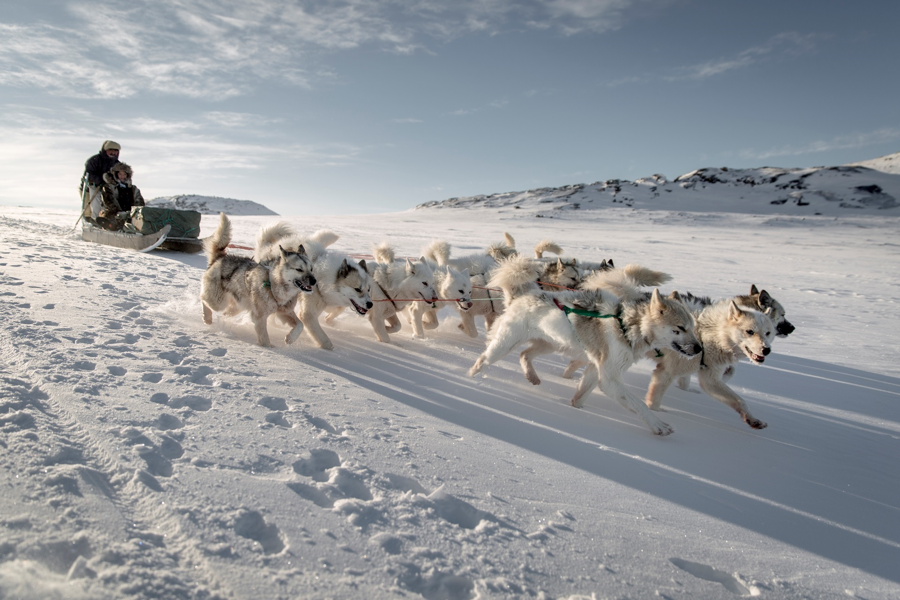

Slide 9
http://viewpure.com/mHgGmfZvzD8?start=0&end=0

