Slide 1
RI.2
(Main Idea)
Identify
Main Topic
K- with prompting
1st- no prompting
K-1
Determine Main Idea
4th- One main idea
5th – Two or more main ideas
4-5
Identify
Main Topic
Of Multi-paragraph Text
2nd
Determine
Main Idea
3rd
(Summarizing)
Summarize- Explain how main idea is supported by key details
Summary
A shortened version of an original text, stating the main ideas and important details of the text with the same structure and order of the original
4-5
Retell
Key Details
Oral Activity
Natural sharing of what someone remembers about a text
K-1
Recount -Key Details
Explain-How They Support the Main Idea
Oral or Written
Chronological Order
Past Tense Verbs
Answers the 5Ws & H
3rd
Identify
Focus of Specific Paragraphs
2nd

Slide 2
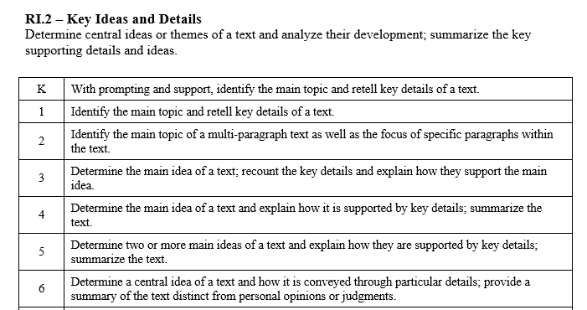

Slide 3
I can Identify the main topic. I can retell key details.
RI.K.2
1st Grade | 4 | Identify the main topic. Retell key details.
Kindergarten | 3 | With help from the teacher- Identify the main topic Retell key details
Pre- K | 2 | Use props to act out a text.
 | 1 | No attempt.

Slide 4
I can Identify the main topic. I can retell key details.
RI.1.2
2nd Grade | 4 | Identify the main topic of a multi-paragraph text. Identify the focus of specific paragraphs.
1st Grade | 3 | Identify the main topic. Retell key details.
Kindergarten | 2 | With help from the teacher- Identify the main topic. Retell key details.
Pre- K | 1 | Use props to act out a text.

Slide 5
I can identify the main topic. I can identify the focus of specific paragraphs.
RI.2.2
3rd Grade | 4 | Determine the main idea of a text. Recount key details and explain how they support the main idea.
2nd Grade | 3 | Identify the main topic of a multi-paragraph text. Identify the focus of specific paragraphs.
1st Grade | 2 | Identify the main topic. Retell key details.
Kindergarten | 1 | With help from the teacher- Identify the main topic. Retell key details.

Slide 6
I can determine the main idea. I can recount the key details.
RI.3.2
4th Grade | 4 | Determine the main idea of a text. Explain how it is supported by key details. Summarize the text.
3rd Grade | 3 | Determine the main idea of a text. Recount key details and explain how they support the main idea.
2nd Grade | 2 | Identify the main topic of a multi-paragraph text. Identify the focus of specific paragraphs.
1st Grade | 1 | Identify the main topic. Retell key details.

Slide 7
I can determine the main idea. I can summarize the text.
RI.4.2
5th Grade | 4 | Determine two or more main ideas of a text. Explain how they are supported by key details. Summarize the text.
4th Grade | 3 | Determine the main idea of a text. Explain how it is supported by key details. Summarize the text.
3rd Grade | 2 | Determine the main idea of a text. Recount key details and explain how they support the main idea.
2nd Grade | 1 | Identify the main topic of a multi-paragraph text. Identify the focus of specific paragraphs.

Slide 8
I can determine the main idea. I can summarize the text.
RI.5.2
6th Grade | 4 | Determine the central idea , explaining how it conveyed through key details. Summarize the text without using personal opinions or judgments.
5th Grade | 3 | Determine two or more main ideas of a text. Explain how they are supported by key details. Summarize the text.
4th Grade | 2 | Determine the main idea of a text. Explain how it is supported by key details. Summarize the text.
3rd Grade | 1 | Determine the main idea of a text. Recount key details and explain how they support the main idea.

